Slide 1
Who is the authority?
God or man
Notes:
My passion here because it seems that man has succumbed to an old earth theology that today is flourishing
Who is the authority when it comes to cosmology-is it God or man?
When did this happen and where did it begin.
This is one of the questions I hope to answer in this presentation
There was a time when the entire theistic universe said it was God.
Big change came about in that period ofhistory called the enlightenment-more about shortly
I’ve called this period “The descent into unbelief-----next slide

Slide 2

Descent into unbelief
Young Earth vs Old earth geology
Notes:
Did God create the heavens and the earth in six literal days? He said He did.
Or, did it take vast eons of time as we are told today---print media, TV, our school, specifically our colleges.
I’ve called what follows in this presentation “a descent into unbelief.” The church, our bulwark, etc…..Next

Slide 3

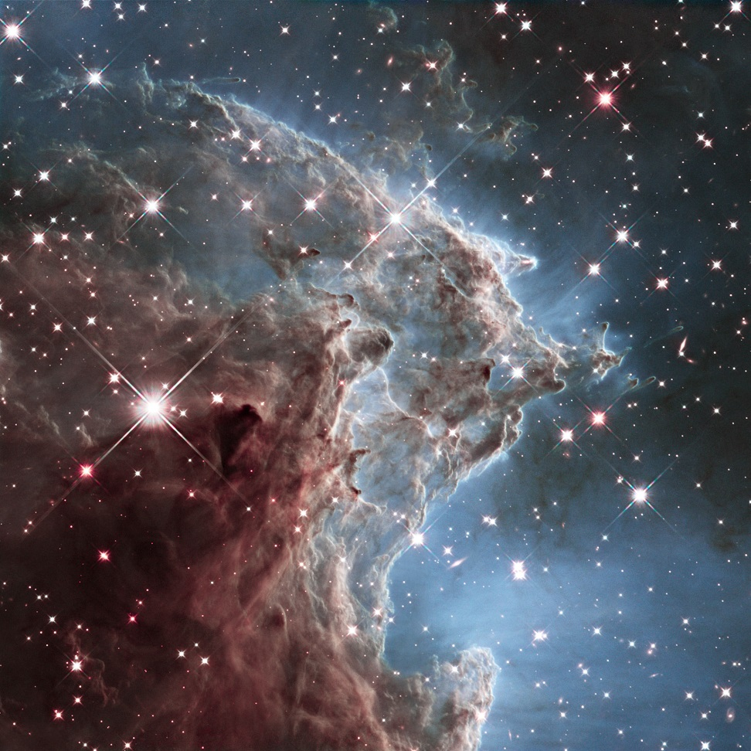
God’s Glory
Notes:
I”ve added these celestial photos as a beautiful example of God’s handiwork. Fourth day of creation week.
Now, as a bit of background, I’d like to offer a brief view of two ancient examples of those who attempted to plumb the depths of God’s creation; Aristotle and Ptolemy…………next slide

Slide 4

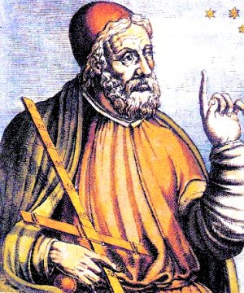
Aristotle (bc384-bc322) Ptolemy (90-168)
Notes:
Aristotle, great 4th century BC Greek philosopher. Today we would call him a philosopher and a scientist. His books-physics, biology, cosmology, zoology, metaphysics, logic ethics, poetry, in Alexandria Egypt.
Ptolemy was the author of several scientific treatises, three of which were of continuing importance to later Islamic and European science. The first was an astronomical treatise now known as the Almagest, the second was Geography and the third Astrology. We look at these two individuals only because they set the stage for how the church accepted cosmology and how they viewed the heavens.
Aristotle said……………….
Ptolemy said ………………..
Then Copernicus straightened it all out- His work was not given much attention as his findings seemed to be mainly a treatise on mathematics.
Next slide

Slide 5

Rene Descartes
Born 11 MA R1596
Died 11 FEB 1650
French
17th century Philosopher & Mathematician
Called the father of modern philosophy
Interests
Metaphysics
Epistemology
Mathematics
Notes:
Inroduce Descartes.Great thinker-genius of his day.
Father of modern philosophy. His seemingly infallible reasoning opened the door to what became known as the Enlightenment.
He formulated a concept for infinitesimals-calculus.
Was emotionally guided by the spirit and had formulated a new form of philosophy.
He had totally formulated analytical geometry and a way of applying philosophy to mathematics.
Ontological arguments for the existence of God-metaphysical study of the nature of being.
Ethics was the highest form of science.
Cartesian dualism-Two kinds of fundamental substance-mental and material.
His Meditations on First Philosophy continues to be a standard text at most university philosophy departments. Descartes' influence in mathematics is equally apparent; the Cartesian coordinate system — allowing reference to a point in space as a set of numbers, and allowing algebraic equations to be expressed as geometric shapes in a two-dimensional coordinate system (and conversely, shapes to be described as equations) — was named after him
His most significant achievement was that he opened the door to the enlightenment, the age of reason
There were two essentially different disciplines, science and philosophy. Once everything worked the scientist was satisfied but with the philosopher that wasn’t enough-it had to be probed further and further. This opened the door to reason and utimately to the enlightenment.
Let’s now look at some of those prominent in the “Enlightenment.” But first let’s define what the movement really was.

Slide 6
The Enlightenment
(The Age of Reason)
Cultural movement of intellectuals
Purpose-reform society by the use of reason
To challenge ideas grounded in tradition
Advance knowledge through the scientific method
Promoted scientific thought, skepticism & intellectual interchange
Created a revaluation in human thought
Sparked by philosophers like Baruch Spinoza, John Locke, David Hume, Voltaire and others
Led to the likes of Jean Paul Sartre & existentialism
Notes:
We’ll look first at two men who played important parts at the beginning of this age of reason; Galileo
Galilie and Francis Bacon.
Next slide

Slide 7
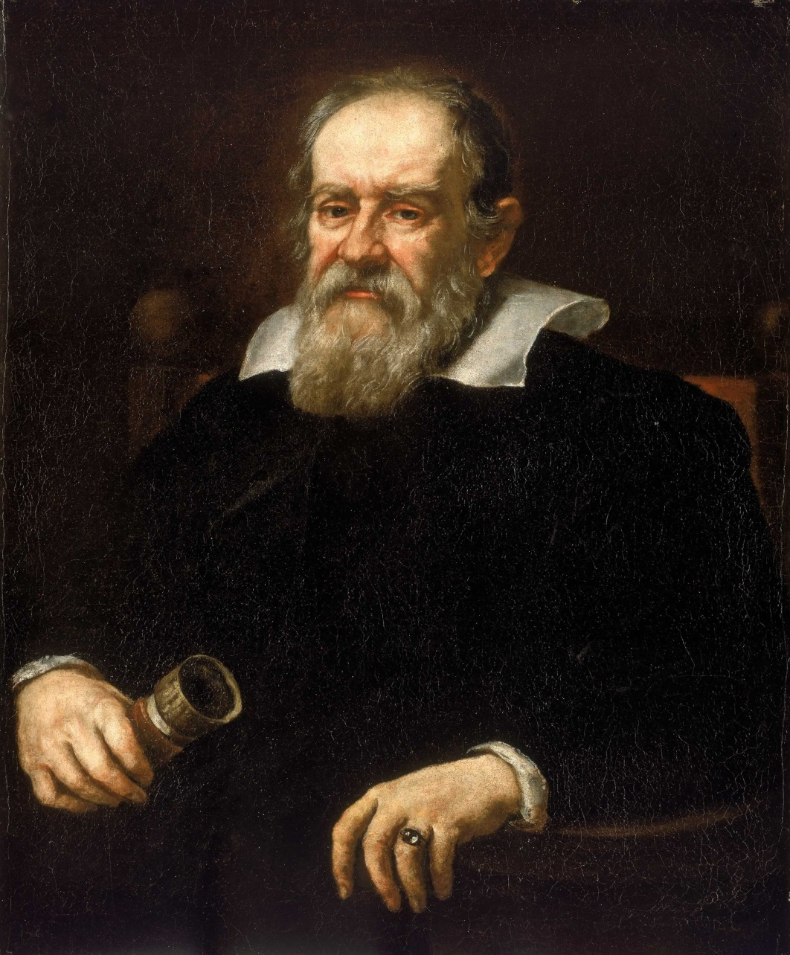
Galileo Galilei
Born 15 Feb 1564
Died 8 Jan 1642
Physicist
Mathematician
Engineer
Astronomer
Philosopher
Heliocentrist
Alma Mater-University of Pisa
Notes:
Give a brief rundown on this man.
A made a great statement of great importance, not for just those of his day but for us today
Next slide

Slide 8
The intention of the Holy Spirit is to teach us how to go to Heaven, not how the heavens go….
Notes:
Our next slide will introduce us to Francis Bacon

Slide 9
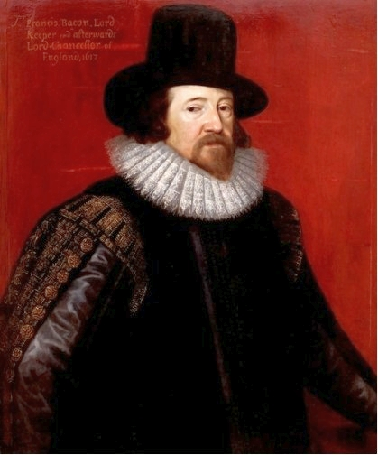
Francis Bacon
Born 22 Jan 1561
Died 09 Apr 1626
Alma mater
  Cambridge University
  Philosopher
  Scientist
  Jurist
  Orator
  Essayist
  Author
Notes:
Bacon was a contemporary of Galileo.
He is called the creator of empiricism which is a theory which states that knowledge comes only or primarily from sensory experience.
One of several views of epistemology, the study of human knowledge, along with rationalism and skepticism, empiricism emphasizes the role of experience and evidence, especially sensory experience, in the formation of ideas, over the notion of innate ideas or traditions;[
Empiricists may argue however that traditions (or customs) arise due to relations of previous sense experiences.
Bacon went on to say….next slide
He said-next slide

Slide 10
“ But some of the moderns however, have indulged in this folly , theology vs philosophical naturalism (science), with such consummate carelessness, as to have endeavored to found a natural philosophy on the first chapter of Genesis, the book of Job, and other passages of Holy Scripture, seeking the dead among the living,
Notes:
Natural philosophy—science today. The next page is a follows up of this page. Next

Slide 11
and this folly is more to be prevented and restrained, because from the unsound admixture of things divine and human, there arises not merely a fantastic philosophy, but also a heretical religion.”
Notes:
It’s interesting that early “old earthers” would quote both Galileo and Bacon to bolster their theories.
Prior to this the Bible was the authority, now the authority for cosmology was slowly but surely shifting toward man.
We’ll now look at the real movers and shakers of what would become known as “old earth geology.”

Slide 12
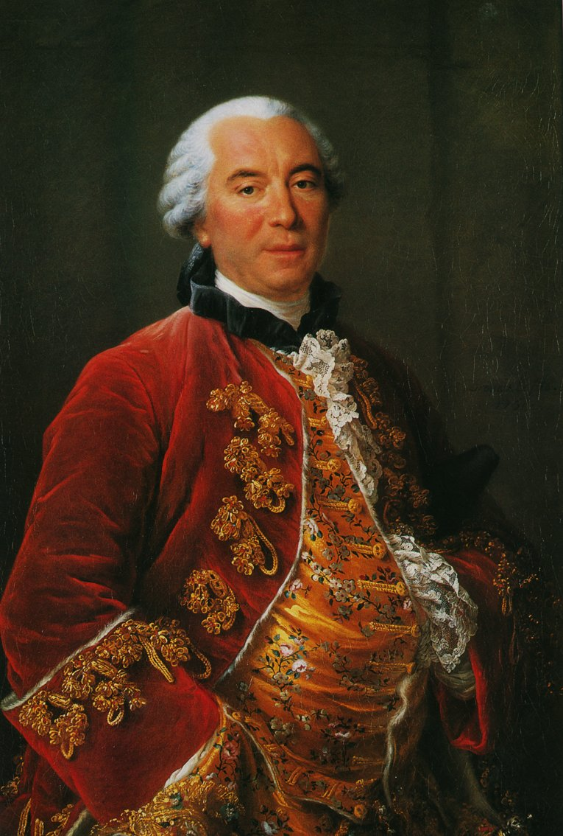
Georges-Louis Leclerc
Comte de Buffon
Born 7 Sep 1707
Died 16 Apr 1788
French naturalist
Mathematician
Cosmologist
Notes:
The first of these individual we will look at is the Compte de Buffon.
His “Book-Epochs of Nature.” HIS history of the earth based upon his study of heated metal balls in the lab.
He actually believed the age of the earth to be millions of years but was hesitant to rile up the religionists of his day so he published it as only 78 K old.
His works influenced the next two generations of naturalists, including Jean-Baptiste Lamarck and Georges Cuvier.
Buffon published thirty-six quarto volumes of his Histoire naturelle during his lifetime; with additional volumes based on his notes and further research being published in the two decades following his death.
It has been said that "Truly, Buffon was the father of all thought in natural history in the second half of the 18th century".
Next

Slide 13
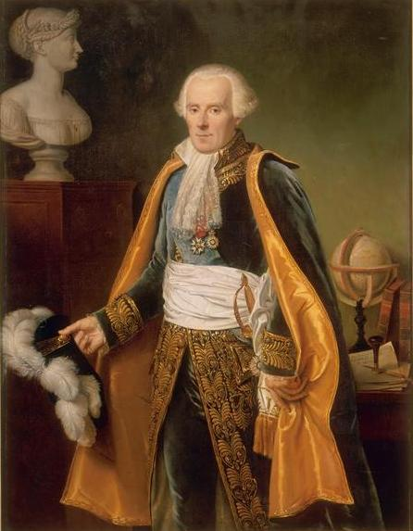
Pierre Simon Laplace
Born 23 Mar 1749
Died 5 Mar 1827
Institutions:
University of Caen
Ecole Militaire
Occupation:
Mathematician
Astronomer
Statistician
Notes:
Laplace was a great mathematician.
He pioneered the Laplace transform which appears in several branches of mathematics. The transform is a widely used integral transform in mathematics with many applications in physics and engineering.
Note that all of these men described are highly educated and because so many of them were virtually contemporaneous it seemed to the proletariat of that day that their hypothesis of origins were the correct ones. So the shift away from God was beginning to take hold and has come to full bloom in our day and age.
Laplace published an exposition of what he called the nebular hypothesis. Stated that universe originated from a huge gas cloud which after millions of years coalesced into solid bodies, one which became the solar system.
Nevertheless Laplace was a brilliant mathematician. Next

Slide 14
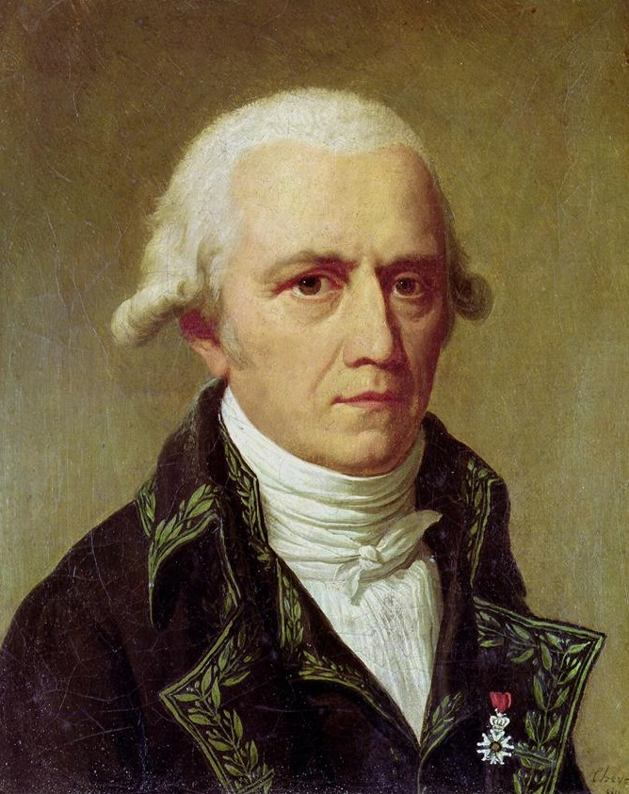
Jean Baptiste Lamarck
Born 1 Aug 1744
Died 18 Dec1829
Institutions:
French Academy of science
Museum Nationale d’Histore
Known for:
Evolution-Inheritance of acquired characteristics
Notes:
Jean-Baptiste Pierre Antoine de Monet, Chevalier de Lamarck, often known simply as Lamarck, was a French naturalist.
He was a soldier, biologist, academic. He was an early proponent of the idea that evolution occurred and proceeded in accordance with natural laws.
He gave the term biology a broader meaning by coining the term for special sciences, chemistry, meteorology, geology, and botany-zoology.^{[1]}
Lamarck's contribution to evolutionary theory consisted of the first truly cohesive theory of evolution, in which an alchemical complexifying force drove organisms up a ladder of complexity, and a second environmental force adapted them to local environments through use and disuse of characteristics, differentiating them from other organisms.
His theory of evolution-The giraffe Next

Slide 15
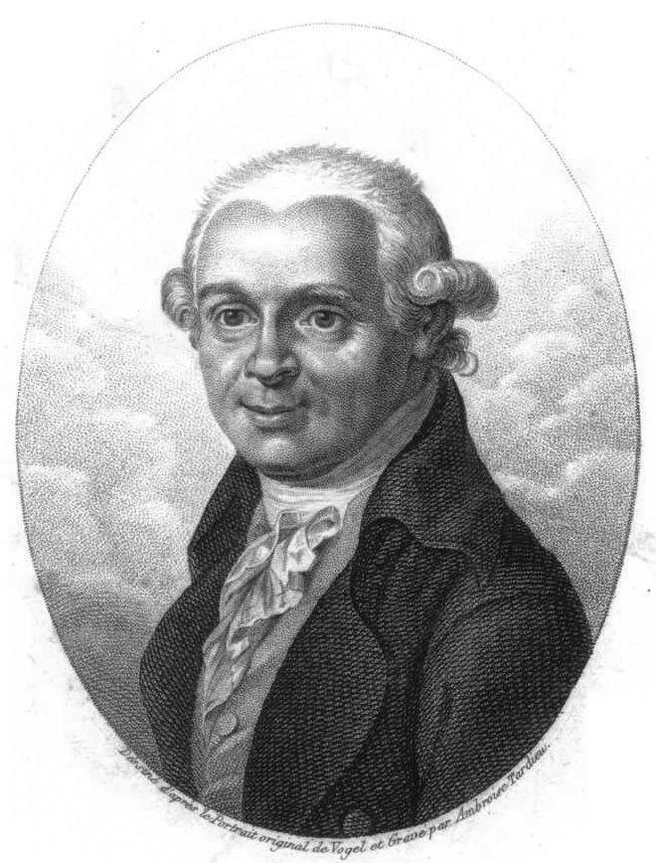
Abraham Gottlob Werner
Born 25 Sep 1749
Died 30 Jun 1817
Field:
Geology
Nationality:
German
Known for:
Stratification
Notes:
Next we have Werner, the first German to appear on the scene in this new science.
Werner, was a German geologist who set out an early theory about the stratification of the Earth's crust and propounded an earth history that others labeled Neptunism. While most tenets of Neptunism were eventually set aside, science is indebted to Werner for clearly demonstrating the chronological succession of rocks, for the zeal which he infused into his pupils, and for the impulse which he thereby gave to the study of geology.
Much of his work was based on pre-existing traditions of stratigraphy and cosmogony in Europe. He has been called the “father of German geology.”
Stratigraphy is primarily used in the study of sedimentary and layered volcanic rocks. Stratigraphy includes two related subfields: lithologic stratigraphy or lithostratigraphy, and biologic stratigraphy. Next

Slide 16
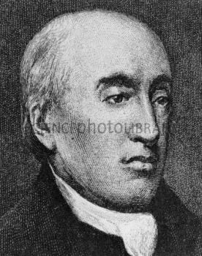
James Hutton
Born 3 Jun 1726
Died 26 Mar 1797
Field:
Physician
Naturalist
Agriculturist
Geology
Notes:
Strong influence on Charles Lyell.
His theory-Earths history is such as he saw it showed no evidence for a beginning or an end.
Thus atheism was now gaining not only in popularity but in numbers.
He believed that processes such as sedimentation and erosion as seen in the present would reflect the same thing in times past.
His theories on geology and geologic time were called “deep time”and later plutonism and finally uniformitarianism.
He expounded on this and wrote a book describing his theories called “The Man Who Found Time”—Next slide

Slide 17
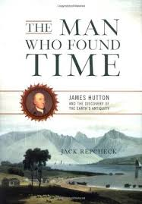
James Hutton
His influential book
Notes:
Next slide

Slide 18
Uniformitarianism
What is it?
Notes:
Next slide

Slide 19
Uniformitarianism
Uniformitarianism is the assumption that the same natural laws and processes that operate in the universe now, have always operated in the universe in the past and apply everywhere in the universe. It has included the gradualistic concept that “the present is the key to the past” and is functioning at the same rate. This has been a key principle of geology and virtually all fields of science. Uniformitarianism was founded by James Hutton, refined by John Playfair and popularized by Charles Lyell. The term was recoined by William Whewell who also coined the term catastrophism for the idea that the earth was shaped by a series of sudden short-lived, violent events.
Notes:
Next slide

Slide 20
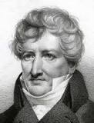
Georges Cuvier
Born 23 Aug 1769
Died 13 May 1832
Fields:
Natural history
Anatomy
Paleontology
Notes:
We now come to Georges Cuvier who argued for multiple catastrophes on a global scale which wiped out most life on the planet, and was responsible for a repetitive cycle of catastrophes.
It is now seeing a revival within some of the evolunitionary community today,
Said last castrosophe-5K yrs. Ago. Christian community applauded-Noah. next

Slide 21
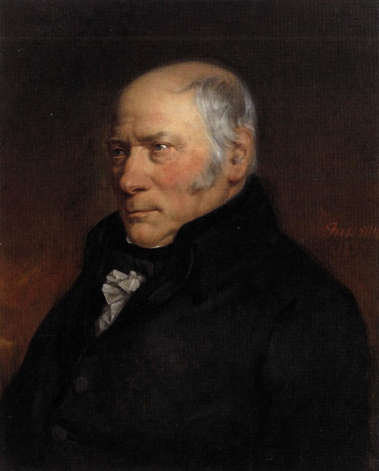
William Smith
Born 23 Mar 1769
Died 28 Aug 1839
Field:
Civil engineering
Geology
Notes:
Another catastrophist. Father of English stratigraphy. Civil engineer-his projects saw a lot of English strata and fossils. He was the first to hypothesize the method of using fossils to give relative dates to the strata he saw. next

Slide 22
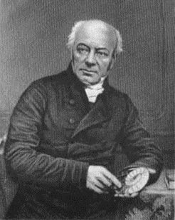
William Buckland
Born 12 Mar 1784
Died 14 Aug 1859
English theologian
Geologist
Paleontologist
Notes:
Wrote first full account of a fossil dinosaur which he called Megalosaurus.
His work proving that Kirkdale Cave had been a hyena den earned him the Copley medal for advancement in science.
He was a pioneer in the study of fossilized dinosaur feces. He called this propolites. He planed to reconstruct ancient eco-systems.
Contemporary with William Buckland was a Scotch Theologian by the name of Thoms Chalmers.
In 1814 in an effort to reconcile the teachings of Scripture with the new teachings of “science” he proposed a theistic concept which he called the “gap theory.” Buckland picked it up and popularized the term. Briefly: Gap Gen 1:1 & 1:2. millions of years between. Undermines Scripture-millions of years-millions of fossils, death, bloodshed, suffering, disease-fall of Satan from Heaven.
G. H. Pember helped popularize-book-”Earth’s earliest ages”-Scofield Bible
Buckland, early in his career thought he had found evidence of Noah’s flood but later recanted. Millions of years—
Why rationalize? explain

Slide 23
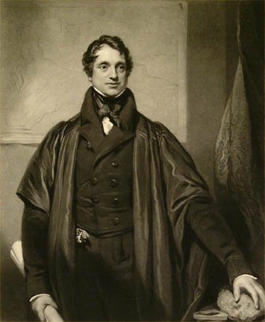
Adam Sedgwick
Born 22 Mar 1785
Died 27 Jan 1873
Geologist
University of Cambridge
Anglican clergyman
Notes:
Third child of an Anglican Vicar. We now see the start of “old earthism” being subscribed to by the church.
Adam studied math, geology & theology. Fellow-Trinity College. Investigated metamorphism & concretion. Well versed in the geology of UK & Europe. Supported the theories of William Buckland.
Charles Darwin was one of his geology students at Cambridge. Charles Darwin went on to receive world acclimation for his theory of evolution.
Darwin accompanied Sedgwick on a geological tour of Wales in 1831. next

Slide 24
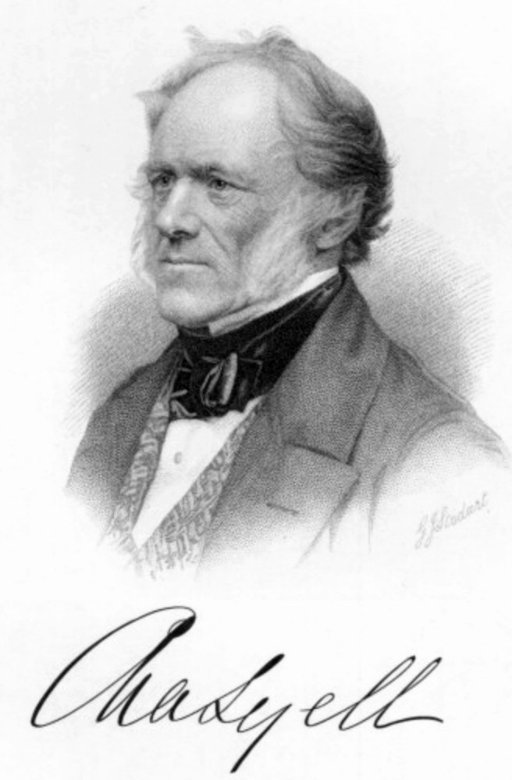
Charles Lyell
Born 14 Sep 1797
Died 22 Feb 1875
Fields:
Law
Geology
Influenced:
Charles Darwin, Alfred Wallace, Thomas Huxley, and Impey Murchison
Notable awards:
Royal medal 1834
Copely medal 1858
Notes:
Now we come to a man who had a profound effect on Darwin. He was first a lawyer before becoming interested in geology. Lyell became the foremost geologist of his day. Lyell wrote Principles of Geology which popularized Hutton’s theory of uniformitarianism.
He used his lawyers training to argue persuasively for an earth that was millions of years old.
Strong influence & close friend of Charles Darwin. Let’s now move to the most eminent of the “old earthers.”
Eager to rationalize-”day age theory”-each day of creation-not 24 hours but millions and millions of years.
Ultimately led to theories-big bang-abiogenesis
Scopes trial-trial of the 20th century-Clarence Darrow-Wm. Jennings Bryan, godly man?? Believed in evolution before Adam-Couldn’t defend himself by Scripture. 1PET 3:15. “Always be prepared to defend yourself in the hope that you have.

Slide 25
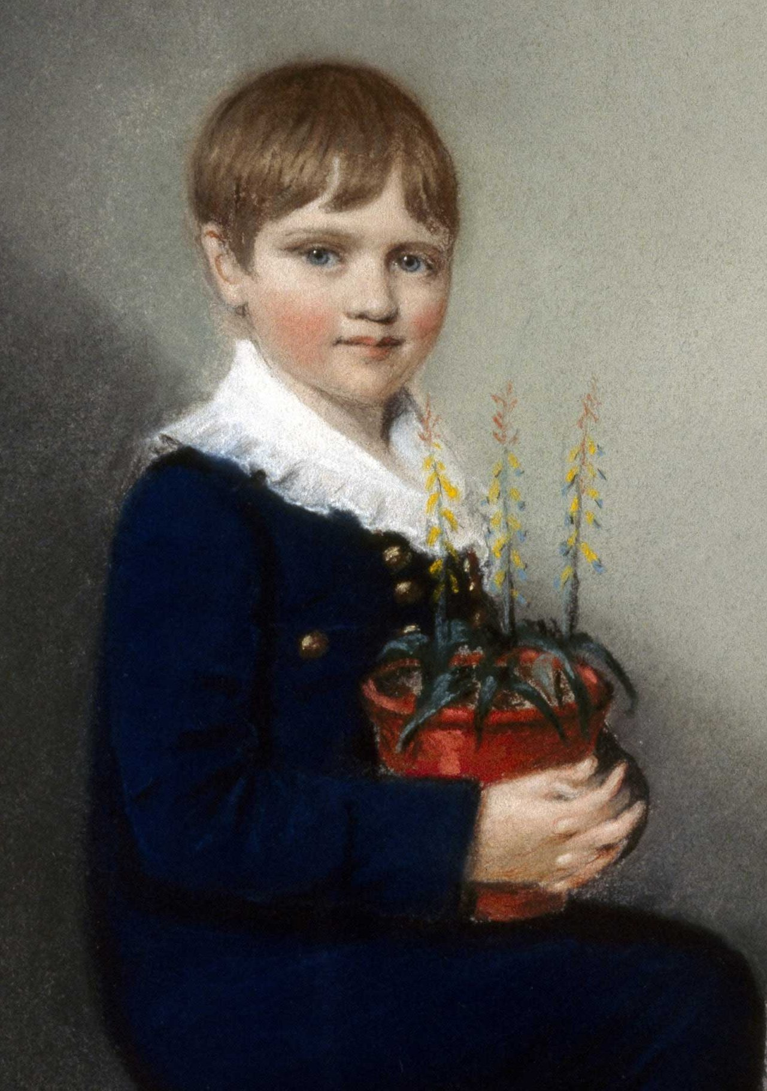
Notes:
This is him as a young lad. Next

Slide 26
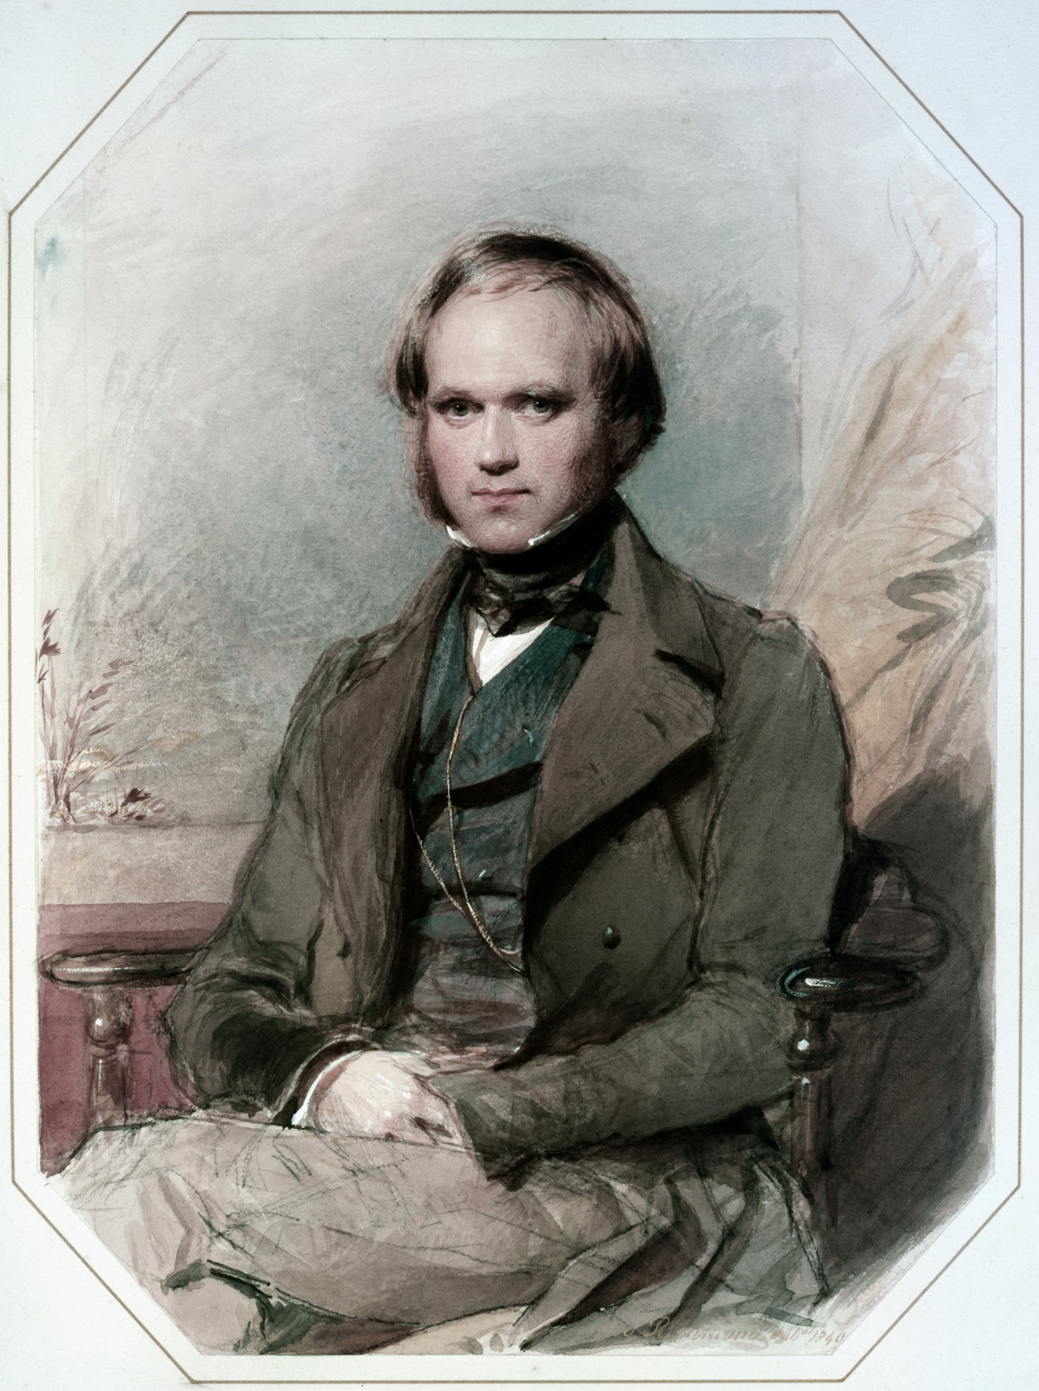
Notes:
This is him as a young man. Next

Slide 27
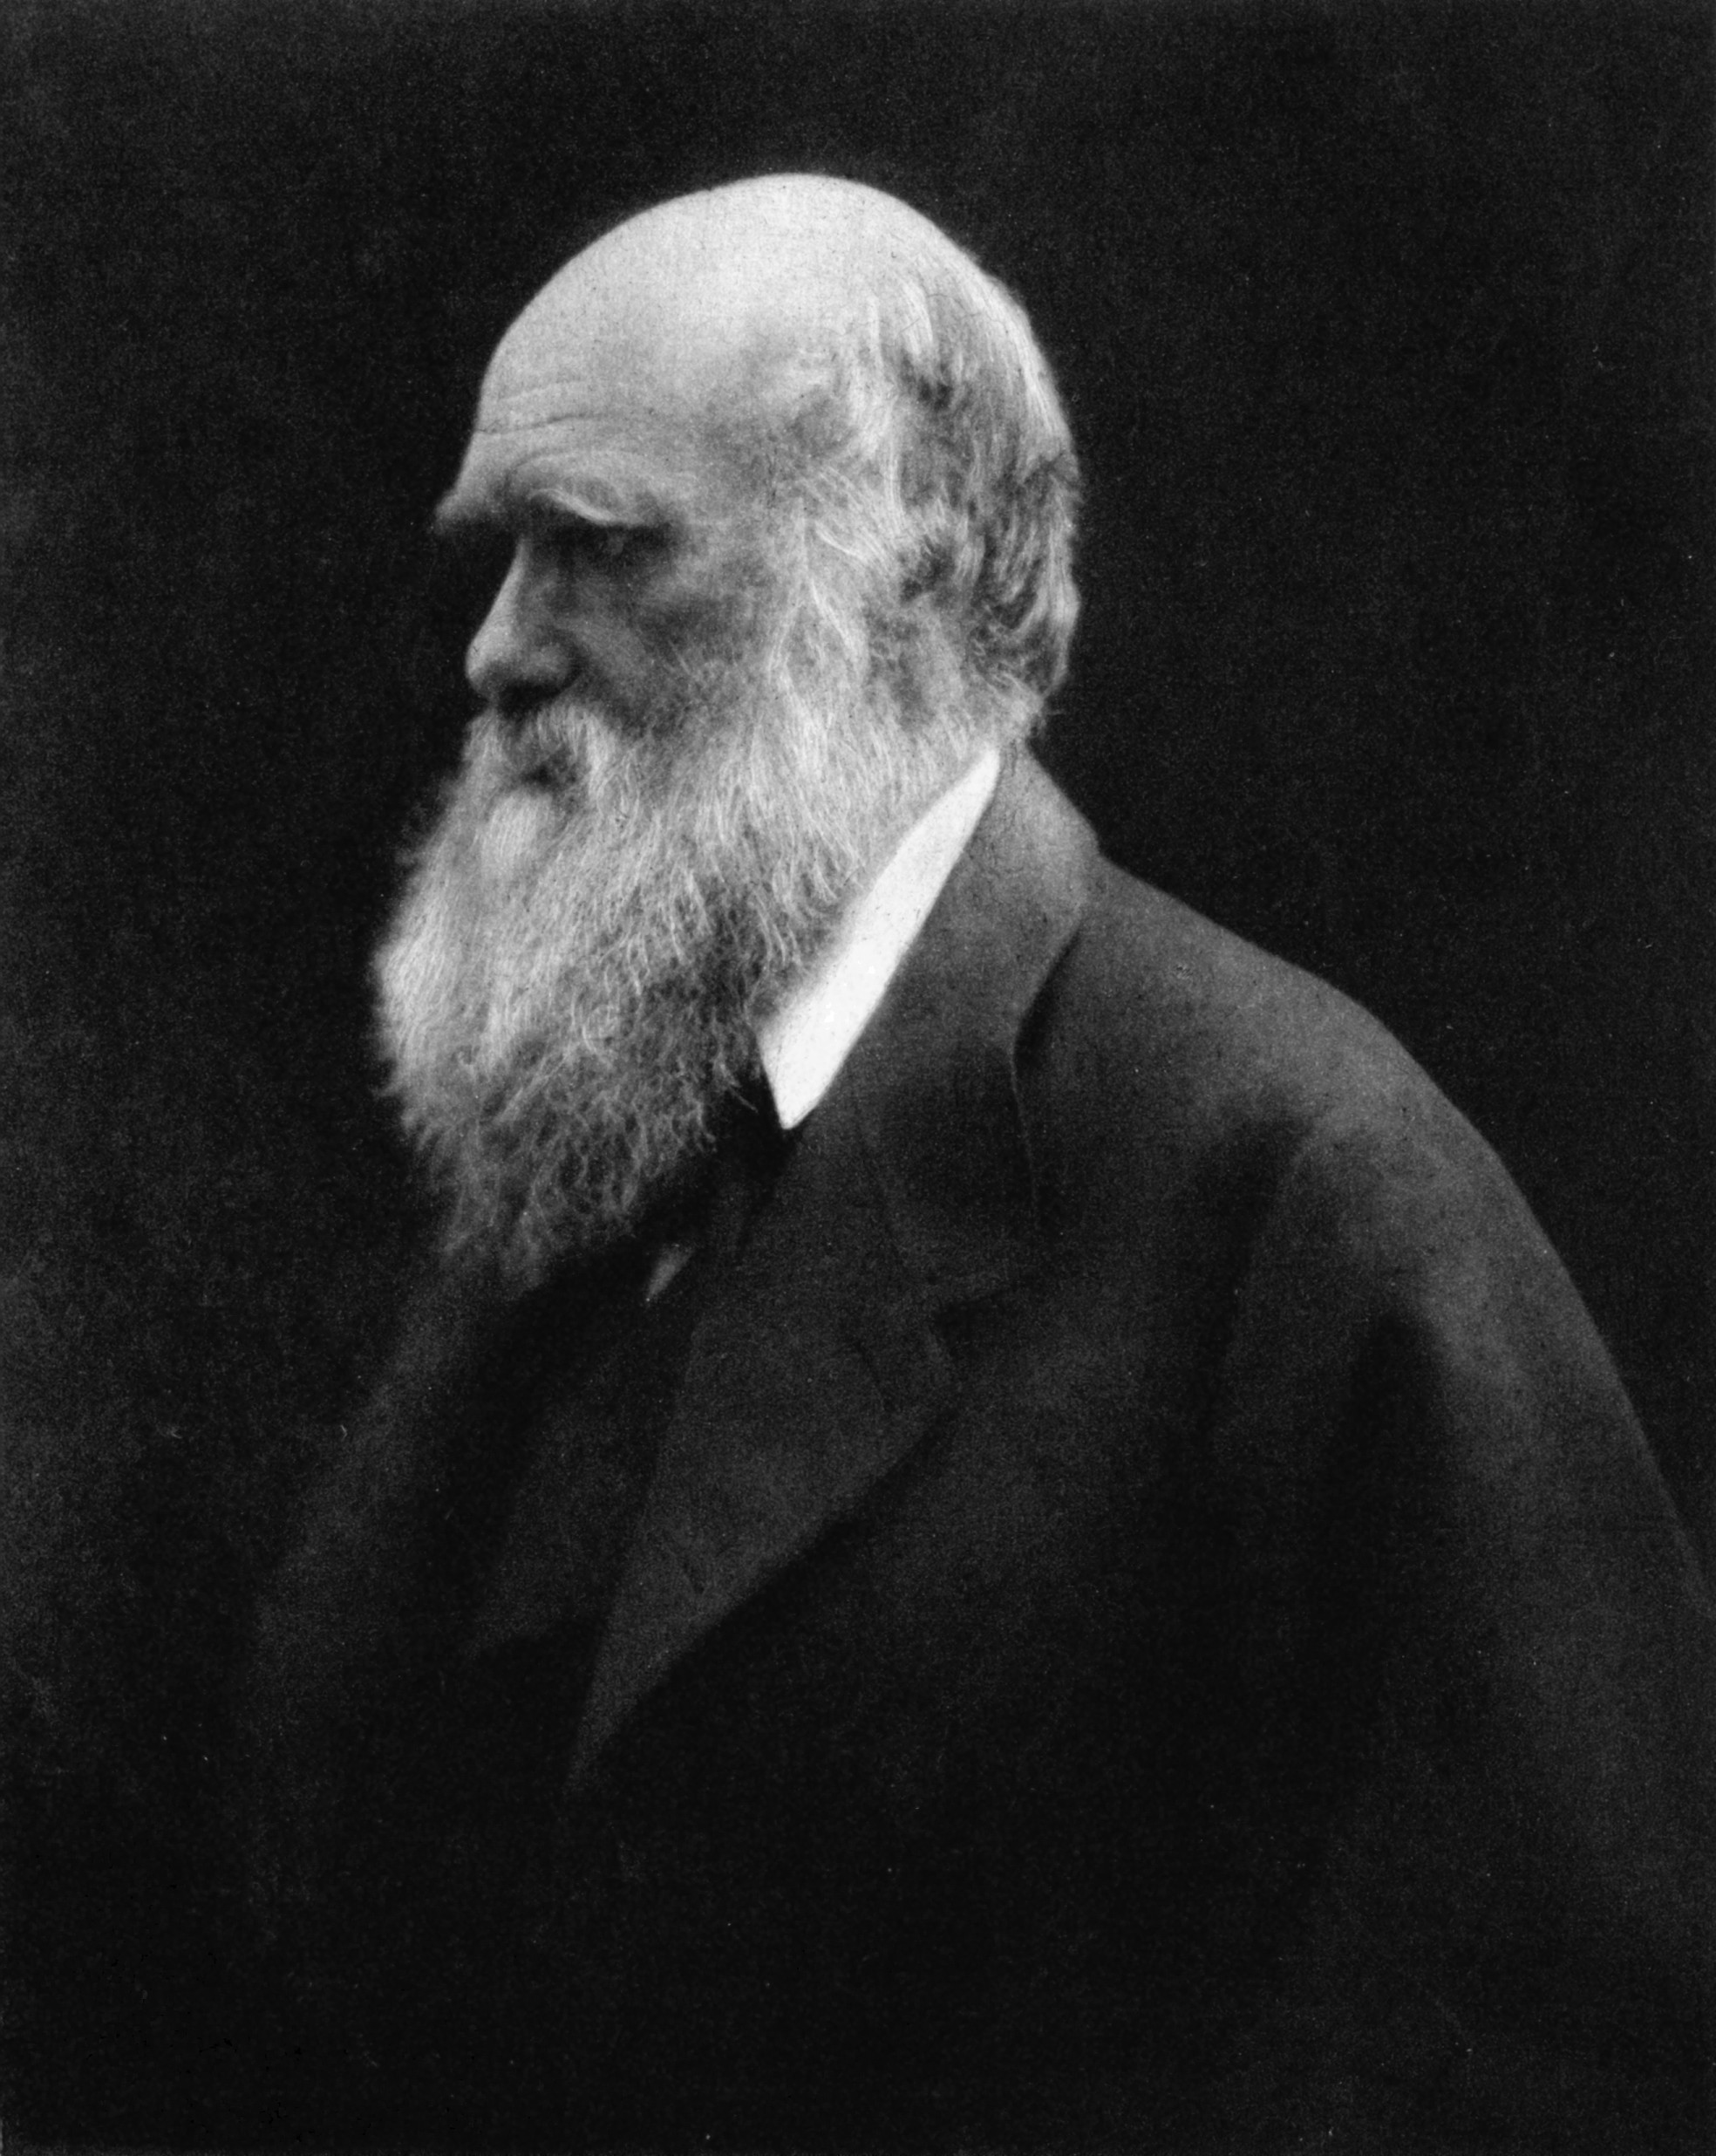
Charles Darwin
Born 12 Feb 1809
Died 19 Apr 1882
Fields:
Naturalist
Geologist
Internationally famous for his Theory
Of Evolution.
His preeminence as a scientist honored by burial in Westminster Abbey
Notes:
And this is how we generally know him—Charles Darwin.
Early interest in nature led him to abandon his seminary training.
Lyell had been mentoring Darwin, a young but disillusioned seminary student.
He talked Darwin into joining a scientific journey that would go around around the world. He took Lyell’s book with him.
His 5 year voyage circumnavigated the globe where he studied and took specimens at every stop.[Rancour] Next is a picture of the Beagle, the ship he sailed on.

Slide 28
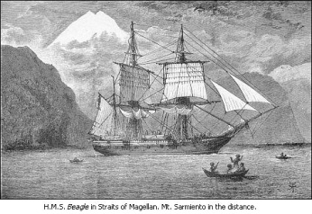
The celebrated HMS Beagle
Notes:
Darwin set sail from England and here is his journey at age 29 on the Beagle. next

Slide 29
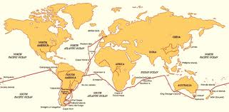
The voyage of the Beagle
Notes:
Show the path of the Beagle. He noted the geographical distribution of fossils and wildlife and in 1888 he conceived his theory of natural selection.
He became internationally famous for his pre-eminence as a scientist. He has been hailed as one of the most influential figures in human history.
Stated that there was no unbridgeable gap between humans and animals. [The three Fuegians].
Influenced by Malthus who had written a treatise on the principles of population growth.
Darwin wrote several books, one which was The Distribution of Coral Reefs which described his theory of atoll formation. Here is an interesting page from his writings on evolution. next

Slide 30
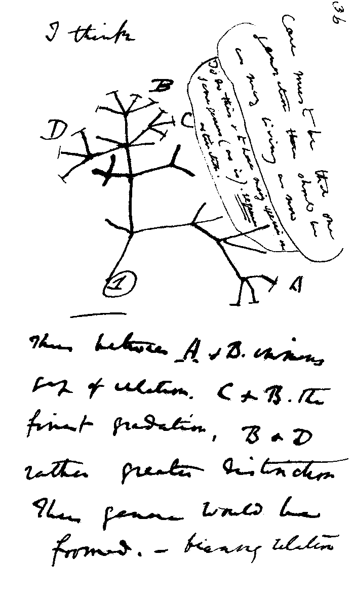
Early Sketch of evolutionary tree
Note “I think” (at top of sketch)
Notes:
Note the words, I think. Next

Slide 31
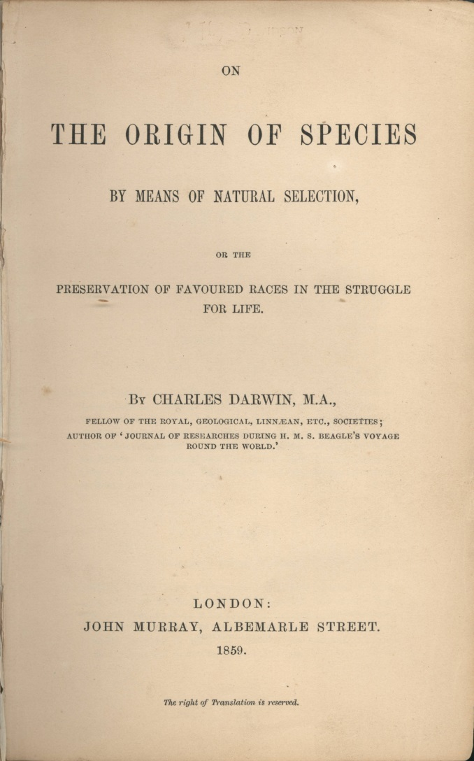
The first copy of his book. “The Origin of Species”
Notes:
An early copy of his famous publication The Origin of Species. Darwin was not without critics and here are a few cartoons the lampooned Darwin early on. Show next three slides.

Slide 32
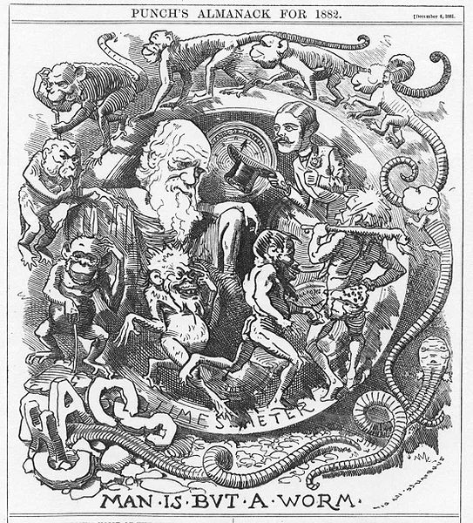
From Punch’s Almanac 1882

Slide 33
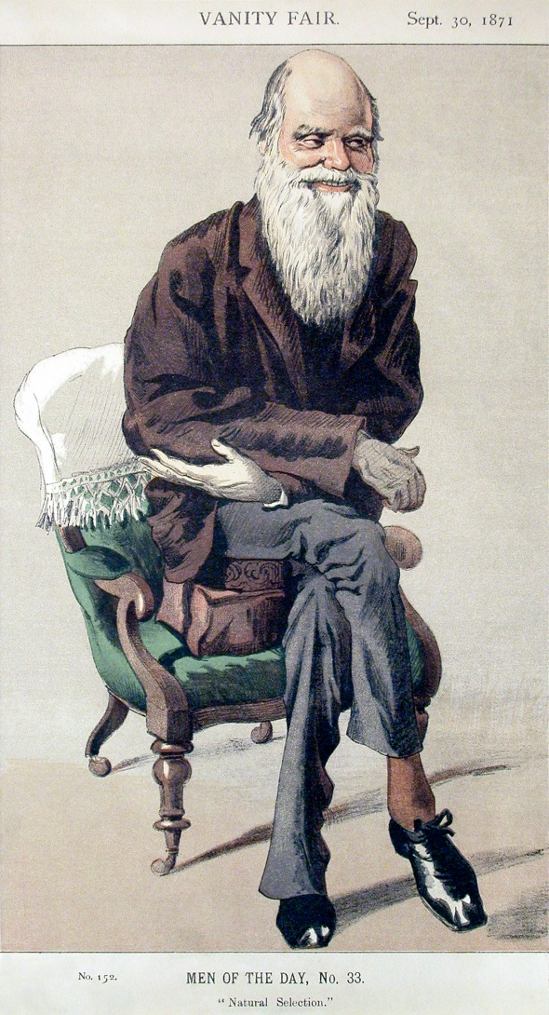
An early caricature of Darwin
Notes:
Now lets look at a summary of Old Earth theories. next

Slide 34
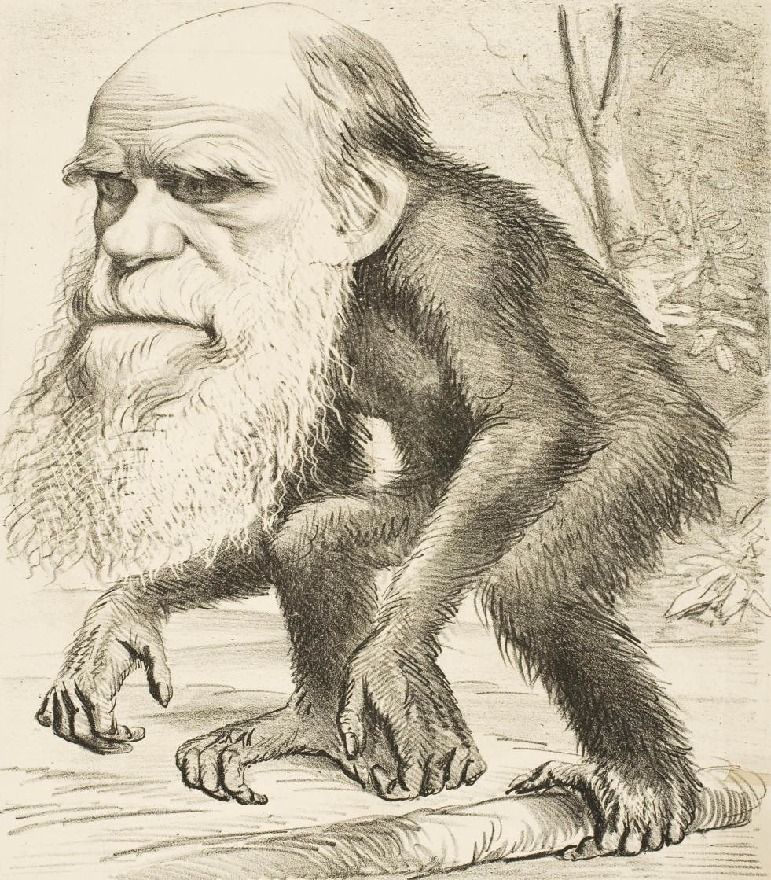
Another Early Darwin Caricature an
Notes:
As far as his legacy was concerned he had convinced virtually all of the scientific world that his theories were the correct ones and that legacy lives on to this day. Let me show you a clip from one of the writings of his son Francis.
Francis Darwin, son of Charles Darwin, in his book The Life and Letters of Charles Darwin quoted his Father as noting with great astonishment the appeal and widespread vogue of the theory he (his father) described in his book, On the Origin of Species.

Slide 35
Surprisingly, Charles Darwin said, “I was a young man with unformed ideas. I threw out theories and suggestions, wondering at all times over everything, and to my astonishment the ideas took like wildfire; men made a religion of them.” He later stated, “If it could be demonstrated that any complex organ existed which could not possibly have been formed by numerous slight modifications my theory would absolutely break down.” Men liked Darwin’s theory, whether it could be proved or not
Notes:
Now let’s summarize. next

Slide 36
Summary
Leclerc: Gradual cooling of earth. 78K yrs. old
Laplace: Nebular hypothesis
Werner: Receding oceon-1 million yr. old earth
Hutton: Uniformitarianism-No beginning and no end
Cavier: Catastrophism-Eons of time
Smith: Molten beginning-Long ages
Lyell: Uniformitarianism-Long ages
Darwin: Evolution
Notes:
There were a few more notable “old earthers” who, taking the theories of the “masters” superimposed their own ideas about earth history.
Christian critics meanwhile were not silent, but this led to “compromises” by a great number of prominent Christian leaders who succumbed to the likes of these well educated and gifted individuals who were hypothesizing that earth history was very, vey old.
Looking at a few of these compromises between “Christians” and old earth scientists we see:
Responses to this tragic turn of events and what Christians were doing about it. next

Slide 37
Compromises
Within the church
1810’s Gap theory was born
1820’s Day age theory arose
1830’s Flood of Noah was a local flood
1830’s Liberalism now enters the fray in a big way
Notes:
next

Slide 38
Liberalism
1 Genesis 1-11 is a myth
2 Nature, i.e. matter is all that exists
3 Everything can be explained by TIME, plus Chance plus the laws of nature working on matter
Due to enlightenment dogma human reasoning was now been raised to the highest level of authority
Notes:
Men were now, unabashedly, turning away from God.
Authority to man was now the authority.
There were some learned men in the church referred to as scriptural geologists that were strong critics of the “old earthers” but by now the odds were strongly stacked against them. Next

Slide 39
Scriptural Geologists
There was a response to these attacks on the church and a number of biblically astute individuals arose to counter these attacks. The raised a number of biblical, geological and philosophical arguments against this false doctrine raised by old earthers and the rising liberal movement. Charles Lyell in particular railed against these scriptural geologists. Speaking of them he once said:
Notes:
Read and next

Slide 40
“They (the scriptural geologists) are wholly destitute of geological knowledge and un-acquainted with the elements of any one branch of natural history which bears on science. They are incapable of appreciating the force of objections or of discerning the weight of inductions from numerous facts. Instead they endeavor to point out the accordance of the Mosaic history with phenomena which they have never studied and every page of their writings proves their consummate incompetence.”
.
Notes:
Strong language against those who dared to defend GOD as their supreme authority. Because of this tide of scriptural unbelief two new world views emerged. The first was deism. next

Slide 41
Deism-Deists believed in a transcendent God but He was distant. He created man and then like a watchmaker who wound up his watch and then left it, never more to be attended. The deist believed in the transcendence of God but not in the imminence of God. He didn’t believe in miracles, answered prayer, fulfilled prophecy, or that Jesus was not the Son of God.
Notes:
Then there was atheism. next

Slide 42
Atheism
This was the second world view to emerge in popularity as a result of the enlightenment.
Notes:
Atheists denied the fall of man, the flood, death before the fall. They totally misunderstood the nature of God because there was no God. My experience with atheists.
France-French revolution-days, months, didn’t work. Needles to say there were many biblical scholars who opposed this rising tide of unbelief but it seemed that the odds were stacked against them. A great German scholar, Henning Reventlow stated at this time. next

Slide 43
“We cannot overestimate the influence exercised by deistic thought, and by the principles of the humanist worldview which the deists made the criterion of their biblical criticism, on the historical-critical exegesis of the 19th century; the consequences extend right down to the present.”
Notes:
At the same time a group of Bible believing scriptural geologists arose to join the fray in defense of Scripture.
There was George Young, George Fleming, John Murray, William Rhind and others. At this time there were three very pertinent objections to the old earth worldview, that seemed to hve bee neglected. These were-----------next slide

Slide 44
1 Scriptural analysis of the Bible
2 Death before the fall
3 The nature of God
Notes:
As to the first, the old earthers were so engrossed in their “findings” they neglected for a the most part to make an objective of what God said in His Word.
Scopes trial. Most significant of 20th century. William Jennings Bryan-Clarence Darrow.
-1PE 3:15---Always be prepared to give an answer to everyone who asks you to give the reason for the hope that you have…..But do this with gentleness and respect.
Finally I would like to give you two other quotes by godly men to give you a taste of how these men wrote and how they reasoned. You can feel the passion in their writings. The first is a quote from a man by the name of George Bugg, an Anglican minister. He wrote 2 books and this quote is from his book, “Spiritual Geology.” Consider his sound reasoning power. Next-2 slides, 45 & 46
As for the second point James Mellor Brown, a Godly man stated. next slide

Slide 45
“And it is a point worthy of our most serious reflection, when men, who are known to be public teachers of morals and religion, place a subject of such incalculable importance as death in a light which essentially varies from that in which it is placed by God.”
Notes:
First of two. Second and last slide follow….Next

Slide 46
“Hence then we have arrived at the wonton and wicked idea of the Hindoos, viz. that God has created and destroyed worlds as if in sport, again, and again and again!! But will any Christian devine who regards his Bible, or will any philosopher who believes that the Almighty works no superfluxes miracles, and does nothing in vain, advocate the absurdity that a wise, just and benevolent deity, has, numerous times, wrought miracles, and gone out of His usual way for the sole purpose of destroying whole generations of animals that He might create others very like them, but yet differing a little from their predecessors!”
Notes:
Next we have Granville Penn, the grandson of William Penn, founder of the colony of Pennsylvania.
He was not a geologist but he was well read and an acute thinker. He wrote the following, this is a long quote, but it is oh so pertinent to the great debate.
This is the first of four slides.
Now, the first slide of the second quote. Four slides total.

Slide 47
“ To assume arbitrarily, a priori, that God created the matter of this globe in the most imperfect state to which the gross imagination of man can contrive to reduce it, which it effectively does, by reducing the creative fiat to the mere production of an amorphous elementary mass; and then to pretend, that His intelligence and wisdom are to be collected from certain hypothetical occult laws, by which that mass worked itself into perfection of figure and arrangement after innumerable ages; would tend to lessen our sense either of the divine wisdom or power, did not the supposition recoil with tremendous reaction upon the supposers, and convict them of the clumsiest irrationality.
Notes:
First of four slides—47, 48, 49, 50

Slide 48
The supposition is totally arbitrary; not only arbitrary, viciously arbitrary; because it is totally unnecessary, and therefore betrays a vice of choice. For, the laws of matter could not have worked perfection in the mass which the Creator is thus supposed to have formed imperfect, unless a power imparted by Himself who established the laws. And if He could thus produce perfection mediately (that is through secondary causes) through their operation, He could produce it immediately, ( i.e. super-naturally)without their operation.
Notes:
This is the second of four slides

Slide 49
Why, then, want only and viscously, without a pretense of authority, choose the supposition of their mediation? It is entirely a decision of choice and preference, that is, of the will; for the reason is no party in it neither urging, suggesting, encouraging, or in any way aiding or abetting the decision, but on the contrary, positively denying and condemning it. The vast length of time, which this sinistrous choice is necessarily is obliged to call in for its own defense, could only be requisite to the Creator for overcoming difficulties, obstructions the perfecting process;
Notes:
Is the third of four slides

Slide 50
It therefore chooses to suppose that He created obstructions in matter to resist and retard the perfecting of the work which He designed; whilst at the same time He might have perfected it without any resistance at all, by His own creative act…. To suppose then, a priori, and without the slightest motive prompted by reason, that His wisdom willed, at the same time , both the formation of a perfect work, and a series of resistances to obstruct and delay that perfect work, argues a gross defect of intelligence somewhere; either in the Creator or in the supposer, and leave it to this science, to determine the alternative.”
Granville Penn, Comparative estimate of the of the mineral and Mosaic geologies,
(Clundon J. Duncan 1825) up to large numbers of Chistians
Notes:
This is the last of four slides
Attempts were made by Bible believing evangelicals to stem the tide of disbelief in biblical authority but to no avail.
In the USA we had the First and second awakening (so called) Cane ridge. While not directed specifically to old earthism it was an attempt to restore the church back to biblical standards. There was no such revival in England or on the continent.
Science was now supreme-media of all sorts-teachings by those considered authorities in matters science. This attitude persists to this very day.
Like a charging knight on a white horse there rode into this arena of disbelief a man named Henry Morris.-Things now took a radical turn.

Slide 51
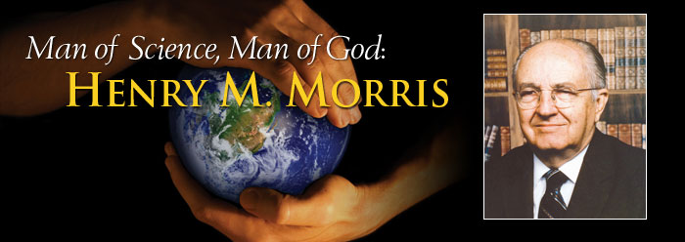
Born October 6, 1918
Died February 28, 2006
Notes:
Henry M. Morris is widely recognized as the founder of the modern creation science movement. He began, In 1946, by publishing a short book, That You Might Believe, exposing the scientific weaknesses in evolution. This was the opening salvo of what was to become a resurgence of God as authority.
He lectured and wrote extensively in defense of a literal interpretation of the Bible's first book, Genesis, particularly the first 11 chapters that describe the creation of the world and all living things, the great Flood of Noah's age, and the human dispersion at Babel.
In 1961, Dr. Morris and an Old Testament expert, Dr. John C. Whitcombe published The Genesis Flood, the book that was widely acknowledged even by prominent evolutionary paleontologist Stephen J. Gould as "the founding document of the creationist movement.“
While serving as president of ICR, Dr. Morris collaborated with scientists and theologians around the world. He wrote more than 60 books on topics that include creation science, evolution, and Christian apologetics, and he lectured worldwide at conferences, churches, and universities. He participated in over 100 debates--many alongside biochemist and ICR vice president Dr. Gish, and debated evolutionary scientists such as biologist Kenneth R. Miller, zoologist Hubert Frings, and paleontologist David B. Kitts.
In 1963, Dr. Morris and nine other young-earth creationists, including Dr. Duane T. Gish, founded the Creation Research Society (CRS), [explain]. He resigned from his teaching post at Virginia Tech in 1969 and in 1970 founded the Institute for Creation Research as the research division of Christian Heritage College (now San Diego Christian College).
ICR's goal was research, communication, and education in those fields of science that are particularly relevant to the study of origins. In 1981, after receiving approval from the state of California to grant masters degrees in science education, ICR became an autonomous entity.
In his final book, Some Call It Science (2006), Dr. Morris revealed the religion behind the so-called science of the evolutionary establishment.
In addition there sprang into existence such organizational, e.g. AIG, CMI and many more like CSFNM.
I would like to mention in closing, statements by two more modern men. First is Charles Templeton. Tell his story and then his apostasy. In closing I would like to quote 2 statements by two men: Charles Templeton and Raymond Damadian. First Charles Templeton……..Tell story of his accent… He wrote:

Slide 52
“From the time of the enlightenment…the gospel of new life in Christ has been replaced by the Darwinian "gospel of death," the belief that millions of years of struggle and death has changed pond scum into people and that evolutionary progress will continue inexorably toward heaven on earth.” He then asked the question, “is it science that supports evolution and disproves the Bible or is it 'science falsely so called?" He proceeded to present the true religion behind Darwinism as professed by the direct words of some of its most ardent followers, including Stephen J. Gould, P. J. Darlington, Richard Dawkins, Isaac Asimov, and even Charles Darwin himself. “
Notes:
Theni in 1996 in his book, “Farewell to God” he wrote….Next

Slide 53
I believe there is a supreme being with human attributes-no God in the biblical sense-but that life is the result of evolutionary forces, having reached its preset transient state over millions of years.
Notes:
His total apostacy. It’s hard to imagine one so strong in the faith going back……… But to his everlasting sorrow he did.
Raymond Damadian, Scientist, mathematician, young earth creationist and the inventor of the MRI scanner. He was once asked-”How did you come to accept the idea of a young earth?” He answered so succinctly………Next slide

Slide 54
“I think the answer is, how did I come to the Almighty? Because once you get there, there is no other answer.
Notes:
That’s all folks.

Slide 55
El Fin
Any Questions?

