Slide 1
Dinosaurs; when did they exist?
Were they created at the same time as mankind?
What is the Evolutionary explanation?
  All died (except a few) about 65 million years ago.
  A meteorite or a comet hit the earth on the Yucatan Peninsula.
  Certainly not on the Ark (Remember, there was no global Flood)
  Fossil records show layers of deposits over millions/billions of years
  Each layer is a time zone.
  Dating of layers is determined by what’s in the layer.
What do we find today?
  Billions of dead things buried by water quickly and in layers.
  Most fossils are scattered, mixed with other animals and all broken up.
  Recently found soft tissue and skin, besides broken bones.
  Almost all finds are not articulated (bits and pieces here and there and must be re-assembled somehow.
  No (or very little) evidence of scavengers.
  Few remains of humans. Artifacts buried in coal seams.
Presented August 17, 2014; @ Faith Bible

Slide 2
Why does all this matter?
Remember that screeching woman who asked,
“What difference does it make?”
The question is foundational and it is this:
  Do we believe the Bible literally or not? (Unless the context clearly indicates otherwise)
  Is Genesis Chapters 1-11 true or not? Do we believe Job 40-41, or not?
  Are 50 million scientists in white coats correct or not? (Remember that phrase in WWII that asked “Can 50 million Frenchmen be wrong?” concerning Hitler)
If your leader says that the Bible is ‘wrong here and there’, do you believe him?
If your Pastor, family friend, relative or teacher says ‘Dinosaurs did not live the same time as mankind’, do you believe them?
If your government says that ‘Christians and their Bible are wrong’, do you believe them?
What is your Authority in all matters of life? What is your Worldview?
Uh, Oh, If dinosaurs existed the same time as mankind, then the whole ‘House of Cards’ called Evolution and Old Earth crumbles to dust and all men are
still held accountable to a Holy God. Is this important or not?

Slide 3

Institute for Creation Research
Dinosaurs are often portrayed as having lived in a time before man. However, the available evidence shows that man and dinosaur coexisted.
Legends of dragons are found among most people groups. For example, there are the stories of Bel and the dragon, the Kulta of Australian aborigines, St. George and the dragon, and of course many Chinese legends. Often, the anatomical descriptions given are consistent, even though they come from separate continents and various times. These depictions match what we know from the fossil evidence of certain dinosaurs. Thus, dinosaurs are known directly from their fossils, and indirectly from cave drawings, tapestries, textiles, figurines, carvings, bas reliefs, and many oral and written eyewitness accounts, most of which are quite old.
The Bible states that “every thing that creepeth upon the earth after his kind” was created by God on Day Six of the creation week (Genesis 1:25)—including dinosaurs. On this same day, the first man and woman were also created (Genesis 1:26-27). Over 1,600 years later, Genesis 8:15 records that a pair of each land-dwelling animal “wherein is the breath of life”—again including dinosaurs—were taken aboard an ark that would have held over 101,000 square feet of floor space. This ensured that a remnant would be preserved through the worldwide watery destruction that fossilized many pre-Flood dinosaurs.
The book of Job refers to a creature called behemoth (Hebrew word, not English). With a massive size and a tail like a cedar tree, its description matches that of a sauropod dinosaur. God calls it to Job’s attention with the words “Behold now behemoth, which I made with thee” (Job 40:15). Thus, this statement affirms that both behemoth and man were made on the same day. Ezekiel, James, and Paul refer to the book of Job, authenticating its reliably historical testimony. Leviathan is also described, and includes capability as a fire breathing dragon (or serpent). Job 41: 19-21 describes a fire breathing dragon.
The fact that dinosaur femur soft tissues have been described as “still squishy” and contain recognizable blood cells also confirms the recency of dinosaur fossil deposition. Science continues to demonstrate that dinosaurs did not predate humans, and that dinosaur kinds did not go extinct (if they all have) until after the Flood, which occurred only thousands of years ago. (How could soft material and blood cells survive intact for millions of years?
Is the Behemoth an elephant or a hippopotamus?
Is the Leviathan a crocodile, sea monster, whale, or a serpent?
What is an easy way to show what it really is?

Slide 4
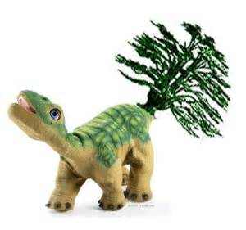
Opponents of Creationists or Biblical scholars say that we interpret the “cedar” as the North Western USA tree and not what grows in the Middle East, which is a tall slender tree with leaves and branches only at the very top. Therefore the “tail of Behemoth like a cedar” is the same as an elephant’s tail which is a rope-like tail with long hairs on the end.
The claim is that creationists ( and they name about 10 well-known creationists) are lying and deceiving people by saying the exact same words and phrases, which is dishonest and not discussing all the evidences as would be done in a court trial. Why do they oppose it? Their Worldview is Evolution)
The Hebrew term rendered “cedar” (eh-rez) refers to a tree of the pine family, the cedrus conifera (Gesenius, 1847, p. 78), more specifically and usually, the cedrus libani—the cedar of Lebanon (Harris, et al., 1980, 1:70). The tree and its wood are alluded to frequently in the Old Testament (some 72 times—Wigram, 1890, p. 154). The renowned cedars of Lebanon grew to an average height of 85 feet, with a trunk circumference averaging 40 feet, and branches that extended horizontally as long as the height of the tree itself (Harris, et al., 1:70). Indeed, the branches themselves were tree-like in size. King Solomon made extensive use of the cedars of Lebanon in his construction projects. The House of the Forest of Lebanon which he built was 45 feet high (comparable to a four-story building today), with its top horizontal beams situated on rows of cedar pillars (1 Kings 7:2-3; 4: 23). No longer the prolific trees they once were, in antiquity they grew in abundance (cf. 1 Chronicles 22:4; Ezra 3:7; Psalm 92:12; 104:16; Ezek. 21: 3).

Slide 5
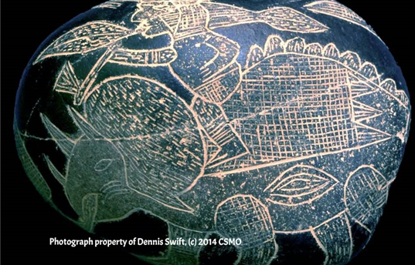
Some examples of ancient depictions of what looks like Dinosaurs or Dragons.
Creation Science Ministries of Oregon.

Slide 6

Examples of Dinosaur and Dragon stories and facts
Stories and sightings of Dinosaurs (Dragons or Serpents) are in every culture.
Historical selectivity and outright hiding of evidences has been rampant since start of 1800s. World Book Encyclopedia edited out their evidences by 1973.
Dragons were large, scaled, and sometimes winged reptile and behaved like intense predators to be feared.
1822 was the first time apparently that discoveries of these creatures were examined. Before this time, let’s say 1800, there were no known fossil finds that were buried in the sedimentary layers of deposits across the world. Myths and Legends abounded, but were they based on facts or visions and dreams?
Dinosaurs supposedly live from 235 million years ago to their extinction 65 million years ago. Extinction was thought to never occur based on the belief that God would not allow that, according to the Church of England in the 15th Century.
The word dinosaur did not exist before 1841. Therefore the Bible could not have that word. Therefore, any mention of an animal that looked like a dinosaur was an “incorrect” interpretation of scripture. Note the theologian’s interpretation of Behemoth and Leviathan still popular today.
But after the flood in the days of Noah many died out. The world was a much more brutal place to live. Vegetation was no longer in great abundance. People also killed dinosaurs because they were a nuisance, but more likely that they were afraid of them. They were scary creatures.

Slide 7
Dinosaur and Dragon stories, page 2
North American Huron Indians had a legend of a giant dragon named Angoni that lived in the rivers swamps and forests.
Seneca Indians had a Legend about Doononagaes that lived in rivers and swamps and acted like a giant reptile.
Pakistan had the Apalala, a dragon
The Swiss had Elbst that was a four-footed dragon that lived in a lake near Lucenne, SW.
The French had a very fierce dragon called Gargouille that lived in the Seine River.
England, Ireland, China, Japan, Russia, North Africa all had Dragons that looked like dinosaur finds.
Chinese calendar and their “Zodiac” consist of all real creatures except the Dragon. Rat, ox, tiger, hare, dragon, snake, horse, sheep, monkey, fowl, dog and pig.
In Asian cultures, Dragon and Serpent are not the same type animals.
Josephus (80 AD) mentioned these creatures several times as land dwelling serpents and serpent-like creatures that could fly.
Herodotus (430 BC) wrote that he saw flying serpents with wings without feathers like bat’s wings at Arabia. The pterosaurs fossils and ancient sculptures look very much like a giant bat of today. These winged creatures are described as having extraordinary colors and up to 30 foot wing spans.
Marco Polo (1280 AD) has written about what we call dinosaurs today.

Slide 8
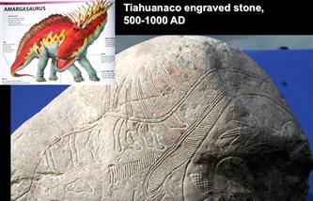
More on coexistence:
If Dragons and Dinosaurs existed the same time as mankind, that might mean that the Bible is true. Carl Sagan was a staunch defender of Evolution and dinosaurs dying 65 million years ago way before mankind showed up.
If a layer of rock has dinosaurs in it then they say it is 165-65 million years old.
If humans are in it they say it is about 1 million years old.
4. Dinosaurs and fish are buried in deposits together, only explanation is rapid water burial.
5. In 1938, a fish skeleton that was extinct for 70 million years ago and was a link between water and land creatures was found. This is the coelacanth, which was found alive and lives in the ocean depths off the coast of South Africa. If the dating was wrong, what else is wrong?
Amargasaurus

Slide 9

A quick lesson in Hebrew, Greek and English Bible translations.
Minor mistakes that we should not make. Were our English Bible translations a bit weak in a very few areas? Maybe! But not critical in one sense……. Dragons and Serpents used interchangeably?
Hebrew word “tanniyn” and “tanniym” is translated as howlers, dragon, serpent, sea creature, whale, and jackal.
Greek word is “drakon”
Hebrew word “nachash” means serpent as in Moses’ rod (staff).
1901 American Standard Version does not use the word dragon.
1611 KJV uses the word dragon.
Young’s Concordance,
Tannim: Dragons Malachi 1: 3; Job 30: 29; Ps 44: 19; Is., 13: 22, 34: 13, 35:7, 43: 20, Jer. 9: 11, 10: 22, 14: 6, 49: 33, 51: 37; Ezek. 29: 3; Mich. 1: 8.
Tannin: Sea Serpents: Deut. 32: 33; Ps. 74:13, 91: 13, 148: 7; Is. 27:1, 51: 9; Jer. 51: 34.
Drakon: Dragon: Rev. 12:3, 4, 7, 9, 13, 16, 17, 13: 2, 11, 16: 13; 20: 2.
Nachash: Gen. 3; Exod. 4, 7; Nu. 21; Deut. 18; Is. Leviathan, serpent, etc.
Ophis (Grk) Serpent: NT references include Revelation and the gospels.
Jackal: Not found. But in NASB is found in Jer. 9: 11. Hebrew Masoretic has ‘TNYC’ or tanniyn.
KJV has Dragons, not Jackal. Rev. 20: 2 uses both words; dragon and serpent (as does the NASB).
KJV Genesis uses Serpent and the Masoretic uses Serpent, but the Hebrew word is “tanniyn”.
Is there some bias that crept in or not?
Is it critical?
Many Christians will argue that the Bible
does not teach that dinosaurs and
man lived together at the same time. Why do
they say this?
If so,
what was the reason?
Truth of Science trumps Truth of Scripture?
(Trick question)

Slide 10
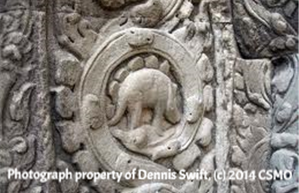
Stegosaurus?
Found in jungles of Cambodia; Temples of Angkor, 1400 BC-50 AD

Slide 11
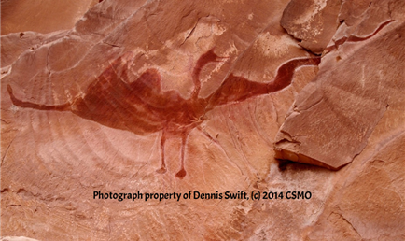
pterodactile?
Brazil: terror of the pterodactyl
Other airborne sightings of pterodactyls have been reported. One encounter reported on by David Hatcher Childress involved a commuter airplane that nearly had a mid-air collision with a soaring pterodactyl during 1992 over a mountainous region of the mostly unexplored Brazilian rainforest.
China: the priest and the pterodactyl

Slide 12
Pterodactyl hoaxes, or not?
Alaska: prehistoric flyby
John Bouker, a 22-year veteran Alaskan bush pilot, thought he'd lost his mind. As he headed toward Manokotak on October 15, 2002, he and his passengers thought they'd somehow flown into a scene from Jurassic Park. Not far off the starboard side of his plane a gigantic winged creature soared. The amazed pilot and his stunned passengers all got a good look at the thing. Comparing notes about the sighting, all agreed that the creature strongly resembled the illustrations in books about dinosaurs and other extinct animals.
A fascinating story along these lines is featured by the Crypto zoology Research Team. A Russian priest recounts the sighting of a pterodactyl: "Here’s an interesting account, which indicates that a few pterosaurs may have survived in China into relatively recent times. At the end of the 19th Century, a Russian Orthodox saint named Saint Barsanuphius was stationed in Manchuria to pastor the Russian soldiers during the Russian-Japanese War.
The paranormal, UFOs, crypto zoological animals, all fall prey to hoaxters and hoaxes. Reports of pterodactyls are no exception. Over the years some hoaxes have emerged that make serious research into the existence of the creatures that much harder.

Slide 13
Dating inconsistencies:
Mt. Etna basalt, erupted 122 BC; dated at 170-330 thousand years
  1972 eruption, dated at 210-490 thousand years.
Mt St. Helens, erupted 1986; dated at 300-400 thousand years.
New Zealand eruption, 1954, dated at 3.3-3.7 million years
Hawaii eruption 1959, dated at 1.7-15.3 million years.
Note that dates get older as eruptions are more recent.
Hell Creek Formation in Montana has T-Rex bones and soft tissue that contains red blood cells and soft tissue that was not decomposed. In the blood samples were found heme (part of hemoglobin protein). The bone is supposedly 70 million years old. Carbon-14 tests were not done, because the results would be too young, therefore invalid. Any presence of C-14 would mean that the sample is less than 100,000 years old. Two bones were tested secretly on the AMS C-14 spectrometer and one bone showed 30,890 years old and the other bone showed 23,170 years old. Note the discrepancies in the same fossil. The circular reasoning of dating rocks is a big part of the problem.
One of the myths and legends about dragons is that they blow fire and that it represents the Chinese culture. The only problem is that some of the people have not talked about some of the other dragons that they have believed to exist. The dragon for both Chinese and Japanese cultures symbolizes power and excellence. In the early days of the dynasty’s some of the dynasties worshiped the dragon as their lord and some actually even asked them for help and guidance.

Slide 14

More on coexistence:
Quote from Francis Schaeffer (a well known Christian Historian)
"I am not at all convinced it has been proven that the dinosaurs became extinct prior to the advent of man. I believe there is much evidence, ancient and modern, to indicate that dinosaurs and human kind existed on earth contemporaneously, and that human beings, while they probably lived in different regions than dinosaurs for the most part, did on many occasions encounter the sometimes huge and fearsome creatures. The memories of these encounters were so vivid and deep that they were passed down in a multitude of cultures as legends, painted on cave walls, represented in pottery, and written of in literature".
Carlisle Cathedral in United Kingdom contains a tomb that is inlaid with brass under the hall rug. It was placed there in 1496 upon the death of Bishop Bell. The sides which are kept hidden show engravings that can only be interpreted as dinosaurs. Appears to be an Apatosaurus.
Scales on dinosaurs are almost identical to Chinese sculpture dated 2500 years ago.
2000 year old dragon bronze vase from the Moche Indians in South America.
Dakota Sioux stories of Thunderbirds is based on eyewitness accounts of sightings of Pteranodons with wing spans of 30 feet. Since they need strong wind updrafts to fly, they were in areas of the North West where thunder storms created strong updrafts.
Northern area people knew that mammoths had lots of hair and a leathery skin and large tusks and were elephant-like. How did they know these details?

Slide 15
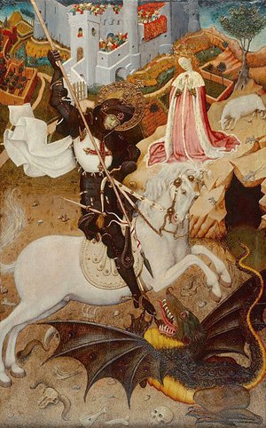
From Beowulf to St. George
(Myths and Legends)
St. George slays the Dragon and saves the maiden. Myth or reality? (or a little of both?)
(There is the reference regarding Alexander the Great and his army disturbing some giant monster in a cave on their way to India.)
Beowulf returns home to Geats and rules there for fifty years in peace. A dragon begins to terrorize his land when some of its treasure is stolen. The first time Beowulf attacks the dragon with his servants, they are unsuccessful. He decides it is best to track the dragon to its lair and attack it then. All of his servants are dead or ran away. The only one left to help him is his kinsman, Wiglaf. Beowulf defeats the dragon, but is mortally wounded. He is buried by the sea in a burial mound with the dragon’s treasure.

Slide 16
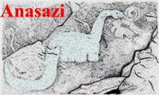
Natural Bridges State Park, Utah; Kachina Bridge petroglyphs.
Apatosaurus? (with the right head)
The “old” Brontosaurus (wrong head)

Slide 17
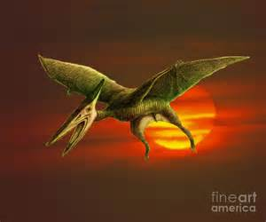
Quetzalcoatlus that has a crest on its head, long neck, wings and feet. 145-65 million years ago. A pictograph found in Utah drawn by the American Indians. (The crest on the head varies from picture to picture. Looks like a giant bat, except for the head)
Artist’s rendition of a cave painting.

Slide 18
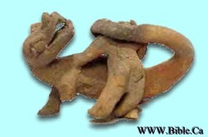
Some pictographs in caves depict Dinosaurs fighting elephants. Usually both animals died, but the elephant more often.
Paleontologists work with many pieces scattered over large distances. Assembly necessitates assumptions. Many missing pieces are hypothetical bones filled in. Finding skin and colors of the animal is rare. If part of the animal is not bone but cartilage or fleshy fatty parts, then these are artist’s renditions.
American Indians had knowledge of Dinosaur’s skeletal size and structure, and also of the scales, hair, habitat, and habits of these creatures.
Elephant?

Slide 19
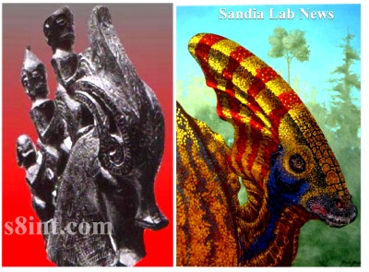
Lambeosuarus type dinosaur.
Men riding on this creature?

Slide 20
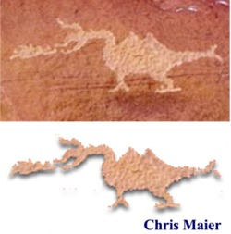
Fire Breathing Dragon (or Serpent)?
Wupatki National Park petroglyph
at least several hundred years old..
Exploding chemical mix
(fire)
Tail is held out straight, not dragging on the ground

Slide 21
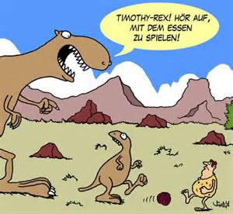
That’s All Folks!
Timmy, do not play with your dinner!

