Slide 1
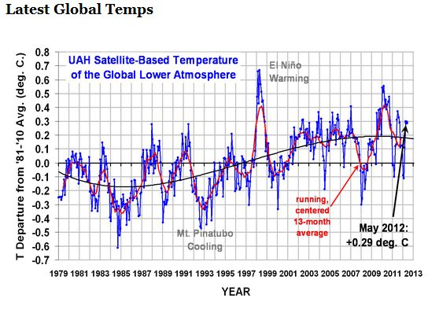
Note the ranges of actual temperature changes
Assembled from the Internet
By Jim Hovis, August 13, 2014.

Slide 2
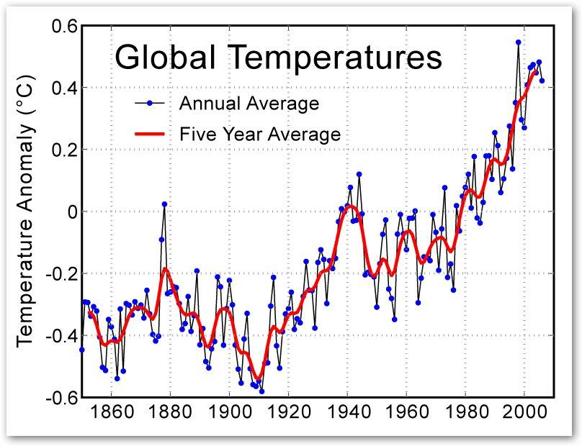

Slide 3
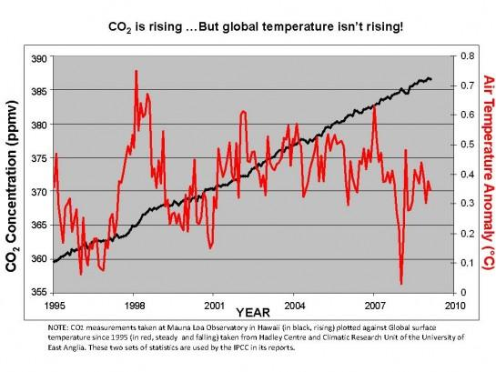

Slide 4
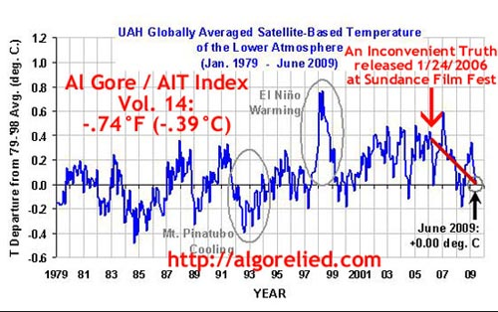

Slide 5
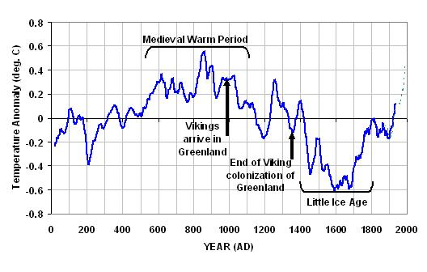
Data is estimated by several indicators (not actually measured).

Slide 6
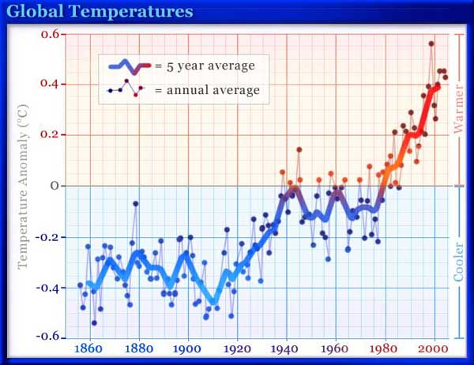

Slide 7
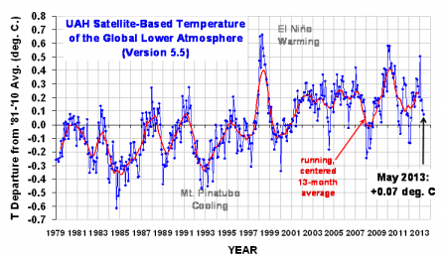

Slide 8
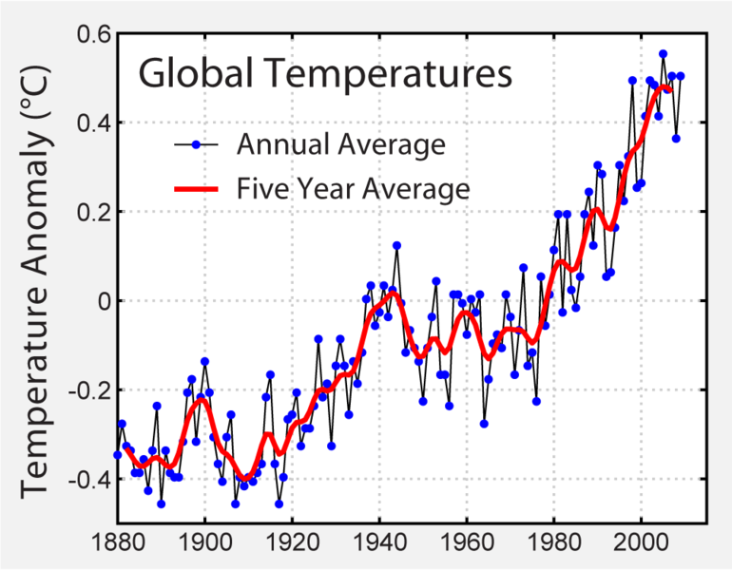

Slide 9
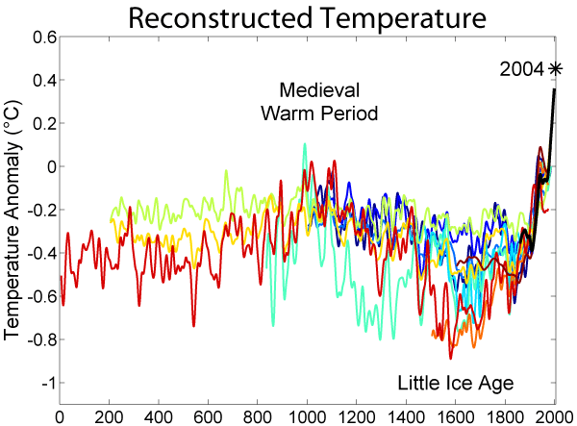
(Estimated)

Slide 10
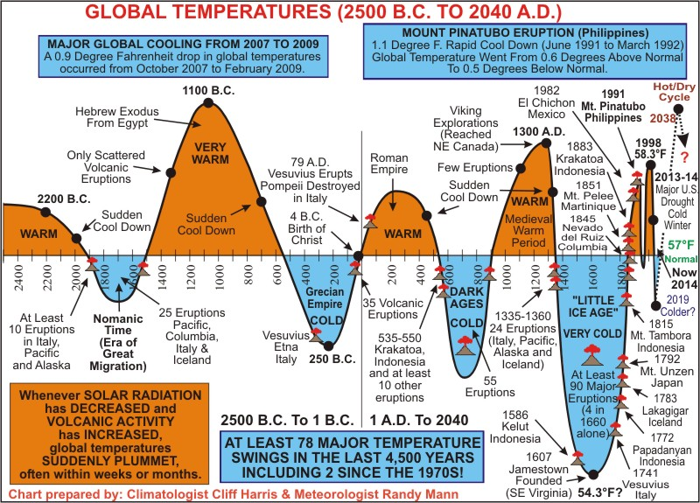
Warning: Do not show this chart to an Evolutionist or Environmentalist!

Slide 11
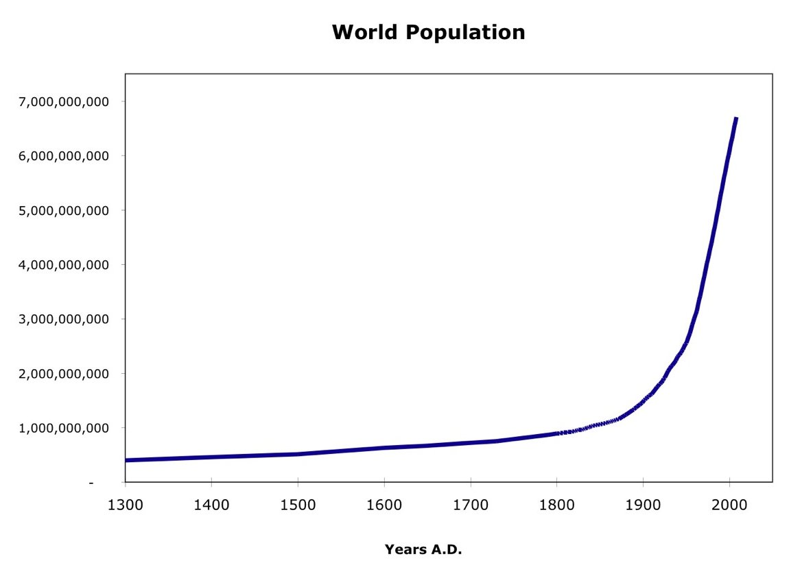
And now a few “inconvenient truths”

Slide 12
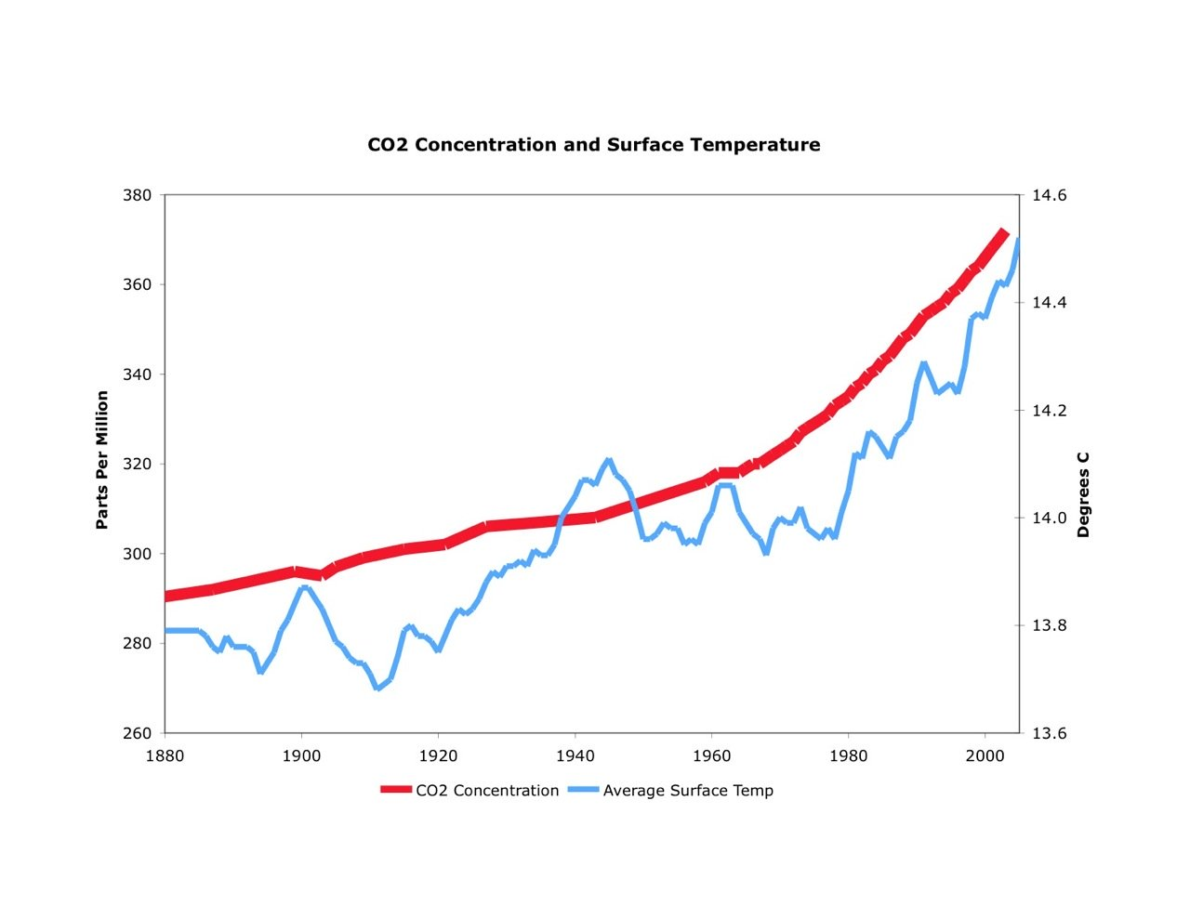
Note that the temperature
Scale does not match real data!

Slide 13
