Slide 1
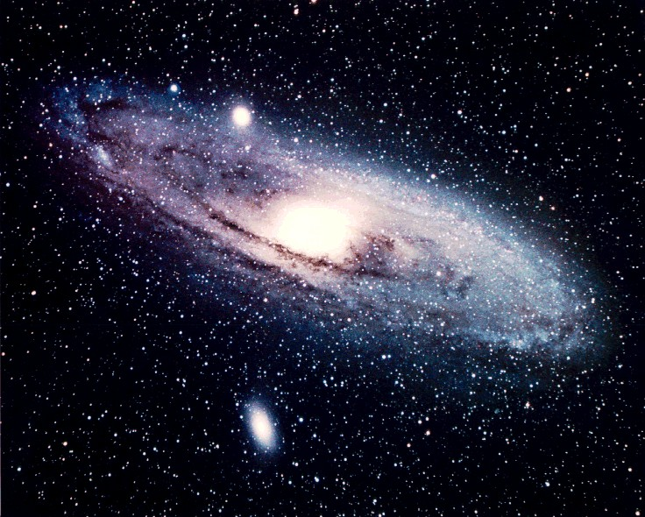
I. Biblical Astronomy Issues
What can we infer from the Bible concerning the Universe, its shape, its properties, and its size?
The Hebrew
Bible
Presentation by Jim Hovis
at Faith Bible Church
CSFNM on April 18, 2014

Slide 2
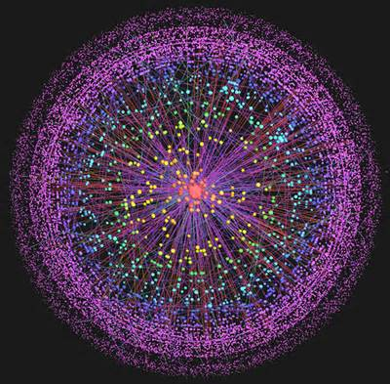
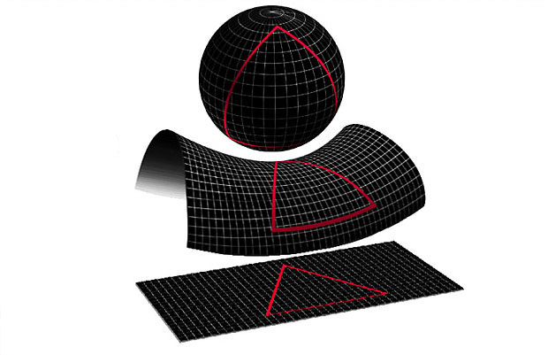
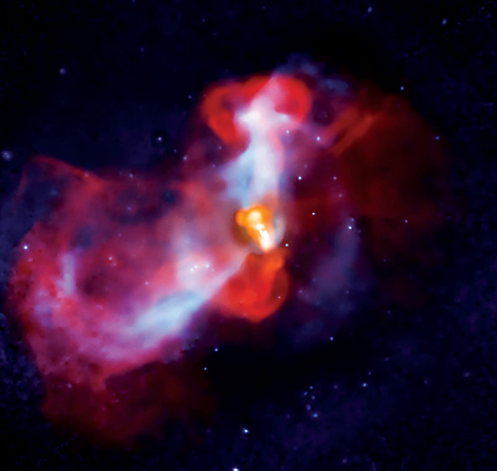
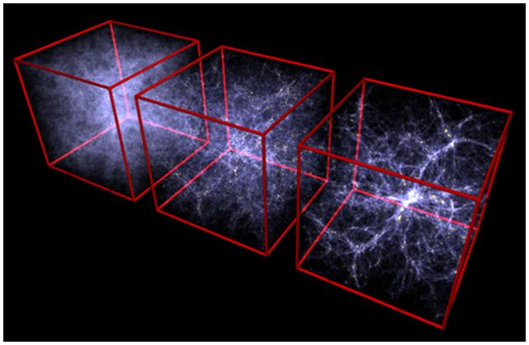
What shape could the Universe be?
Spherical, Oblong, Elliptical, Cubical?

Slide 3
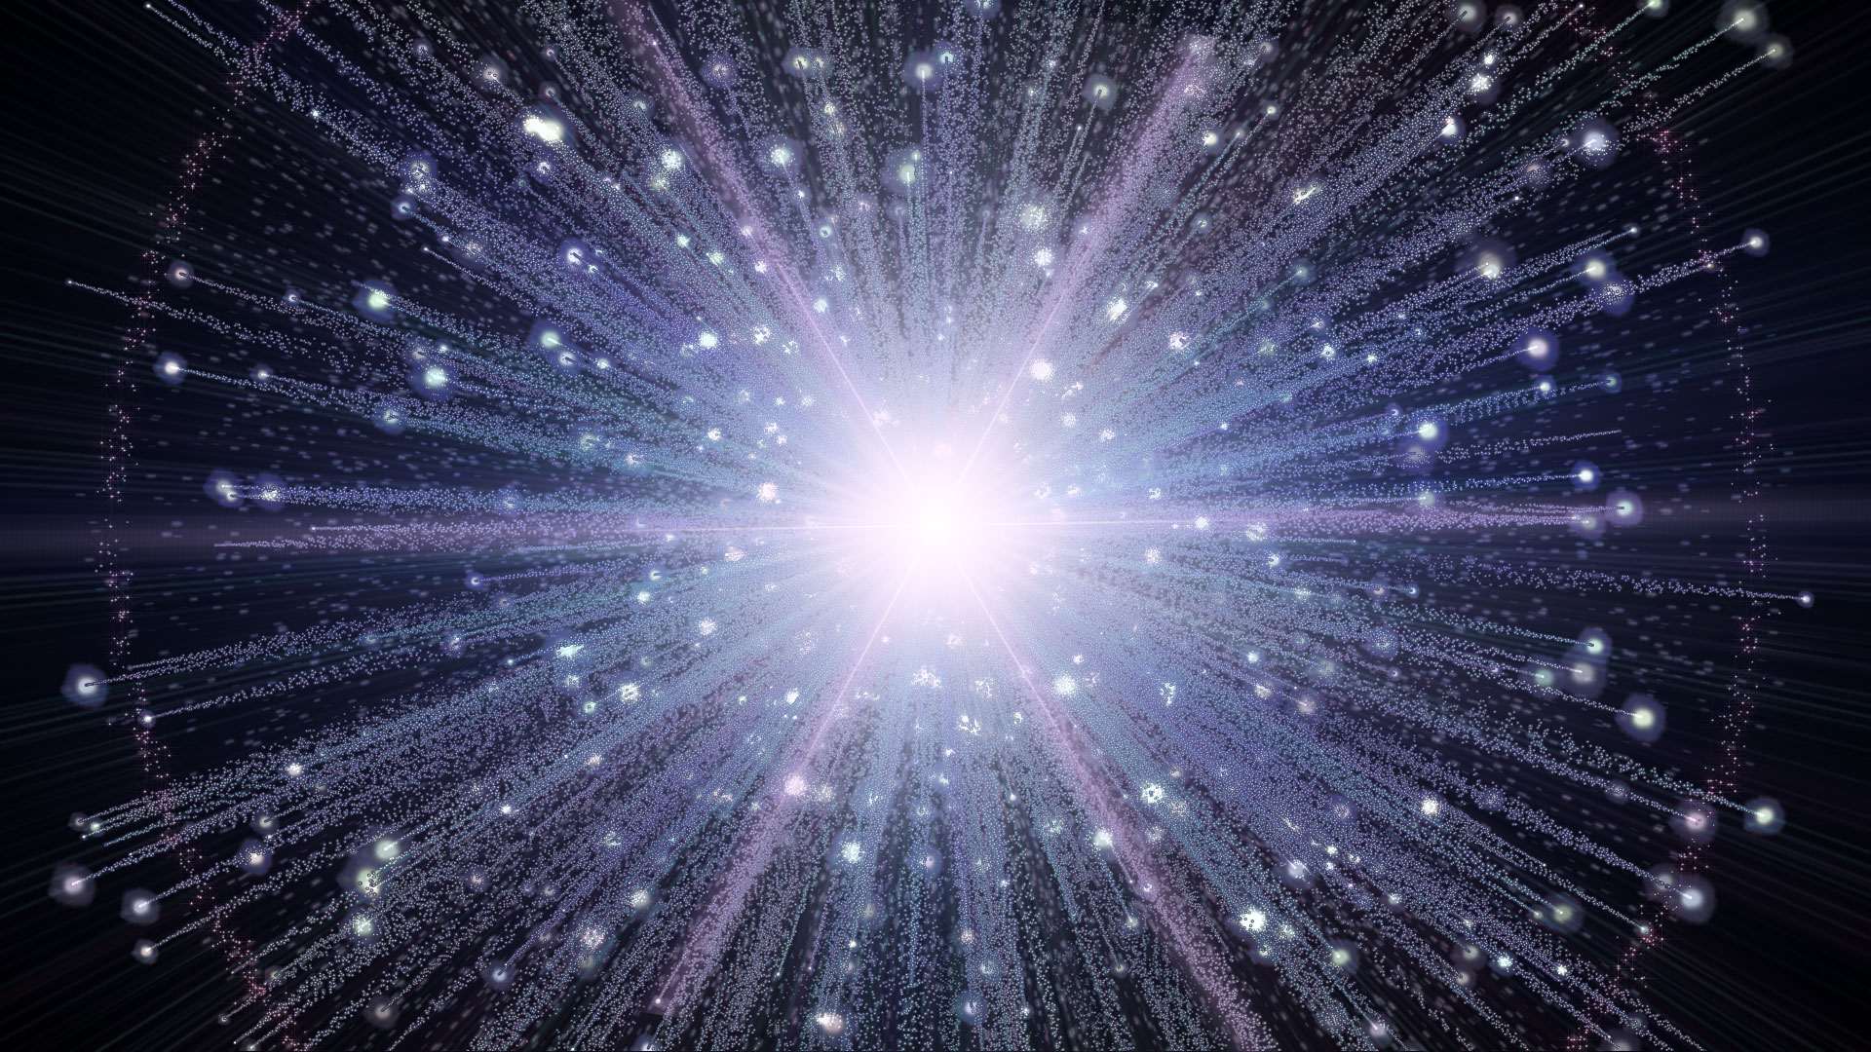
The latest picture of our Big Bang (Computer model)[Time?]
Galaxies

Slide 4

Now let’s see if I got this right, an explosion results in
a complex universe, that shows order, design, purpose,
which gives us our solar system and the world I live on....
E
Sun
V
J

Slide 5
Here is an illustration of what the scriptures may be indicating from Genesis and other passages
What is beyond the sphere of water?
The 3rd Heaven, the abode of God? (II Cor. 12: 2)
Wall of the “waters above” the Firmament (expanse)
that surrounds the entire sphere of the Universe,
an ocean of water is at the boundary of the Universe.
???
Water
Milky Way Galaxy and our Earth near the center of
the Universe. And yet not near the center of the galaxy!
Diameter is
Approx. 26 BLY,
Maybe.
Concentric “rings” of galaxies (Circular Filaments?)
Water
The 2nd heaven, the Firmament, II Cor. 12: 2; Ps. 148: 4.
(And the 1st heaven is the sky, clouds and atmosphere.)
Is. 64: 1 Rend the heavens and come down.
On the Second Day of creation (Genesis 1: 6-8) God made the expanse
in the midst of the waters and it will separate the waters below the expanse
and the waters above the expanse.
Then in verses 14-19, the two great lights (Sun and Moon) and the stars also were
placed in the expanse on the 4th day. ‘The stars (Hebrew word “kokab” means small bright
lights) would include the galaxies, gas clouds and comets.’
Beginning with Isaiah 41: 22 and at least 2 other times in the next few chapters,
(Jer. 10; Job 9) it says that God stretched out the expanse (Firmament: KJV word for expanse).
The expanse must be something if it can be stretched out!

Slide 6
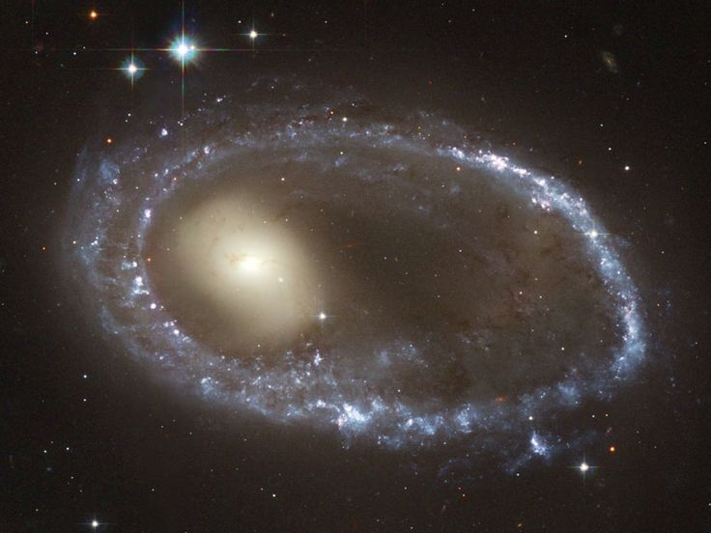
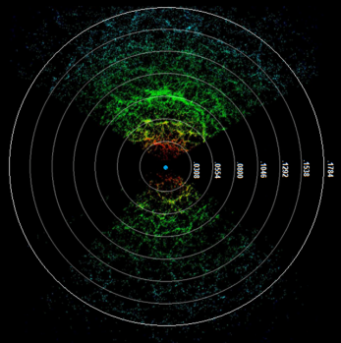
Structure of the Universe:
Rings around galaxies or rings of galaxies?
Earth’s location
Redshift quantization is the hypothesis (??) that the
redshifts of cosmologically distant objects
(in particular galaxies) tend to cluster around multiples of some particular value. Since there is a correlation of distance and redshift as expressed in Hubble's Law, redshift quantization would either indicate a quantization of the distances of galaxies from the Earth or a problem with the redshift-distance correlation, either of which would have serious implications for cosmology. Many scientists who oppose the Big Bang theory, including Halton Arp, have referred to observations claimed to be in favor of redshift quantization as reason to reject the standard account of the origin and evolution of the universe.

Slide 7

Here’s a question to keep us awake at night!
We know that the earth was at the center in the very beginning (Genesis 1: 1-5) then verse 6 talks about the expanse that separated the waters (oceans) on the earth from the waters (ocean) above.
On Day 4 God made the Sun, Moon and stars and whatnot and “placed” them in the expanse. Did he move the earth into its position in the Milky Way Galaxy?
Or did he place the stars and all that is in the Milky Way around the earth, such that the earth is now in one of the outer “arms” of stars surrounding the galaxy center?
The redshift measurements of star light and the quantization of them seem to imply that the earth is still very near the center of the known Universe.
Evolutionary minded astronomers of course reject this idea completely!
Russ Humphreys, John Hartnet, Jason Lyle, and others ponder these.

Slide 8
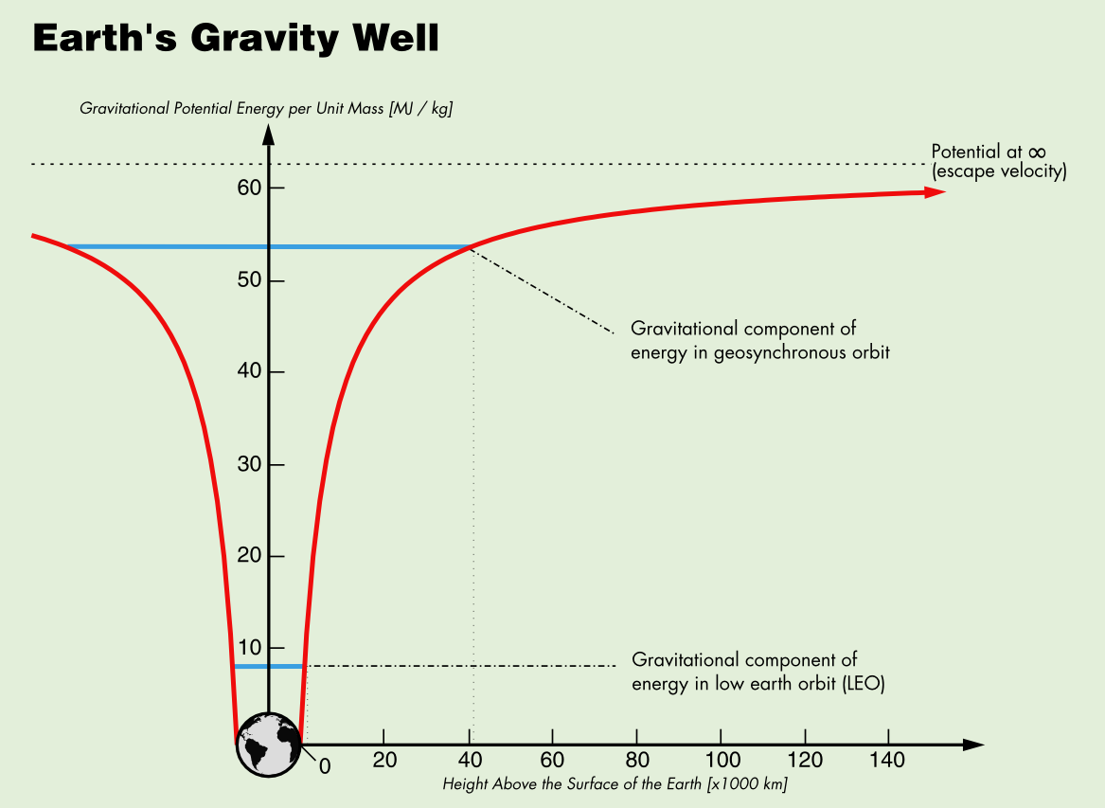
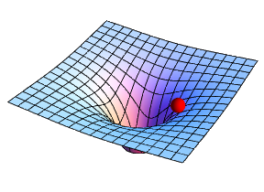
Moon
A mass
The Space-Time Continuum,
the Expanse or Firmament.
What causes a gravity wave?
A moving large mass (within the expanse volume)
A force field results from the presence of a mass.
The mass moves in the expanse at high speeds.
A gravity or force field follows the large mass.
The gravity force field extends outward to infinity.
  But at a large distance the strength is nil.
  The field travels at the speed of light (??)
  Force = G*(M1*M2)/r*r
  As distance “r” gets greater, the square gets even greater.
  Force gets very small at large distances.
The “pull” of gravity follows
the force field lines
Objects follow the lines
Photons follow the lines
The Big Bang caused a
massive gravity wave,
So what is the evidence?

Slide 9
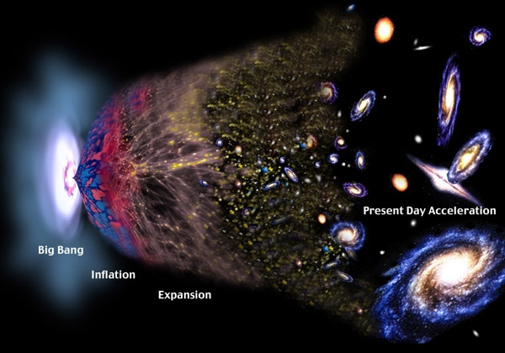
Gravity Wave
Gravity Wave

Slide 10

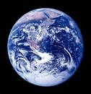
A Gravity Wave from the expansion of the expanse and the placement of stars, galaxies and so on?
Gen. 1: 6, 7; The expanse is created on the 2nd day. The “waters” separated.
1: 16, 17; He made the heavenly objects and placed them in the expanse.
Is. 41: 22, 26; 42: 5; 44: 24; 45: 12; He stretched out the expanse, He placed the stars in it.
Gravity waves as the
Expanses stretches out
Earth
Are galaxies out here
larger than galaxies
closer to earth????
Big Problem:
Waves are moving
away from earth.
Evolution’s Big Bang
Theory has waves
moving all directions,
with no center. ??????
Evolution says galaxies are expanding
within the expanse, not expanding
themselves, or are they ??????

Slide 11

II. What is difference between Astronomy and Astrology?
Astronomy is a scientific discipline that studies the Observable Universe of objects within our solar system and beyond. (Psalm 19) It cannot define origins or age of the Universe and cannot refute the Second Law of Thermodynamics or the Law of Death and Decay (and functional failure of everything with time) which is universal according to Genesis 3 and Romans 8.
Astrology is a religious and cultic practice based on signs in the Universe and determining positions and motions of astronomical objects relative to human activities and living. It is not a science in the normal definitions.

Slide 12
What difference does it make about these conclusions? Does it help me to be a better Christian?
The answer is absolutely YES!
How?
  We would be able to refute the Evolutionist who rejects God and His Word
  We would help weak Christians be stronger in the Word and True Science
  We can show Evolutionary minded scientists that God’s Word is the correct Worldview and the basis for all science.
  We can give help to weak Christians to understand the command of Psalm 19
  We can help our Children and/or Grandchildren who attend Public school know the difference between truth and error.
  We can give the proper tools to children and others to understand the world we live in and how it operates and the wonder of God’s Creation and diversity
  It helps us understand that Genesis is foundational for all of scripture.
Why?
  Hebrews 6: 1-2, 9; II Tim. 3:17: Let us move on from the elementary teachings about Christ, that we may be adequate and equipped for every good work.
  Jude 3; We must be able as mature Christians to defend the (our) Faith.
John 5: 46, 47; “For if you believed Moses, you would believe me; for he wrote of me.
But if you do not believe his writings, how will you believe My words?”

Slide 13
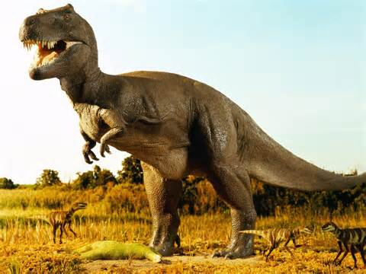
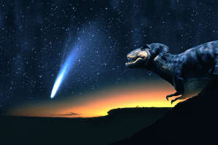
III. Did the meteorite that hit the Yucatan Peninsula (Mexico) kill off the dinosaurs 65 million years ago?
Probably not, for the following reasons:
  One event in Mexico affected the whole world? How did other animals survive?
  Climate change was so bad from that one “hit”?
  Food became scarce after the “hit”?
  No evidence even that it was 65 million years ago.
  Biblical evidence (plus history) indicates that Dinosaurs and man were contemporary.
  How many huge volcanic eruptions have we had (and those killed only the local populations)?
  The evidence of a global Flood is ignored (II Peter 3: 5, 6).
  Did man kill them off? (St. George and the Dragon?)
  What about abundance of food after the Flood?
  Was the climate conducive for very large animals?
  What about the Ice Age immediately after the Flood?

Slide 14
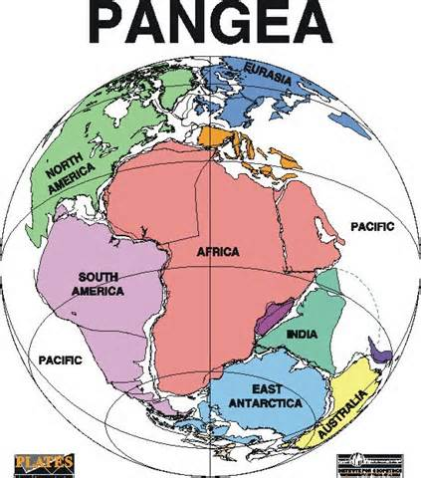
IV. How was the world topology and climate different before and after the Flood?
II Pet. 3: 7 This world was destroyed.
Gen. 6: 13 Destroy them with the earth and by water.
Before the Flood:
  Mostly hills and perhaps some low mountains and flat terrains
  One continent (Pangea)? One ocean? (Gen. 1: 9: One place?)
  Mild climate everywhere. (Evidence that plants grew everywhere, even in the far north regions.)
  No violent rain storms, just mist that watered the ground. (Gen. 2: 6-14)
After the Flood:
  High mountains and long valleys (Rugged uplifts)
  Deep ocean trenches ( 1 mile, 3 miles, 6 miles)
  5 Continents
  Severe weather in many places (rain, snow, ice, dry desert)
  Volcanoes, earthquakes, tornadoes, hurricanes, etc.
?
Is this true?
1859 was when a geologist
noted the continents
seem to fit together.

Slide 15
V. Why are people looking for life on other planets?
  What are the arguments for why there must be life out there?
    Why not? There is life here. (Argument from silence is a logic fallacy)
    Probability multiplied by a very big number gives more than zero.
    Number of stars and galaxies and planets like earth (sort of).
    Because they believe that it is so. (Belief trumps evidence and scripture)
  Have we ever been visited by aliens from out there?
    No evidences that can be verified. (Unverified visions are also logical fallacies)
    Distances are too great (speed of light is still the limit, even if time doesn’t pass)
    No evidence of time travel either forward or back from the future. (Yes, I did like the movie)
    Bible does not address life anywhere except here. (Not counting Heaven and Angels)
  What are the arguments from scripture against life out there?
    Second Law of Thermodynamics and Law of Death and Decay is universal.
    Only one occurrence of Jesus dying for the sin problem. Once for all.
    No Sun, Moon and stars; sky will be rolled up like a scroll and discarded. (Is. 60: 19; 34: 4.)
If life is proven to exist outside of our Solar System, then
there is no God, no accountability, and no Hell (no Heaven either).
???

Slide 16
VI. Some interesting implications concerning the Creation
After God presented a helper to Adam (when Eve was presented to Adam he called her “woman”, Gen. 2:23), but after the Fall and yet before any children were conceived and born, how did Adam know that she would be the Mother of all living, when he named her Eve? (Gen, 3: 20)?
How did Satan know that there would be a kingdom that he wanted to rule and be like the Most High God (Isaiah 14), before there were children born to Adam and Eve? We know that he planned to deceive Eve and take the kingdom of God for himself? How did he know or suspect that Eve was the easy target? He apparently knew what the basic plan was of God. He wanted to be in control.
Probable answers from scripture:
Gen. 1: 28; Be fruitful and multiply, fill the earth, subdue it and rule over it and everything in the earth.
Gen. 3: 16; God said that He will multiply Eve’s pain in childbirth. She will bring forth children in pain. (This was before she had relations with Adam. Gen. 4: 1)
Adam and Eve were instructed by God in the Garden before they fell. Gen. 3: 8.
Mankind started out with high intelligence and intellect. Gen. 4: 20-22.
Satan was the Cherub that covered (Ez. 28), he was a great angel. (Is. 14) The top angel (archangel)? God probably told Satan and all the angels before the 6th day.

Slide 17


VII. Some more observations about Biblical Creation issues:
  Observation: The Universe is not infinite in size, but it is incomprehensibly large. For a Creator to have made this Universe, it begs the question of “How big must the Creator be?” It would require a being to be outside of the Universe with the attributes of Omniscience (all knowledge), Omnipotent (all power), and Omnipresence (everywhere present). The diversity of all that is in the Universe is seen in stars that differ from one another, various and diverse objects. We see patterns, order, and design, especially in how galaxies are arranged. That is, we can see purpose and meaning (but one has to look). We can understand that the Creator is into diversity and unlimited creation designs. Even to see the diversity of life here on earth is mind-boggling.
  Purpose: The Solar system is ordered and operating perfectly to sustain life on earth. The Moon is positioned just right for light, tidal actions; the stars can be used for determining seasons and navigation, we draw imaginary figures from the patterns of stars and use them (Signs of the Zodiac) to calculate planting and harvest times; the Sun is just right in size, illumination, heat, temperature, distance and stability; the earth is titled just right for seasons and weather patterns; the planets can be used for signs and seasons as well.
  Illustrations: The Creator says that if the Universe can be measured and the bounds determined, then He will cast off Israel. We conclude that we cannot do this, therefore Israel is not discarded. The Creator says that He knows the number of hairs on our heads. He also says that He knows the number of the stars and calls them all by name; not one of them is “missing”. If the Creator can do that, why can’t He also know the most insignificant detail about each of us? The Creator says that He will roll up the sky (the heavens and all of outer space) like a scroll can be rolled up. What does it take to be able to do that? The vastness of the Universe tells of the Creator’s abilities, even if we cannot see all of it, or even a small part of it.
  Conclusions: When we follow the advice of Psalm 19, we can appreciate the Creator, understand to some degree the capability of the Creator and the validity of his statements concerning the vastness of the Universe, and then we can appreciate the vastness of the Universe, even if we can’t see it all.

Slide 18
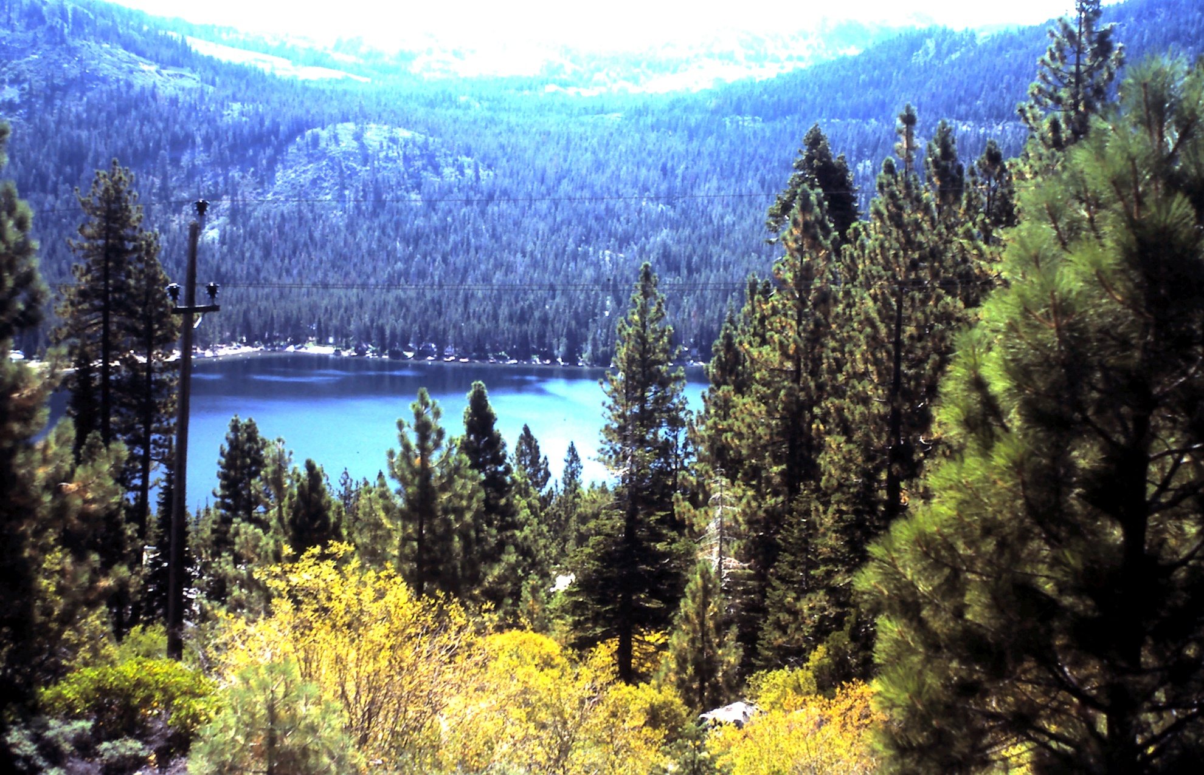
That’s All Folks!

