Slide 1
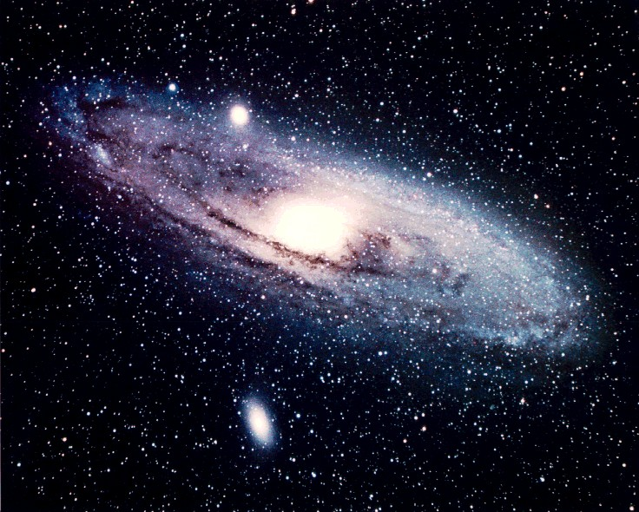
Some fundamental concepts that we need to understand before we formulate our Christian Worldview (I will define this later….)
The Hebrew
Bible
Luke 16: 29, 31; “If they do not listen to Moses and the Prophets,
neither will they be persuaded, even if someone rises from the dead.”
John 5: 46, 47; “For if you believed Moses, you would believe me; for he wrote of me.
But if you do not believe his writings, how will you believe My words?”
Presentation by Jim Hovis
at Victory Christian School
April 15, 2014

Slide 2
Do we have a serious problem?
If we believe Historical Science (origins, Big Bang, Dinosaurs, but no people, old earth, etc.) in addition to Observational Science, then what?
If we try to harmonize Historical Science and Genesis, then what?
If we believe that the Universe is about 13 Billion years old and the Earth is about 4.6 billion years old, then what?
If we say that it doesn’t matter how old the earth and the universe are, do we have a problem?
If we say that only believing in Jesus matters, do we have a problem?
If we say that Genesis is not science, do we have a problem?
If we believe that death and decay were in the Universe since the Big Bang, or before Adam and Eve, do we have a problem?
If we believe that science teaches us that we are just highly developed animals, do we have a problem?
If we believe that marriage is whatever we define it to be, are we in trouble?
???
Yes, indeed, we do have a serious problem! (Heb 5:12; become mature in the Faith)

Slide 3

What is so great about Genesis?
It is a Foundational Book, especially Chapters 1-11.
It tells us the beginnings of everything that matters. Like what?
  How the Universe and the Earth came to be. (about 4350-4750 BC, i.e. 6020-6400 years ago?)
    It (the earth was shapeless and void of life) was covered with water.
    Light followed after this creation act.
    The expanse (Firmament) was created. (The space-time continuum of space, it’s not nothing. Not an empty vacuum.)
    The waters above and the water below were separated. (Hebrew word is “oceans”, not clouds)
    Dry land appeared
  Plants were created. (Day three)
  The Sun, Moon and stars and planets, galaxies, etc. were created and placed in the expanse. (Day four)
  Gen. 1: 28; the mandate for man is given by God. (Day 6)
  Marriage is defined. (Mark 10: 6-9; Gen. 2: 24; Eph. 5: 31; I Cor. 7: 2 From the beginning, male and female, one flesh) (Day 6)
  The one prohibition (that tree) was given. Violate this commandment and dying you will die.
  The fall of Adam and Eve. Death enters the world through one man, Adam. (After Day 7 ?)
  The first murder, the first polygamist, The Noachian Flood (about 3075 BC). (Allowed to eat meat, flesh of animals)(Death penalty for murder).
  The Tower of Babel (About 2700 BC)

Slide 4

Why does all this matter to me?
What is my worldview?
How do I see things around me?
How do I interpret what I learn and what people teach me?
How does this affect my personal life.
  How does it affect what I do, what I say, how I act.
  Does it have any bearing on marriage, children, interpersonal relationships?
How does it affect my faith?
  Is my faith based on anything? (What I see, what I hear, What I feel?)
  Can I defend my Faith [Jude 3; Contend (Apologetics) earnestly for the faith.]
  Can you defend your faith and know for sure that you are in God’s hands?
  Can you show other people (if they will listen) what your faith is based upon?
  How do you view Scripture?
Yes indeed, It matters!

Slide 5

How do I use my Worldview?
I interpret what I see, hear, and feel based on my knowledge of scripture, not on what the world says or society tells me.
My behavior (how I act, what I think, what I believe) depends on a proper Worldview.
I use science disciplines (Math, Physics, Chemistry, etc.) according to the principle of Creation by God; order, purpose, beauty, design, functionality.
I use history that is accurate, philosophy properly, follow the proper use of foods, treat animals properly, follow good interpersonal relationships properly, treat marriage as God intended it to be.

Slide 6
What happens if my Worldview is off base and inaccurate?
You can be deceived by the world and believe all that it teaches that is not Biblical.
You can be the slave of Satan and do his agenda.
You can think that marriage can be whatever you want it to be. (homosexual, multiple partners, perversions, etc.)
You can be a slave to Government agendas that are not according to Romans 13 and other passages concerning leaders and the purpose of Government.
You can think that you are just a higher order of animal.
You can think that you can disobey your parents and legal authorities delegated by God. (Do whatever you want.)

Slide 7
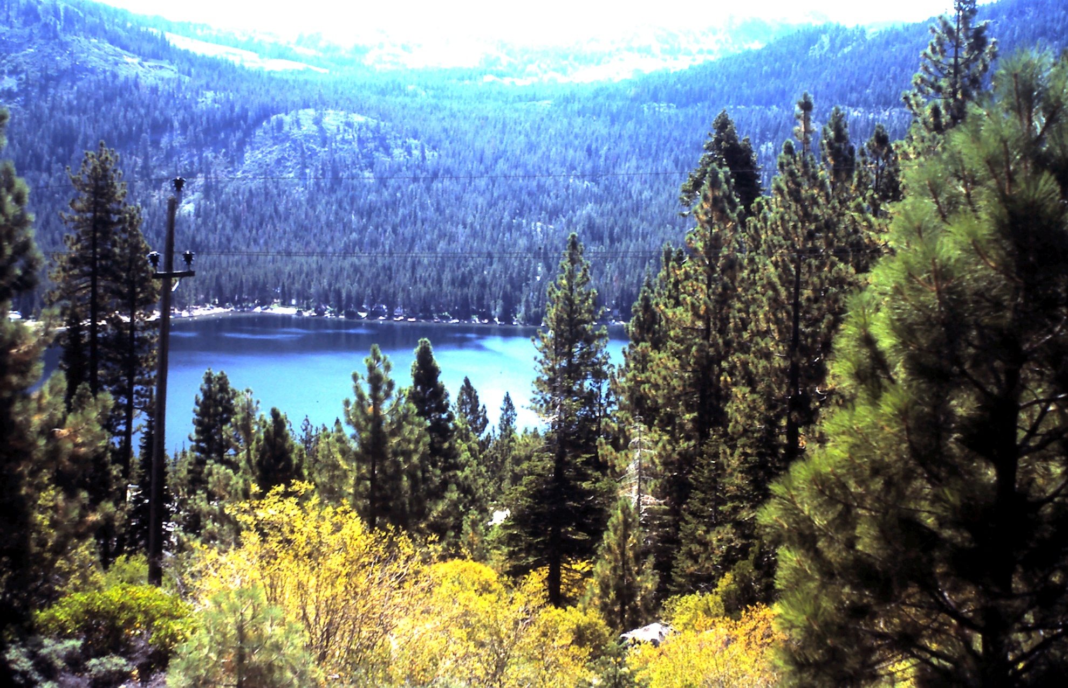
That’s All Folks!

