Slide 1
Before the Beginning……………………….
There was nothing, but God Himself…………..
He has always existed, He had no beginning, there was no Universe.
No Earth, no space, no stars, no planets, no galaxies, no light, no life.
Then God Spoke!
And God Said…………………..!
We can not even image what it was like before…..?
Jim Hovis, June 18th at Faith Bible Church
CSFNM General Meeting.

Slide 2
From Galaxies to Grasshoppers,
Scale of the Universe
Sun
Edge of the Universe,
(water per Genesis 1: 7)
Orion
500 light years, more or less
93 million miles to the Sun
8 light minutes
Earth
Moon
Andromeda galaxy
1-2 million light years, more or less
372 million miles
40 light minutes
Radius about 13.8 billion light years, more or less
Jupiter
Not to scale by any means
Prepared by Jim Hovis
For CSFNM June 18th

Slide 3
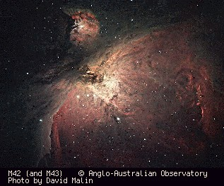
Portion of Orion Nebula (gas clouds)
Job 38: 31; Can you loose the cords of Orion?

Slide 4
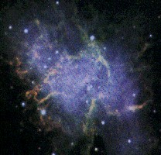
Crab Nebula (Star explosion) Evidences of dead stars, how about birth of stars?

Slide 5
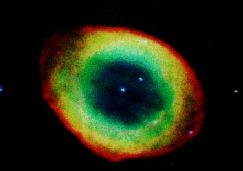
Ring Nebula (Star explosion)

Slide 6
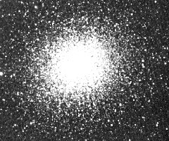
Hercules Globular Cluster Why don’t the stars collapse into the center?

Slide 7
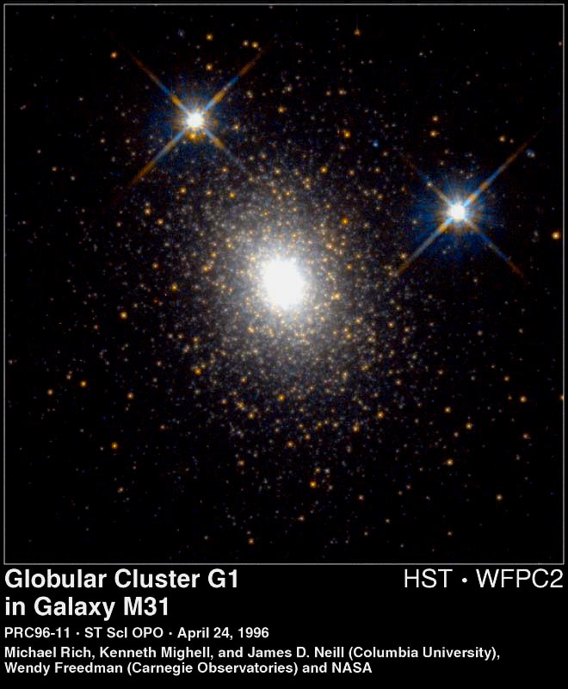
Another cluster (stars really don’t move much as they do in a rotating galaxy)

Slide 8
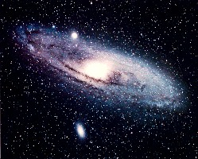
Andromeda Galaxy (1-2 million lights years distant)
[Stars in the arms move fast; obey Newton’s Laws, not so in the Bulge]

Slide 9
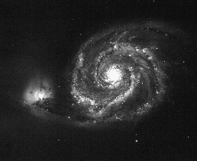
Whirlpool Galaxy Notice the tidal attraction to a small system of stars?

Slide 10
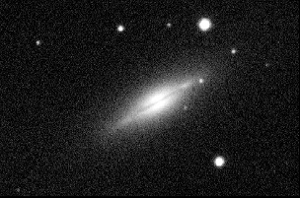
Spindle Galaxy Stars everywhere, not just in the disk

Slide 11
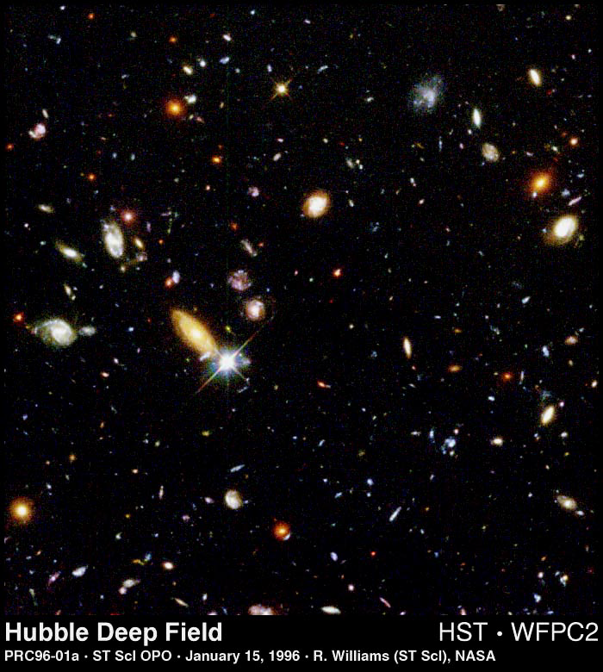
Billions of galaxies How many stars altogether?

Slide 12
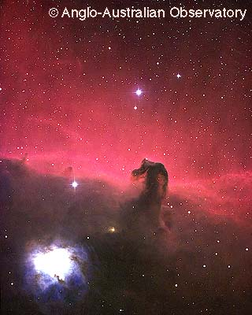
Horsehead Nebula in Orion (Star forming areas?)

Slide 13
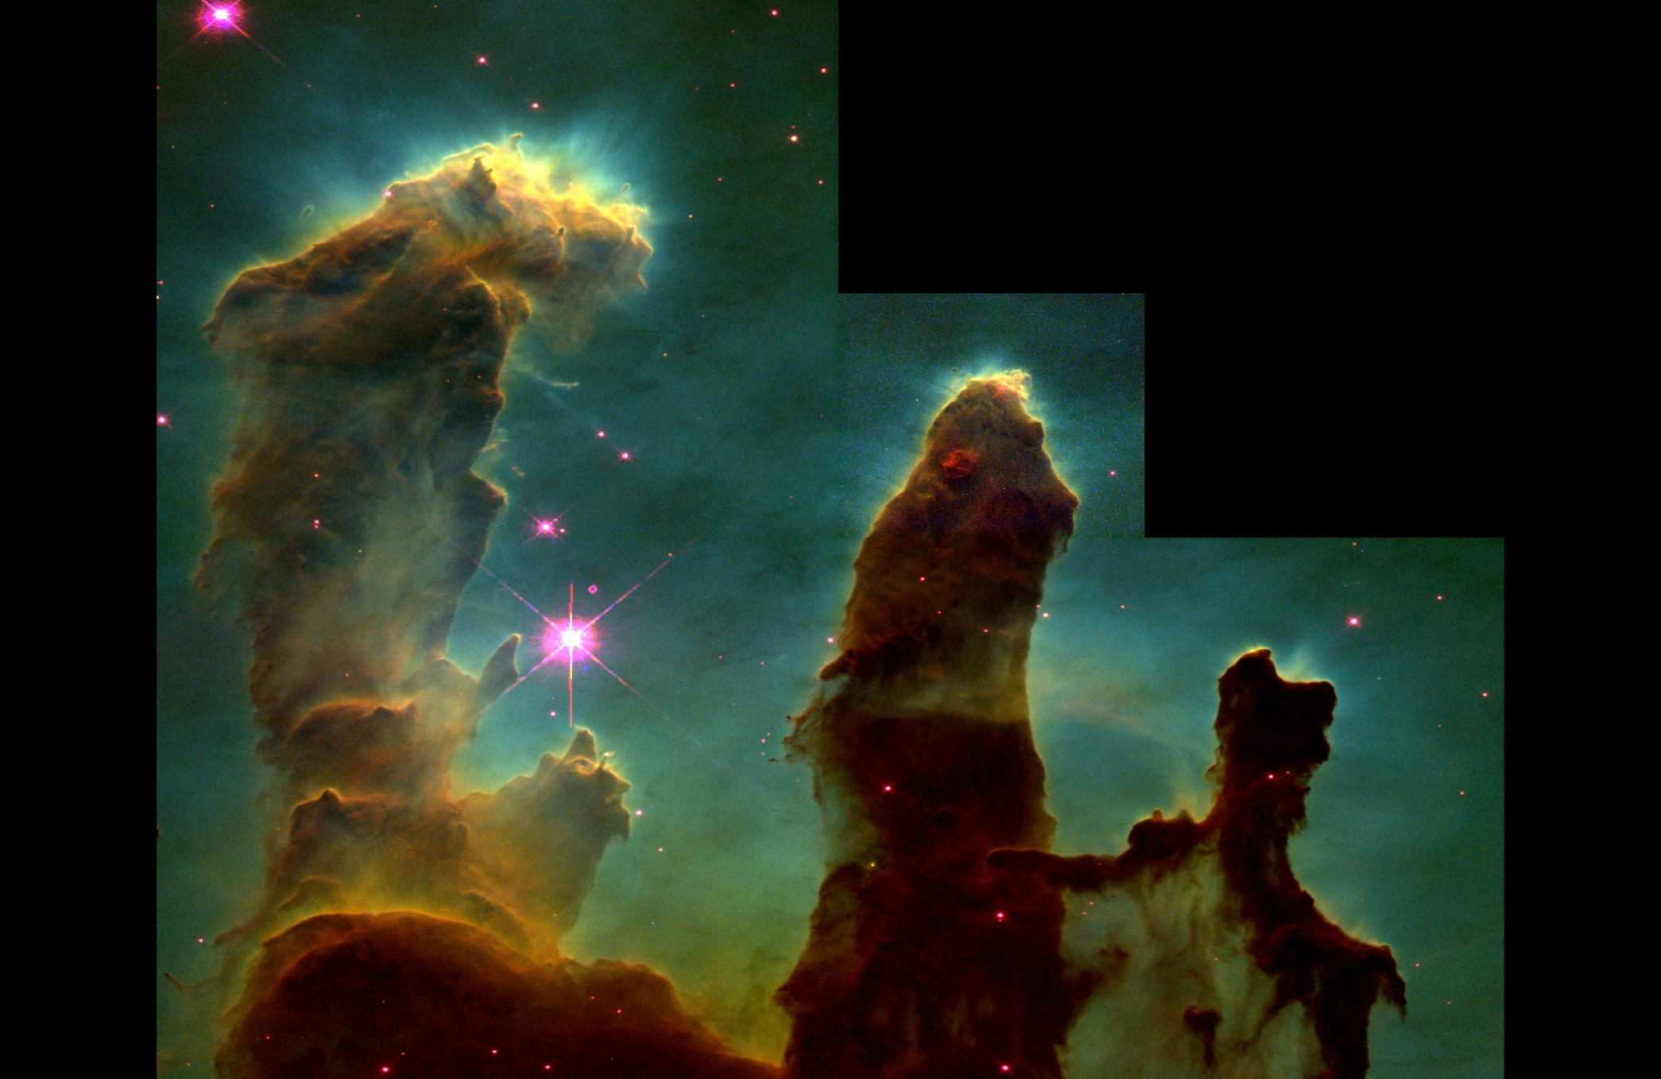
Pillars of Stellar Creation?
Or stars hidden
behind the gas?

Slide 14
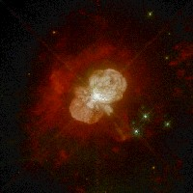
Eta Carinae star (100+ times mass of Sun, supernova) [Largest known star 300X the Sun]

Slide 15
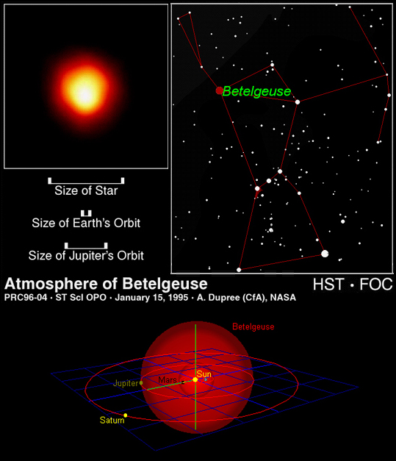
Orion
Huge, man!

Slide 16
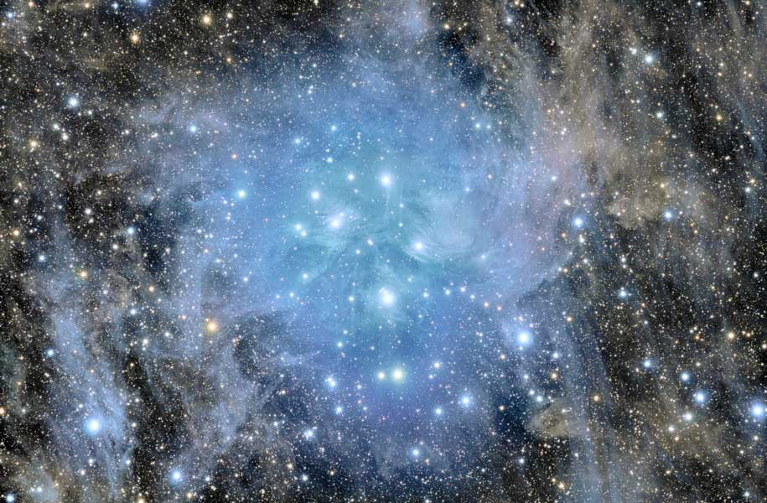
The Pleiades (7 Sisters) (Mentioned in the Bible, Can you tie them together?)

Slide 17
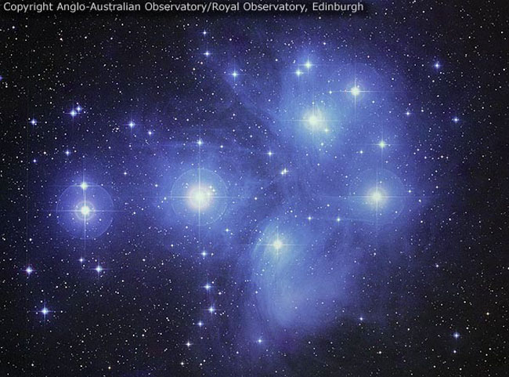
The Pleiades (another view in different light)
Job 38: 31; Can you bind the chains of the Pleiades?

Slide 18
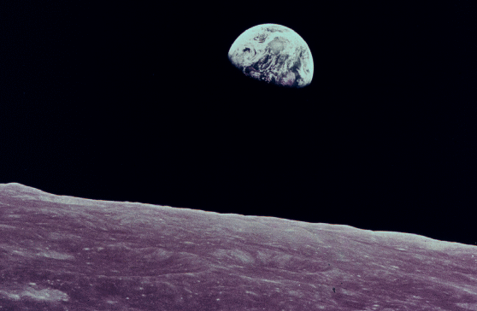
Earth as seen from the Moon,
(Only known planet to support life. Why?)

Slide 19
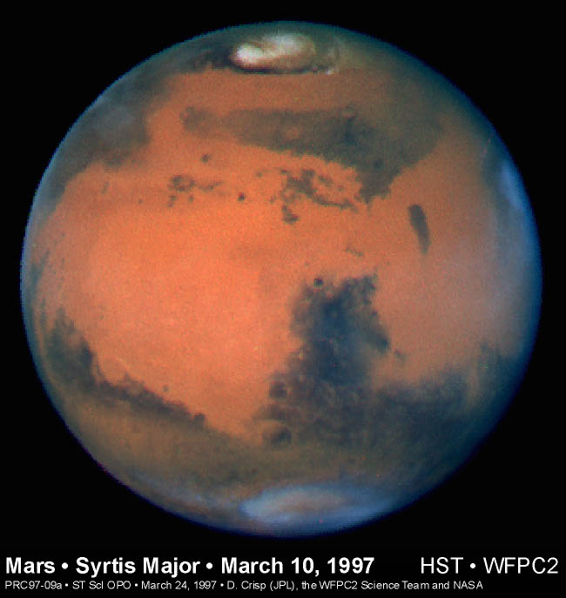

Once had
an ocean
of water?
Once
had life
(Lichens)?
Once
had canals,
(rivers or
roads)?
???

Slide 20
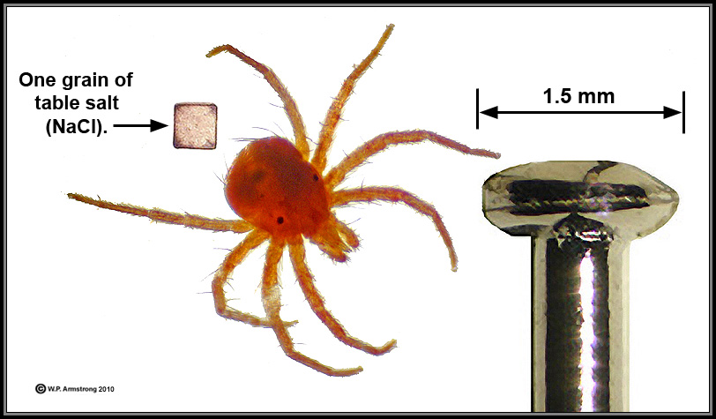
Now to earth and its scale of things: A dust Mite
A pin head

Slide 21
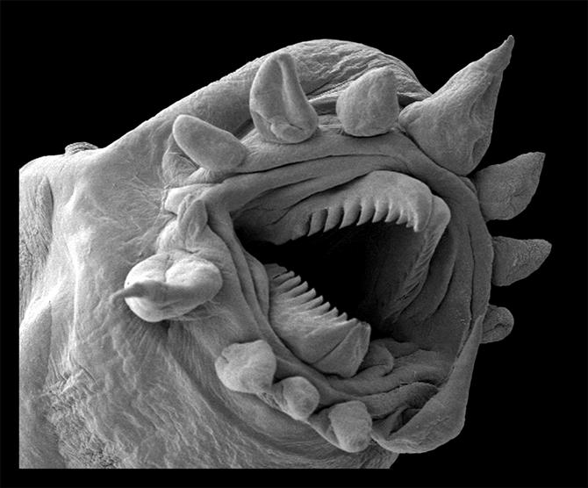
Hydrothermal Worm
Bacteria-sized worms live in the deep sea,
and are mostly found around hydrothermal vents.
It's about half a millimeter long.
Whoa, Dude!

Slide 22
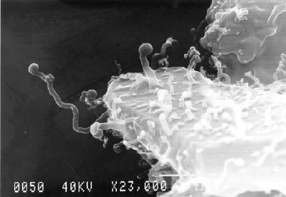
A nanobe is a tiny filamental Structure first found in some rocks and sediments. Some scientists hypothesize that nanobes are the smallest form of life, 1/10 the size of the smallest known bacteria.

Slide 23
Scale of the Universe
From outer edge of the Universe to the opposite edge is about 26 billion light years distance (diameter)
Our Milky Way galaxy is 75,000 light years in diameter. Earth is near the outer edge
The Earth is near the center of the Universe, but on the scale it is 1/30 trillionth in size.
Man is 1/100,000th the size of the earth. Men are larger than the smallest by 35 orders of magnitude (powers of 10) and smaller than the largest by 27 orders of magnitude.
A grasshopper is 1/80th the size of a man.
A dust mite is 1/100th the size of a grasshopper.
A micro, hydrothermal worm or a nanobe is 1/100th the size of a dust mite.
How many galaxies are there? Over 500 billion (500 followed by 9 zeros)
How many stars in one normal size galaxy? Over 2 followed by 11 zeros
How many stars are there? 300 followed by 21 zeros
How many people are there? Over 7 billion (7 followed by 9 zeros).
How many insects are there? 10 followed by 18 zeros.
How many microbes, nanobes, bacteria, or hydrothermal worms are there? Totally unknown. The microscopic world is of the order of the number of stars and more!

Slide 24

What does Scripture contribute to our understanding?
John 1: 3; All things came into being by Him, and apart from Him nothing came into being that has come into being.
Hebrews 4: 13; There is no creature hidden from His sight.
Psalm 147: He counts the stars ; He gives names to them all.
Romans 1: 20; His power is evident in the Creation.
Jeremiah 31: 37; If the heavens above can be measured and the foundations of the earth searched out below…..?
Job 22: 12; Look at the distant stars, how high they are….And you say “What does God know?” Ps. 103: 11; As high as the heavens above the earth.
Matthew 10: 29; Not one sparrow will fall to the ground apart from God’s knowing; the very hairs on your head are numbered. Ps. 11; 1 knows every bird of the mountains. Ps. 116: 15; Precious in the sight of the Lord is the death of one of His godly ones.

Slide 25

What question can we ask?
What kind of Power would God (The Creator) have to have to be able to know about everything He has created?
It would require God to know everything from the edge of the Cosmos to the smallest atom, and even beyond.
And He would have to know everything all at the same time, as we would measure it.
So how do we respond to this truth?
You must decide for yourself!

