Slide 1
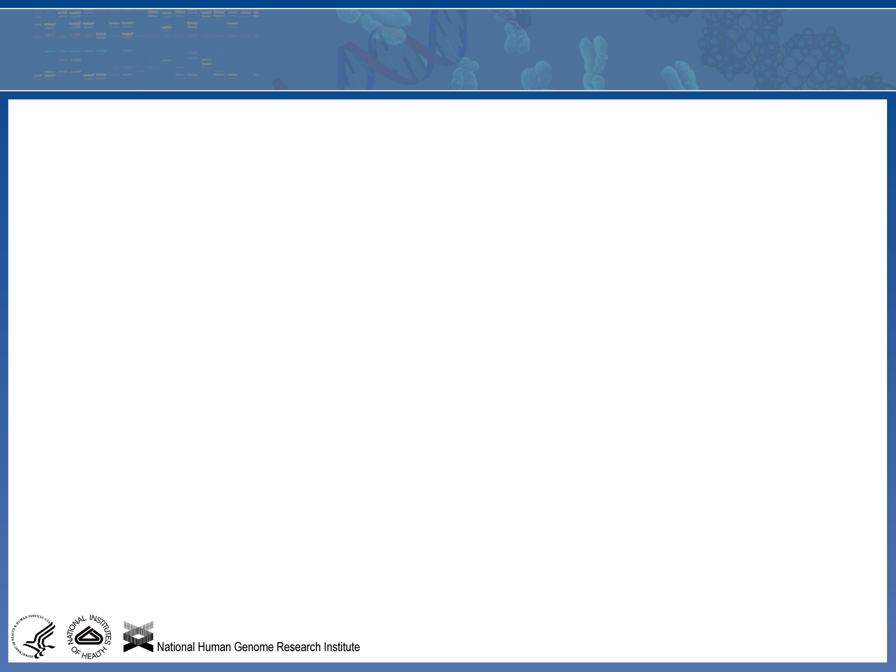
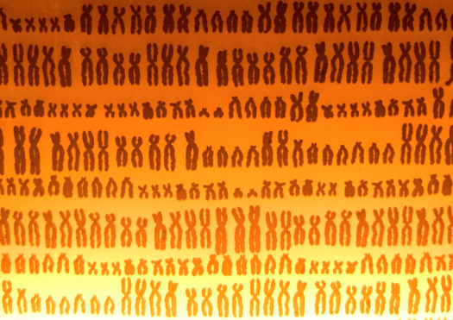
Recent Human Genome Research Supports a Creation Model
April 16, 2013 Linda Walkup PhD

Slide 2

Recent Human Genome Research Supports a Creation Model
April 16, 2013 Linda Walkup PhD
Statement about Evolution, Baylor Biology Department
"Evolution, a foundational principle of modern biology, is supported by overwhelming scientific evidence and is accepted by the vast majority of scientists. Because it is fundamental to the understanding of modern biology, the faculty in the Biology Department at Baylor University, Waco, TX, teach evolution throughout the biology curriculum. We are in accordance with the American Association for Advancement of Science's statement on evolution. We are a science department, so we do not teach alternative hypotheses or philosophically deduced theories that cannot be tested rigorously.”
“Baylor's Christian heritage and identity shape and direct the University's entire mission. Assumptions grounded in faith will make our academic programs both distinctive and excellent…”
Direct quote from the NCSE

Slide 3
Recent Human Genome Research Supports a Creation Model
April 16, 2013 Linda Walkup PhD
Summary:
Majority of Human Genome Declared “Junk” by Evolutionists
Now Found to Be Biologically Active
Thorough, Unbiased Comparison of Chimp and Human Genomes
Puts the Overall Similarity at 70%, not 99%
Notes:
blank

Slide 4
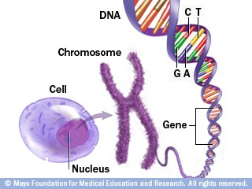
An analogy to the human genome stored on DNA is that of instructions stored in a book:
What is a Genome?
The Instructions for Making a Cell
-The book (genome) would contain 23 chapters (chromosomes)
-Each chapter contains 48 to 250 million letters (A,C,G,T) without spaces
-The book would contain over 3.2 billion letters total
-The book fits into a cell nucleus the size of a pinpoint
Notes:
blank

Slide 5
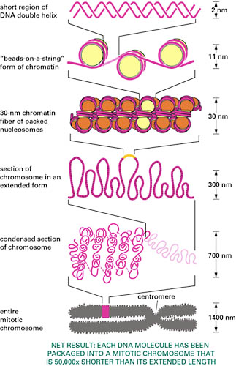
DNA is Packaged and Marked
DNA is Packaged and Marked
-Each chromosome is bookmarked for content and packaged according to its use in a particular place and time
-The same nuclear DNA is present in virtually all cells, but the many genes are only expressed in a certain type of cells at particular point in development
Notes:
blank

Slide 6
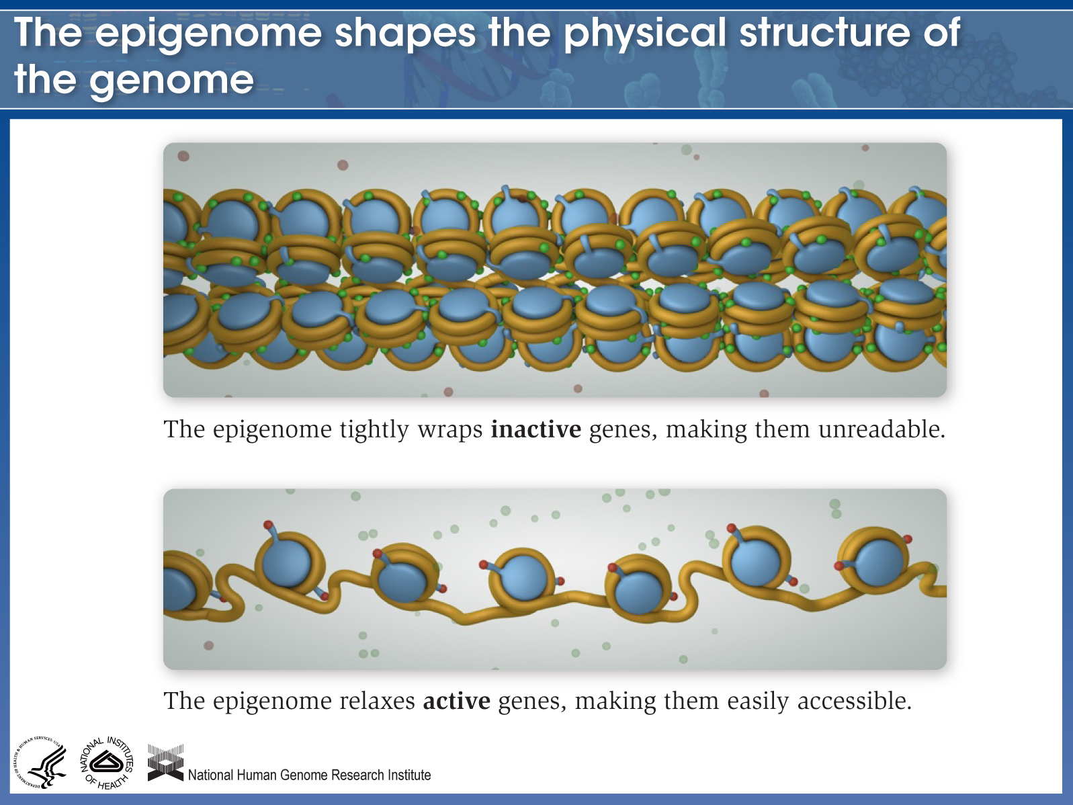

Slide 7
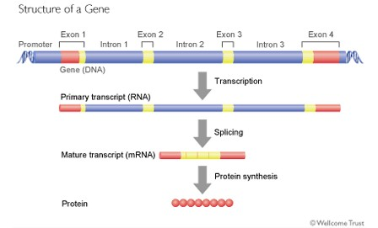
Genes are the Basic Unit of Stored Information
Approximately 2-3% of the DNA in the human genome codes for protein products
About another 2-5% codes for RNA products of known use
Notes:
blank

Slide 8
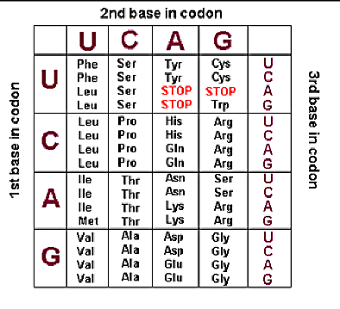
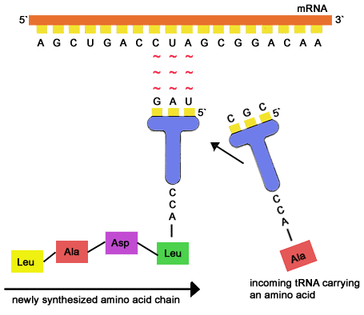
The DNA Contains a Code Encoded by a Designer
The DNA through the RNA must be translated from its triplet code to a chemically
unrelated chain of amino acids to make up a protein

Slide 9
In the Beginning was Information ---
Question from a student on the Human Genome Project website
Answer from a human genome researcher
Who determines the “proper order”? What do adenine-thymine base pairs have to
do with making proteins?
Plans imply encoded information put there by an Intelligent Designer!
Notes:
blank

Slide 10
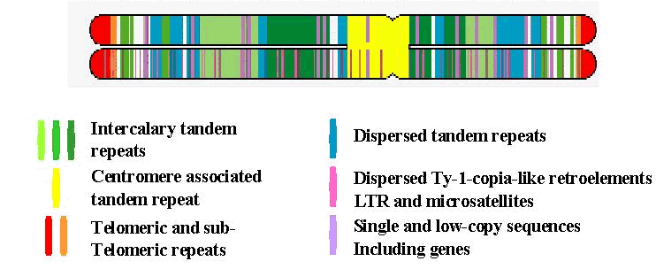
What about the other 95% of DNA in the human genome?
Composition of non-protein coding DNA
Initial sequencing of such DNA revealed several different classes
of repetitive DNA, believed to be remnants of retroviruses, discarded genes and just useless DNA sequences which could could repeat the same sequence of base pairs for thousands of base pairs.
Francis Crick, co-discoverer of the structure of DNA in 1980:
Crick stated that the vast majority of the genome consists of discarded byproducts of millennia of evolution and was “little better than junk”. For scientists to “hunt obsessively” for the beneficial function of such DNA, he argued, would be “folly”.
Notes:
blank

Slide 11
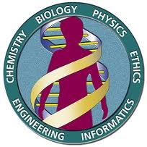
What is the Human Genome Project?
Begun formally in 1990, the U.S. Human Genome Project was a 13-year effort coordinated by the U.S. Department of Energy and the National Institutes of Health. The project originally was planned to last 15 years, but rapid technological advances accelerated the completion date to 2003.
Project goals:
- identify all the approximately 100,000 20,000-25,000 genes in human DNA,
-determine the sequences of the 3 billion chemical base pairs that make up human DNA,
-store this information in databases,
- improve tools for data analysis,
- transfer related technologies to the private sector, and
- address the ethical, legal, and social issues (ELSI) that may arise from the project
Also, to map where the genes are in relation to one another.
Notes:
blank

Slide 12
Surprises found in Drafts of Human Genome
Both the public and private project (Celera Genomics) announced a draft version
covering 90% in 2001.
- 2.85 billion base pairs
Protein coding genes estimated to be just 30,000-35,000
2003 estimate revised downward again to 20,000-25,000, <2% of DNA
Only a few thousand more than a roundworm, less than the plant Arabidopsis
DNA sequence in any two individuals is 99.9% identical
Half of genome consists of highly repetitive DNA
But three times as many proteins had been identified by other means ---where are they coming from?
Notes:
blank

Slide 13
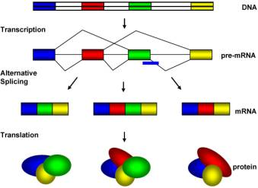
Alternative Splicing of Gene Pieces Creates Protein Variety
Function for Introns
Notes:
blank

Slide 14
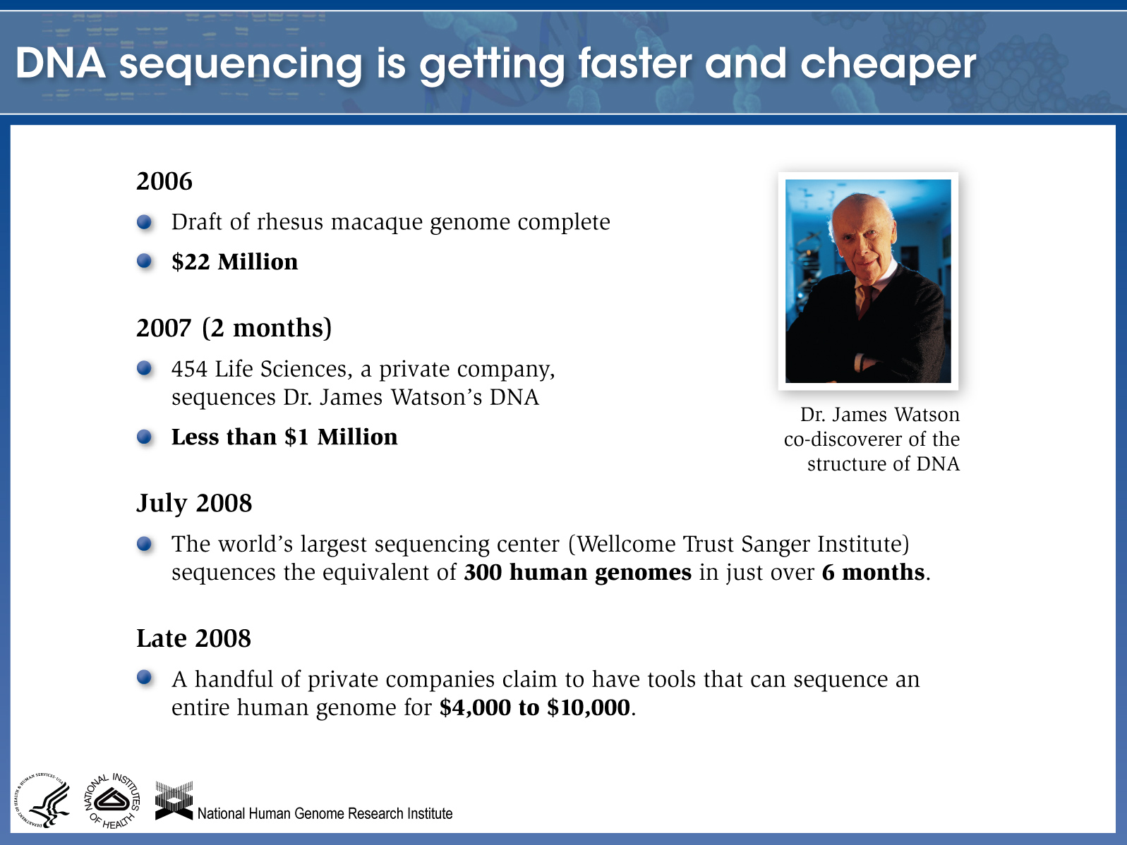
Notes:
Information sources:
(Rhesus macaque) Robert F. Service. Science 311: 5767. 1544-1546 (2006).
454 press release, May 31, 2007. http://www.454.com/about-454/news/index.asp?display=detail&id=68
Wellcome Trust Sanger Institute press release, July 2, 2008. http://www.sanger.ac.uk/Info/Press/2008/080702.shtml
Complete Genomics article in Bio-IT World: http://www.bio-itworld.com/BioIT_Article.aspx?id=82058
Applied Biosystems press release, October 1, 2008. http://phx.corporate-ir.net/phoenix.zhtml?c=61498&p=irol-abiNewsArticle&ID=1207598&highlight=

Slide 15
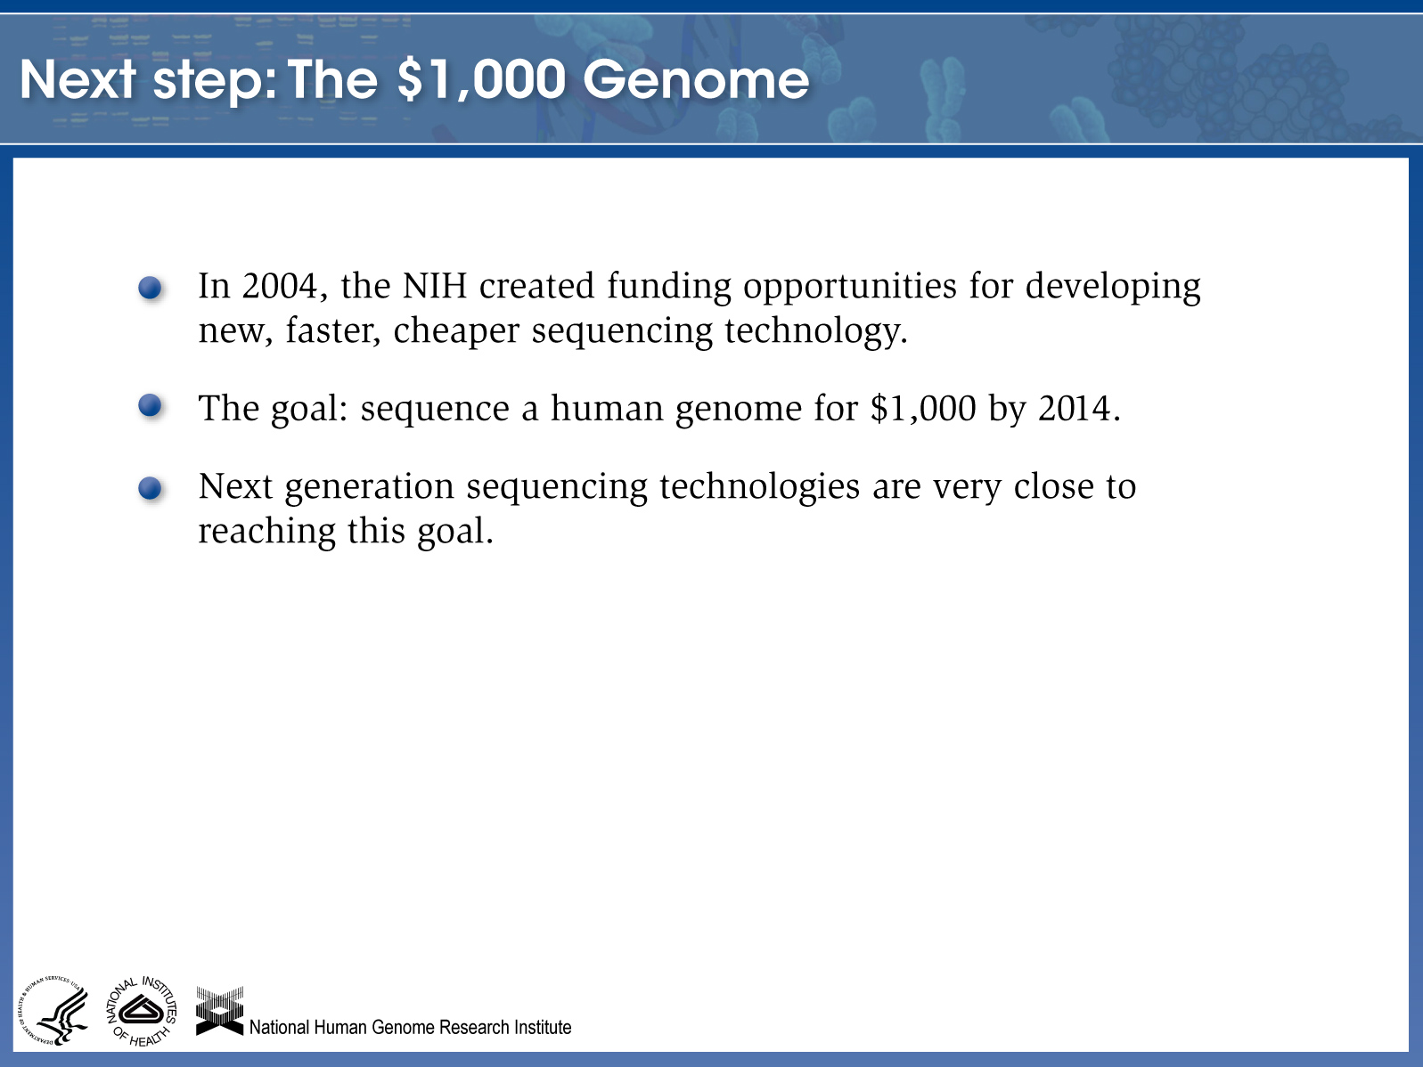

Slide 16
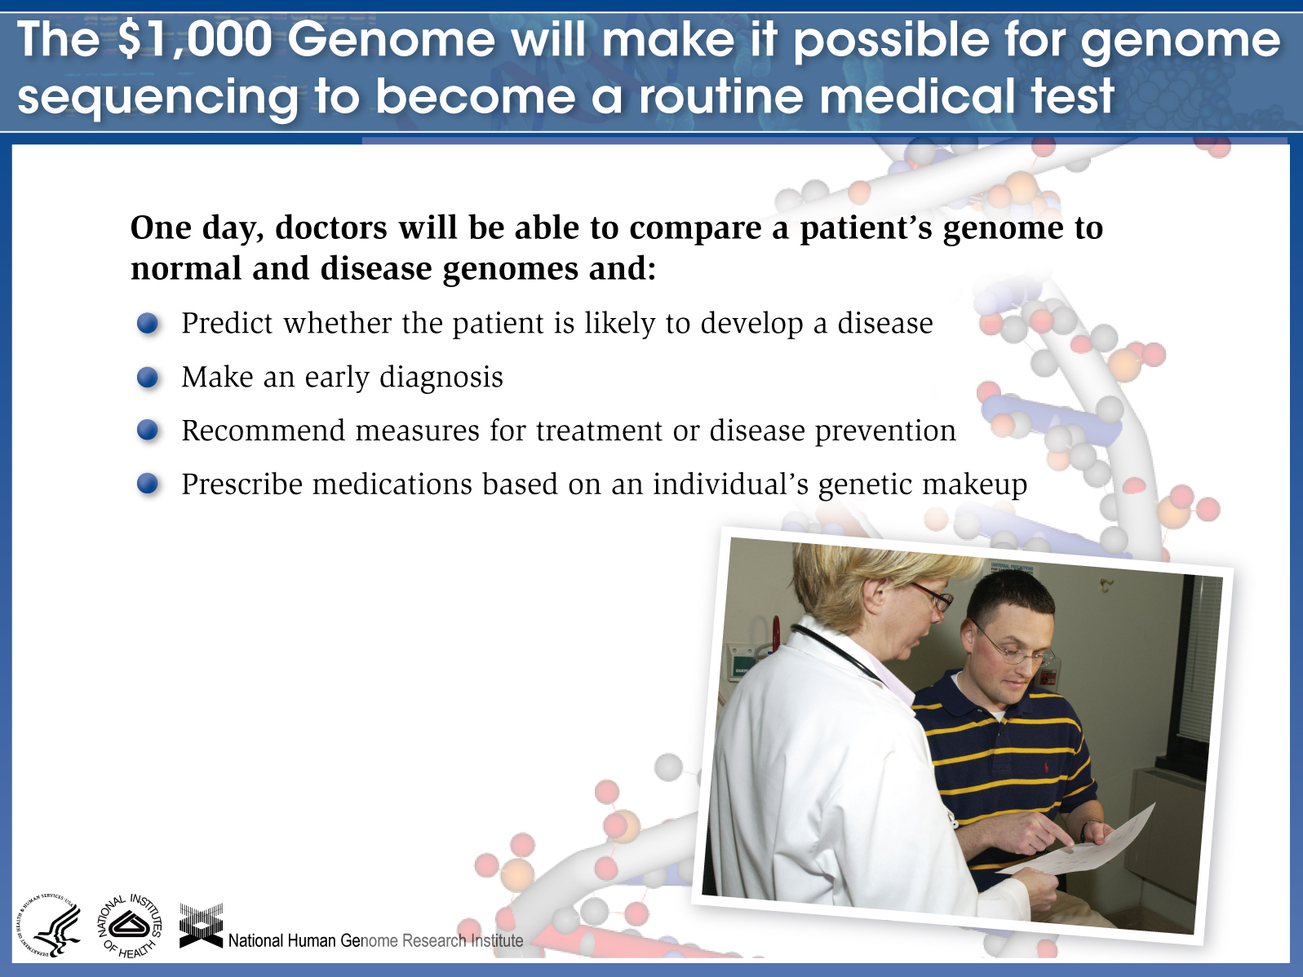

Slide 17
The ENCODE Project: ENCyclopedia Of DNA Elements
Surprising Results of the “Junk” DNA Investigation
-Launched in 2003, ENCODE involved 442 researchers from the US, UK, Japan, Spain
and elsewhere.
-Initial results published in 2007 suggested many previously unrecognized regulatory
and transcriptionally active sequences
-Mapping of genetic markers associated with diseases kept pointing to non-coding DNA
-September 5, 2012 – 30 papers published on final results: with the help of new, rapid
sequencing technology, they discover the presence of 4 million switches that turn genes
on and off in the previously dismissed “junk DNA” regions
-These regions were often very distant from the genes they regulated, but evidently
fold and bend to the site of gene regulation, interacting via RNA and proteins
-At least 80% of human DNA is biochemically active, and is vital to the proper functioning
of the human body --- IMAGINE THAT!
Notes:
blank

Slide 18
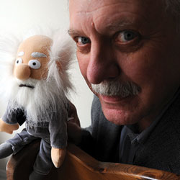
“Junk” DNA Debunked
"During the early debates about the Human Genome Project, researchers had predicted that only a few percent of the human genome sequence encoded proteins, the workhorses of the cell, and that the rest was junk. We now know that this conclusion was wrong," said Eric D. Green, M.D., Ph.D., director of the National Human Genome Research Institute (NHGRI), a part of the National Institutes of Health. "ENCODE has revealed that most of the human genome is involved in the complex molecular choreography required for converting genetic information into living cells and organisms."
The creationists are going to love this,” complained resercher Larry Moran. “This is going to make my life very complicated.”
Notes:
Dan Graur, a professor of molecular evolutionary bioinformatics at the University of Houston, is the lead author of a seething response to a global consortium of genetics and bioinformatics researchers that provoked plenty of frustration from evolutionary biologists.
“Big science, like the Human Genome Project, should publish data. Small science should do the analysis.”One of the key complaints: That Encode authors are computational scientists, not biological scientists. "They're computer jocks," as Graur put it. "Big science, like the Human Genome Project, should publish data. Small science should do the analysis."
In evolutionary biology, “function” is a loaded word--an organ, a piece of DNA or a cell can perform a function that’s selected for, and a function that’s causal. Selected functions are things that confer an evolutionary advantage, while causal functions don’t, to put it very simply.

Slide 19
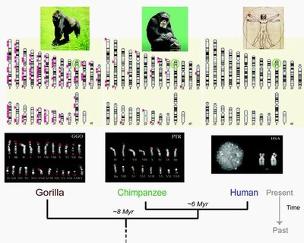
You Can’t Make a Monkey Out of Me
Notes:
blank

Slide 20
How should we compare genetic sequences?
Methods of comparison – What sequences should we be comparing?
- Equivalent genes from both species? But functions the same, so expect sequence similarity
- Non-coding, presumably “junk” DNA sequences in between genes? They are proving to
be functional, thus also resistant accumulation of mutation
- General gene and sequence family arrangements on chromosomes? Yes, but we are just
learning that even small changes can have large phenotypic effects
- Current methods of analysis – Large segment of genome sequence alignment, sequencing
and matching large chromosomal fragments, now even whole genome comparisons
The online availability of the 2005 draft of the chimpanzee genome, and a recent more
detailed update allow more comprehensive and unbiased comparison of large
segments of the two genomes by any researcher --- even creation researchers!
Notes:
blank

Slide 21

High Sequence Similarity Between Human and Chimp?
Partly a Product of What is Compared
Example of the myth perpetuated:
“Bonobos Join Chimps as Closest Relatives”
June 13, 2012” – Nature 486(7404):527-531
On average, the two alleles in single-copy, autosomal regions in the Ulindi genome are
approximately 99.9% identical to each other, 99.6% identical to corresponding sequences in
the chimpanzee genome and 98.7% identical to corresponding sequences in the human
genome.
But this is comparison of protein-coding genes only, and deliberately excludes the sex chromosomes, which show a huge difference between humans and apes.
Ulindi, the bonobo or pygmy chimpanzee (Pan paniscus) whose genome was sequenced
Evolutionary assumption:
Similarity = related by descent
Notes:
We find that more than three per cent of the human genome is more closely related to
either the bonobo or the chimpanzee genome than these are to each other.

Slide 22
DNA Analysis Is Not Independent of Evolutionary Assumptions
How do we know what sequence is the “ancestral” one?
“Researchers can reconstruct ancestral Y chromosome DNA sequences by reversing mutated DNA segments to their original condition. The most likely original or ancestral state of a DNA sequence is determined by comparing human DNA sequences with those of a closely related species, usually non-human primates such as chimpanzees and gorillas. “ From Y chromosome mutation report
-Ancestral relationship is assumed
-Accumulation of differences through time uses fossil record as a measuring stick for “time since split from common ancestor”
Notes:
blank

Slide 23
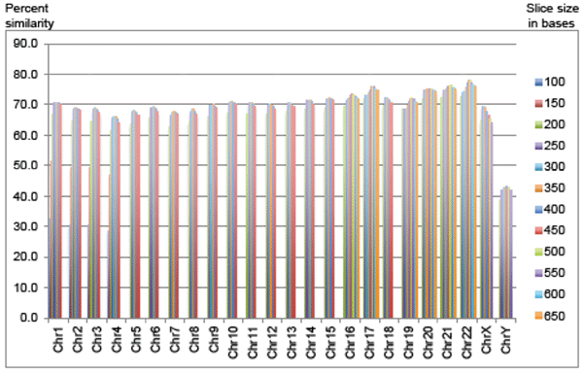
Complete Genomic Comparison Between Human and Chimp
Reveals Only 70% Similarity
From Tomkins, ARJ 6(2013):63-69
Using BLASTN (Basic Local Alignment Search Tool
Notes:
Using a range of smaller sequence slices for queries would not only allow for individual chromosome optimization, but would also increase alignment levels because it would be irrespective of gene/feature linear order. Therefore, a comprehensive chromosome-by-chromosome genome comparison between chimpanzee and human was undertaken using a complete range of sub-experiments based on different chimp DNA sequence slices.The most recent version of the chimpanzee chromosome assembly (aligned and anchored to human) was downloaded from the UCSC Genome Browser site. On an individual chromosome basis, new fasta query subfiles were created that produced fasta header line demarcated query files with sequences of 100 to 450 bases in 50-base increments for chimp chromosomes 1 to 4.

Slide 24
Similarities Ranged from a 77.9% to 43.2% --- Average of 70%
Chromosomes compared | Optimized slice size (number bases) | Percent chimp sequence aligned to human
1 | 350 | 70.9
2A, 2B vs. 2 (h) | 300 | 69.0
3 | 300 | 68.9
4 | 300 | 66.1
20 | 400 | 75.2
21 | 500 | 76.2
22 | 450 | 77.9
X | 300 | 69.4
Y | 400 | 43.2
Results were chosen to maximize similar sequence alignments, and gaps between non-aligning areas were not counted
Notes:
he definition of similarity for each chimp chromosome was the amount (percent) of optimally aligned chimp DNA (minus ‘N’s). This definition was considered to be quite conservative because it did not include the amount of human DNA absent in the chimp genome nor does it include chimp DNA that could not be aligned to the human genome assembly—a category of chimp DNA termed “unanchored contigs”. The inclusion of chimp DNA not able to be aligned and anchored to human, although negligible for most chromosomes, would have produced slightly lower overall similarities. nterestingly, the one autosome (chromosome 22) that was selected by secular researchers in 2004 for extensive comparison to human (Watanabe et al. 2004) also happens to be the most similar chromosome in the chimp genome at 77.9% in the present study. Furthermore, Watanabe et al. omitted large sections of chromosome 22 that contained extreme dissimilarities. The MSY regions of the chimp and human Y-chromosomes were recently compared in great detail and found to be extremely dissimilar in not only DNA sequence similarity, but also gene content (Hughes et al. 2010). This present study confirms the striking difference between human and chimp Y chromosomes, and indicates that these differences are still being largely understated.

Slide 25
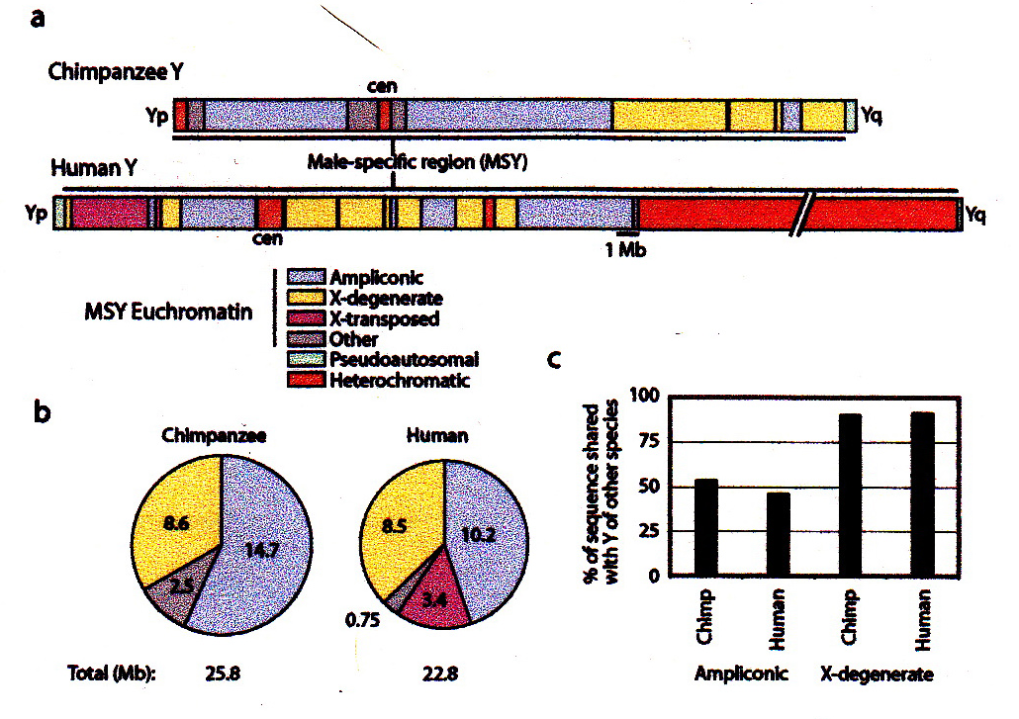
Chimp/Human Y chromosomes differ by 30% in the
MSY region - from Hughes, et al, 2010
-Chimp Y chromosome lacks 50%
of the genes found on the human Y
- The Y chromosomes are as different from each other as the human’s and the chicken’s!
Notes:
Not only were the locations of DNA categories completely different between human and chimp, but so were their proportions. One sequence class, or category containing DNA with a characteristic sequence, within the chimpanzee Y chromosome had less than 10 percent similarity with the same class in the human Y chromosome, and vice versa. Another large class shared only half the similarities of the other species, and vice versa. One differed by as much as 3.3-foThld (330 percent), and a class specific to human "has no counterpart in the chimpanzee MSY [male-specific Y chromosome]."¹ The Y chromosome also has much less variation in its DNA than other types of DNA, meaning that the sex chromosomes in two men will look more alike than other chromosomes do --- so intraspecies changes are very slow.
As far as looking at specific genes, the chimp and human Y chromosomes had a dramatic difference in gene content of 53 percent. In other words, the chimp was lacking approximately half of the genes found on a human Y chromosome. Because genes occur in families or similarity categories, the researchers also sought to determine if there was any difference in actual gene categories. They found a shocking 33 percent difference. The human Y chromosome contains a third more gene categories--entirely different classes of genes--compared to chimps. "Indeed, at 6 million years of separation, the difference in MSY gene content in chimpanzee and human is more comparable to the difference in autosomal gene content in chicken and human, at 310 million years of separation."¹

Slide 26
Evolutionary Assumptions About the Genome Have Hindered Progress
--Assuming the majority of the human genome consisted of evolutionary
discards has slowed the investigation into its true function
-- Assuming the common descent of apes and humans has biased the interpretation of important sequences determining what makes us human biologically
Understanding the fact of CREATION is fundamental to
understanding biology, our world, and our place in it!
Notes:
blank

Slide 27
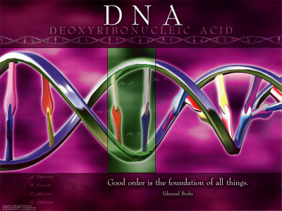
Happy DNA Day! April 19, 2013
Celebrate the wonder and complexity of what God has created and made!
Notes:
blank

Slide 28
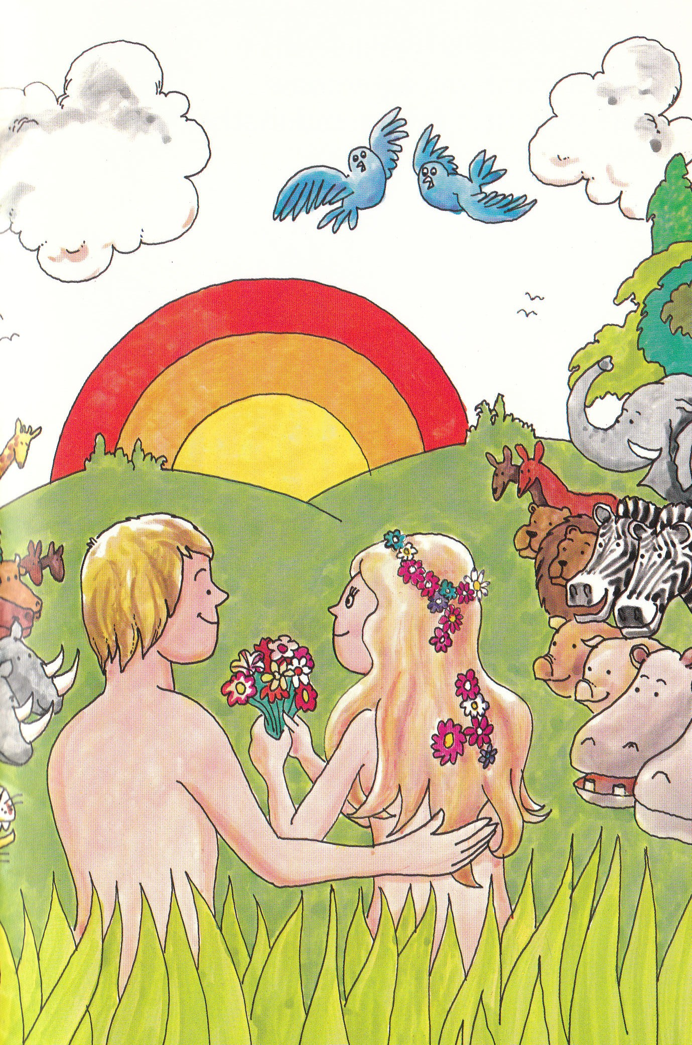
Resources Available for Further Study
Comprehensive Analysis of Chimpanzee and Human Chromosomes Reveals Average DNA Similarity of 70% - Jeffrey Tomkins, Answers Research Journal (online) 6(2013):63-69
The Myth of Junk DNA – Jonathan Wells, 2011, Discovery Institute Press
The Bible – Genesis and following
So God created man in His own image; in the image of God He created him; male and female He created them… Then God saw everything that He had made, and indeed it was very good.
Notes:
blank

