Slide 1
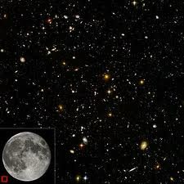
The Foundations and Implications of a Biblical Worldview
CSF Presentation
June 19, 2012
By David L. Broersma, D.Min.

Slide 2

Lessons from a Fish Pond…

Slide 3
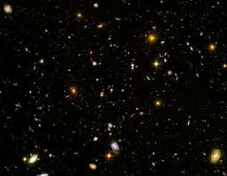
Ways to think about Worldviews…
Historical –how and when this kind of thinking began
Philosophical –how the basic categories of thought apply to worldviews & belief systems
Experiential –how a worldview actually impacts life on a daily & practical basis
Biblical –how the Bible relates to overall worldview considerations

Slide 4
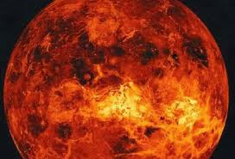
How to understand worldviews…
A worldview is a conceptual scheme by which we, consciously or unconsciously, place or fit everything we believe in life
We use our worldview to interpret and judge what we perceive as reality
A worldview is often described as the lens through which we view the world and the means by which we make sense of it

Slide 5
Development of the worldview approach
The German term 'Weltanschauung‘ is used to refer to the "wide worldview" or "wide world perception" of a people, family, or person
It was used first by Kant and later popularized by Hegel and was used in German, and later in English, to refer to philosophies, ideologies and cultural or religious perspectives
Worldview can be expressed as the fundamental cognitive, affective, and evaluative presuppositions a group of people make about the nature of things, and which they use to order their lives

Slide 6
Development of the worldview approach
The Christian thinker James W. Sire defines a worldview as "a commitment, a fundamental orientation of the heart, that can be expressed as a story or in a set of presuppositions (assumptions which may be true, partially true, or entirely false) which we hold (consciously or subconsciously, consistently or inconsistently) about the basic construction of reality, and that provides the foundation on which we live and move and have our being."

Slide 7
Development of the worldview approach
Sire suggests that “we should all think in terms of worldviews, that is, with a consciousness not only of our own way of thought but also that of other people, so that we can first understand and then genuinely communicate with others in our pluralistic society.” (The Universe Next door, 2004)

Slide 8
Development of the worldview approach
The philosophical importance of worldviews became increasingly clear during the 20th Century for a number of reasons, such as increasing contact between cultures, and the failure of some aspects of the Enlightenment, such as the rationalistic idea of attaining all truth by reason alone. Mathematical logic showed that fundamental choices of axioms were essential in deductive reasoning and that, even having chosen axioms not everything that was true in a given logical system could be proven.

Slide 9

Development of the Christian worldview approach (1)
The first modern Christian thinker to utilize the worldview approach to defend his Christian faith was the Scottish theologian James Orr in his book “The Christian View of God and the World” (1893)
In the late 1930’s Gordon Clark began to develop his own worldview approach in his philosophy and apologetics classes at Wheaton College

Slide 10
Development of the Christian worldview approach (2)
One of Clark’s early books was titled “A Christian View of Men and Things”
Two of his students at Wheaton who utilized the worldview approach were Carl F. Henry and Edward J. Carnell
The one who most popularized this worldview approach to Christianity was Francis Schaeffer
He used this approach to develop and promote a Christian view of culture

Slide 11
Development of the Christian worldview approach (3)
Conclusion: The worldview approach developed in response to faulty enlightenment thinking (esp. rationalism) and the need to address the increasing pluralism of the world due to significant advances in communication and transportation
As people had greater contact with others with differing views, it became increasingly necessary to distinguish beliefs and truth claims

Slide 12
Development of the Christian worldview approach (4)
In addition, as more fundamental issues were being discussed, it became necessary to think through the implications of these views
Matters of cosmology, theology, anthropology, and ontology became major areas of disagreement with huge implications on the philosophical and practical levels
It will be helpful to consider the philosophical underpinnings of all worldviews…

Slide 13
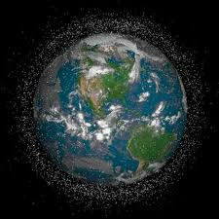
Philosophical Underpinnings of all Worldviews
Philosophy deals with the matters of “why”
Young children point out this critical element with all of their “why” questions as they try to make sense of their world
The highest levels of educational pursuit deal with the matters of philosophy
A “world” view is essentially an informal philosophy of life
The objective here is to consider it formally…

Slide 14
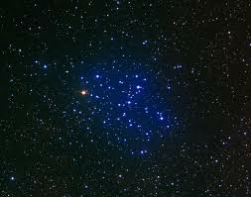
The major categories of philosophy:
-Metaphysics –The branch of philosophy that deals with the nature of reality –What is ultimately real?
-Epistemology –The branch of philosophy that deals with the nature, sources, and validity of knowledge –What is true? How do we know?
-Axiology –The branch of philosophy that deals with matters of value –What is of value, what is right, what is good, what is beauty?

Slide 15
The major categories of philosophy:
Some practical questions…
-How does this designation handle the hard sciences?
-Where does cosmology fit into this grid?
-What is the place of empiricism?
-What is the place of history, mathematics, art?
-How comprehensive is this designation?

Slide 16

Philosophical Underpinnings of all Worldviews -Metaphysics
Metaphysics –What is real? –root meaning…
-Is this perhaps too simplistic or unnecessary?
-Isn’t the average person quite sure of the reality of his or her world?
-Just open your eyes and look at the decor on the wall, listen to the traffic, touch the floor beneath you; aren’t they all quite real?

Slide 17
Consider some levels of perception… (1)
Consider the floor beneath you:
What exactly is the reality of the floor ?
-It may seem to have a rather straight-forward existence –flat, solid, specific color & covering
-It is composed of identifiable materials: concrete, wood, fiber; it supports your weight
-At first glance, this is the reality of the floor…

Slide 18
Consider some levels of perception… (2)
The view of a physicist: the floor is made of molecules and these consist of atoms which are made up of electrons, neutrons, and protons, and these consist of electrical energy alone
-Essentially the floor is a hotbed of molecular motion in which there is more space than matter…

Slide 19
Consider some levels of perception… (3)
The view of the chemist: this view of the reality of the floor is that it is a body of hydrocarbons associated in a particular way and subject to certain kinds of environmental influences, such as heat, cold, wetness, dryness, and oxidation
This points out that reality is not as simple as it might seem at first glance
If the reality of the common floor has multiple levels, what about the larger matters of life?

Slide 20
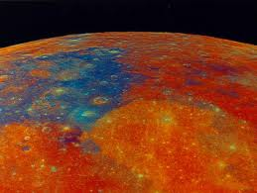
The Aspects of Metaphysics (1)
This realm of consideration deals with the most general and basic questions that can be asked
The answers to these questions are needed before people can find satisfactory answers to their more specific questions
The complete verification of any particular answer to these questions is beyond the realm of human demonstration

Slide 21
The Aspects of Metaphysics (2)
This does not make the discussion of these issues irrelevant, or a mere exercise in mental gymnastics, since people, whether they consciously understand it or not, base their daily activities and long range goals upon a set of metaphysical beliefs
No one can escape metaphysical concerns
Metaphysical constructs lie at the foundation of the modern sciences –beyond physical [=belief]

Slide 22
The Aspects of Metaphysics (3)
It essentially represents the speculative and synthesizing activities of philosophy, and it provides the theoretical framework that allows scientists to create worldviews and develop hypotheses that can be tested according to their assumptions
Thus, theories of science are ultimately related to theories of reality, and the philosophy of science underlies scientific experimentation

Slide 23

The Aspects of Metaphysics (4)
It should be recognized that scientists are at times tempted to make interpretations that go beyond the “facts” of the answers to their relatively narrow questions
Such have invaded the realm of supplying metaphysical answers
That is the position of scientists who make positive statements about either creation or evolution

Slide 24
The Aspects of Metaphysics (5)
They have gone beyond their experimental facts and assumed the role of metaphysician
This may be well, in and of itself, as long as both they and their students consciously realize that they have exited the realm of science and entered that more basic world of metaphysics

Slide 25
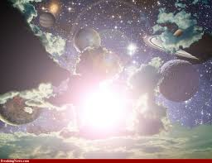
The Critical Questions of Metaphysics (1)
Metaphysical questions may be divided into four subsets…
1. The Cosmological –This consists in the study of theories about the origin, nature, and development of the universe as an orderly system
The matters of cosmology include the origin and development of the universe, the question of the purpose of the universe, and the nature of time and space

Slide 26
The Critical Questions of Metaphysics (2)
How did the universe originate and develop?
-The answers people give are seen as various points on a continuum between the polar extremes of design and accident…
Is there any purpose to the universe?
-There are three main responses:
-teleological –theism
-randomness –naturalism
-circularity in history –transcendentalism

Slide 27
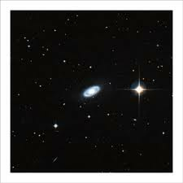
The Critical Questions of Metaphysics (3)
2. The second metaphysical aspect is the theological –it is related to the cosmological
Theology is that part of religious theory that has to do with conceptions of and about God
Such considerations include: Is there a God? If so, is there one or more than one? What are the attributes of God? If God is all good and all powerful, how is it that evil exists? Are there such being as angels, Satan, and the Holy Spirit?

Slide 28
The Critical Questions of Metaphysics (4)
People answer these questions in various ways:
-Atheists claim that there is no God
-Pantheists claim that God equals the universe
-Deists see God as a detached creator
-Theists understand God as a personal creator
-Polytheists see a plurality of deity

Slide 29
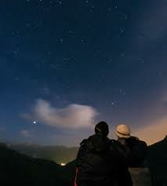
The Critical Questions of Metaphysics (5)
3. A third aspect of the metaphysical is the anthropological –the study of mankind
This is a unique category because man is both the subject and the object of the study
This aspect considers matters such as: What is the relationship between mind and body? Is there interaction between mind and body? Is mind more fundamental than body, with body depending on mind, or visa versa?

Slide 30

The Critical Questions of Metaphysics (6)
What is mankind’s moral status? Are people born good, evil, or morally neutral?
To what extent are individuals free? Do they have free will, or are their thoughts and actions determined by their environment and inheritance?
Does an individual have a soul? If so, what is it?
People have obviously adopted various positions on these questions with implications

Slide 31
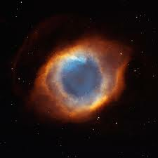
The Critical Questions of Metaphysics (7)
4. A fourth aspect of the metaphysical is the ontological –the study of being
Ontology is the study of existence, or what it means for anything to be
The ontological task is to determine what we mean when we say that something is
There are several questions which are central to ontology:

Slide 32
The Critical Questions of Metaphysics (8)
Is basic reality found in matter or physical energy (the world we can sense), or is it found in spirit or spiritual energy?
Is it composed of one element (e.g., matter or spirit), or two (e.g., matter and spirit), or many?
Is reality orderly and lawful in itself, or is it merely orderable by mankind?
Is it fixed and stable, or is change its central feature?
Is reality friendly, unfriendly, or neutral to us?

Slide 33
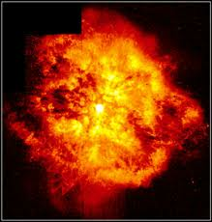
The Critical Questions of Metaphysics (9)
Even a cursory glance at either historical or contemporary societies will indicate the impact of the cosmological, theological, anthropological, and ontological aspects of metaphysics upon their social, religious, political, economic, and scientific beliefs and practices
People everywhere assume answers to these questions and then turn around and operate their daily lives on those assumptions

Slide 34
The Critical Questions of Metaphysics (11)
The questions of metaphysics are important
They have implications that are far reaching
They would seem to need some basis greater than mere assumption since we base our lives on our views of reality
Is there any way we can determine the certainty or truth of our perceptions of what is real –this is the realm of epistemology –what is true?

Slide 35
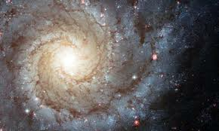
Philosophical Underpinnings of all Worldviews -Epistemology
This is the branch of philosophy which studies the nature, sources, and validity of knowledge
It seeks to answer such questions as “What is true?” and “How do we know?”
Since the study of epistemology deals with such issues as the dependability of knowledge and the propriety of various methods of reaching warrantable truth, it stands with metaphysics at the very center of distinguishing worldviews

Slide 36
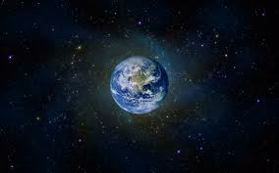
Epistemology & the dimensions of knowledge (its nature)
1. Can reality be known?
-In contrast to the skeptic or classic agnostic
2. Is truth relative or absolute?
-Is it subject to change, is it determined by us…?
3. Is truth/knowledge subjective or objective?
-Three basic positions: Are we recipients only, participants, or manufacturers of truth?
4. Is there truth independent of human experience? –Is knowledge a priori or a posteriori (1 + 1 = 2)

Slide 37
Epistemology & the sources of knowledge
The Senses (empiricism)
Revelation (supernaturally revealed truth)
Authority (tradition or society authorized)
Reason (rationalism –use of reasoning, logic)
Intuition (unconscious insight, feeling certain)
The complementary nature of knowledge sources…
Is there one source that trumps the others?

Slide 38
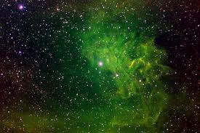
Epistemology & the validity of knowledge
The correspondence theory –truth is faithfulness to objective reality (that which corresponds with “fact”) –whatever that is…
The coherence theory –consistency with all of one’s judgments –requires a proper foundation
The pragmatic theory –whatever works is valid or true (focuses on utility, workability, or satisfactory consequences) –leads to relativism

Slide 39
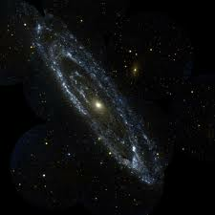
Philosophical Underpinnings of all Worldviews –Axiology
Axiological systems are built on conceptions of reality (metaphysics) and truth (epistemology)
The concerns of axiology –What is of value?
Humans desire some things more than others
Much of life is based on a system of values
The question of values deals with notions of what a person or society conceives of as being good or preferable –this is a potential source of conflict when people have differing values

Slide 40
-The elements of axiology
1. Ethics –the study of moral values and conduct
It deals with the questions, “What should I do?” “What is the good life for all people?” and “What is good conduct?
Ethics issues that tend to divide people…
-Are ethical standards and values absolute?
-Do universal morals and values exist?
-Does the end ever justify the means?
-Who or what is the basis of ethical authority?

Slide 41
-The elements of axiology
2. Aesthetics –the realm of value regarding beauty and art
Aesthetics deals with the theoretical aspects of art in its widest sense and should not be confused with actual works of art or the technical criticism of them
Aesthetic valuation is a part of daily experience and cannot be avoided
Are there any inherent principles or boundaries

Slide 42
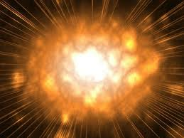
The metaphysical-epistemological dilemma
There is a problem with our presuppositions regarding our understanding of reality and knowledge/truth –Which comes first?
It is not possible to make statements about reality without first having a theory for arriving at truth
And such a theory cannot be developed without first having a concept of reality
So we are caught in a web of circularity…

Slide 43

The metaphysical-epistemological dilemma
Through the study of basic questions, people are forced to realize their smallness and helplessness in the universe
They realize that nothing can be known for certain in the sense of final and ultimate proof that is open and acceptable to all people
Every person, the skeptic and the agnostic, the scientist and the businessman, the Hindu and the Christian, lives by faith!

Slide 44
The metaphysical-epistemological dilemma
The acceptance of a particular position in metaphysics and epistemology is a faith-choice made by individuals, and it entails a commitment to a way of life
The circular nature of the reality-truth dilemma is not the most comforting aspect of philosophical thought, but it points out that we are all in the same boat –living by faith
So is there any other validation for our views?

Slide 45
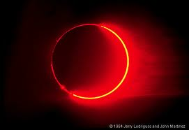
What is an adequate test for the validity (truth) of a worldview?
Consider the following suggested tests…
1. Fideism –the view that there are no rational ways to justify one’s beliefs; faith alone is necessary
But this is not actually a test for truth, but an unsubstantiated belief; there may be conflicting beliefs that are actually contradictory but held with equal passion –both cannot be true in the same way at the same time

Slide 46
Consider the following suggested tests…
2. Rationalism –The view that stresses reason or rational explanations; use of logic
This proves only the possibility of a view, not the actuality
3. Experientialism –the view that experience is a test for truth since all knowledge begins with sense experience
Experience is neither true nor false and it may be conflicting

Slide 47
Consider the following suggested tests…
4. Revelationism –The view that special revelation is the test for truth
But it is a claim to truth, not a test; in fact it is a form of fideism –one is simply to accept by faith, not evidence, and there may be conflicting claims

Slide 48
Consider the following suggested tests…
5. Evidentialism (factualism)–The view that evidence or facts are the test for the truth of a worldview
But facts, as such, are neither true nor false and do not establish truth, and may be used in conflicting truth claims and frameworks

Slide 49
Consider the following suggested tests…
6. Non-contradictionism (systematic consistency) –The view that the truth is found in the system which maintains logical consistency with itself
But the law of non-contradiction only shows the possibility of truth, and it is possible for more than one worldview to be non-contradictory

Slide 50
Consider the following suggested tests…
7. Pragmatism –The view that whatever gets desired results is true, the end justifies the means
But the desired results may be unrelated to the truth of the view (i.e. lying); pragmatism does not establish what is true but simply what works

Slide 51
Consider the following suggested tests…
8. Supernaturalism –The view that supernatural events (i.e. miracles) prove a worldview to be true
But supernaturalism presupposes the truth of a worldview and there are conflicting truth systems which claim supernatural support

Slide 52
Consider the following suggested tests…
9. Combinationalism (systematic coherence) –The view that combines evidentialism and non-contradictionism as a test for truth
But combining two inadequate views does not make an adequate one, and a number of opposing worldviews may be equally systematically coherent
Ill: leaky buckets

Slide 53
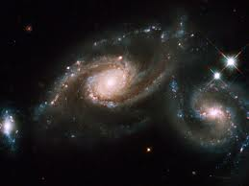
Is there an Adequate Test for Truth?
Undeniability is an adequate test for the truth of a worldview
-What is actually undeniable is true
-What is actually unaffirmable is false
-Undeniability is exclusive; it can eliminate some statements as false
-Undeniability is inclusive; it can establish statements as true

Slide 54
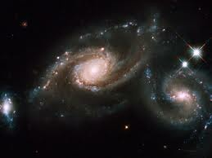
Undeniability…
2. On this test for truth theism can be shown to be true and non-theisms can be shown to be false
-Each premise within the theistic argument is undeniably true
-At least one central premise in each non-theism is unaffirmable and false

Slide 55
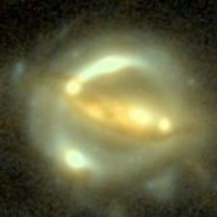
Undeniability…
3. Once theism is established as true, undeniably, Christian theism can be established over other theisms (Muslim, Jewish) by supernaturalism and/or systematic coherence

Slide 56
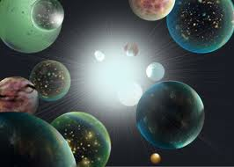
The Argument for Theism using Undeniability as the Initial Test for Truth
1. Some things undeniably exist (I cannot deny my own existence)
2. Since I undeniably exist, I am either Necessary Being or contingent being (independent or dependent)
a. If necessary being exists at all, certain things must be true:

Slide 57
The Argument for Theism using Undeniability as the Initial Test for Truth
-Necessary Being must exist (by definition) and would be changeless, not limited by time or space, eternal, singular and uncomposed, infinite, uncaused, and unlimited in power…
b. Whatever is temporal, limited, changing, composed, finite, or caused is contingent
3. I am not necessary existence (both obviously and undeniably)
4. Therefore, I am a contingent being

Slide 58
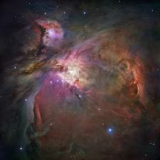
The Argument for Theism using Undeniability as the Initial Test for Truth
5. Every contingent being is ultimately caused by a Necessary Being
6. On this basis other naturalistic arguments for the existence of God are valid and applicable:
-Cosmological –an effect calls for first cause
-Teleological –calls for an intelligent designer
-Anthropological –calls for a personal 1st cause
-Ontological –calls for a perfect 1st cause

Slide 59
The Argument for Theism using Undeniability as the Initial Test for Truth
7. Therefore, there exists a first cause of all contingent beings that is necessary, immutable, eternal, infinite, one, uncaused, all-knowing, all-powerful, all-loving, and personal

Slide 60
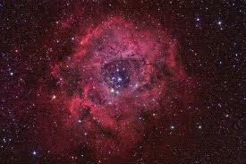
The Argument for Theism using Undeniability as the Initial Test for Truth
8. Whatever is all this is appropriately called God
a. He is the creator of all else that exists, is unique or one of a kind, is the ultimate and absolute basis of all good
b. Thus as ultimate worth, He is worthy of our worth-ship (worship)
c. The ultimate object of our worship is what we mean by the term God
d. Therefore, this being is appropriately God

Slide 61
The Argument for Theism using Undeniability as the Initial Test for Truth
9. This God is identical with the one described in the Judeo-Christian Scriptures (This means that the God of the Bible exists)
10. This God is identical with the God of classic theism –as distinct from:
-Atheism –which holds that the universe as a whole is necessary and uncaused (but the observable universe is changing and a necessary being cannot change)

Slide 62
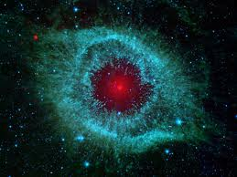
Theism is distinct from…
-Deism –which holds that God cannot (or does not) intervene in the world (An all-loving God would be interested enough and an all-powerful God would be capable of intervening in the world)
-Polytheism –which holds that there are many finite gods (There can only be one necessary being)

Slide 63
Theism is distinct from…
-Finite Godism –which holds that God is finite, changing, and temporal (But God is infinite, unchanging, and eternal)
-Pantheism –which holds that God is identical with all there is (However, I exist as a contingent being and am distinct from God)

Slide 64
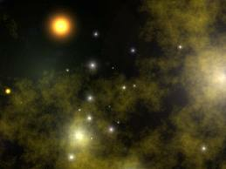
Further Implications of Theism…
1. Since theism is true, miracles are possible
2. The possibility of miracles substantiates the claims of the New Testament
3. The NT records that Jesus claimed to be God, and His deity was confirmed by miracles
4. Therefore, Jesus is God
5. Jesus affirmed the Bible to be the Word of God
6. Therefore, the Bible is the Word of God

Slide 65
Further Implications of Theism…
7. If the Bible is the Word of God, then we should take the account of Genesis as true and accept the view of creation as it is presented (as distinct from any other competing views)
8. Then the biblical worldview is validated and the presentation of reality (metaphysics) as presented in the Bible is true (the epistemological basis) and then the values prescribed in the Bible are correct (axiology)

Slide 66
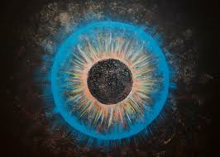
Bonus Observations from a Biblical Worldview
1. The Bible begins with a declaration –In the beginning God created the heavens and the earth –it indicates time, matter, space, origin
2. It describes God’s creative acts as an intrusive form of communication
-Some observations from vs. 11 & vs. 26
3. This communication ability was passed on to mankind –vs. 28 –and God said to them…

Slide 67
Bonus Observations from a Biblical Worldview
4. There was a conflicting communication that discredited God’s communication (Gen 3:1)
-The result was separation and enmity
5. God’s solution came in the form of the divine logos who took on the form of man and identified with him and took his punishment
(Jn 1:1-14) the Word became flesh and spoke volumes…

Slide 68
Bonus Observations from a Biblical Worldview
6. In the meanwhile the Word of God is the object of the world’s attack and ridicule
7. The authority of the Word of God (both the living Word and the Written Word) is the crucial issue in all of this
8. The Word of God created it all and was the first thing to be attacked and continues to be attacked with increasing intensity…

Slide 69
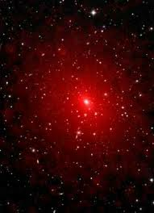
Selected Bibliography
Norman Geisler, Christian Apologetics
N. Geisler and W. Watkins, Perspectives: Understanding and evaluating Today’s World Views
George Knight, Philosophy and Education: An Introduction in Christian Perspective
G. Phillips & W. Brown, Making Sense of Your World
James Sire, The Universe Next Door

