Slide 1
Does the Bible allow for the option of an old earth (~4.5 Billion Years old)
and an old universe
(~14.6 billion years old)?
And does it really matter?

Slide 2
Authority of the word of God
2 Timothy 3:16 All scripture is inspired by God and profitable for teaching, for reproof, for correction, for training in righteousness;
Romans 15:4 For whatever was written in earlier times was written for our instruction, so that through perseverance and the encouragement of the Scriptures we might have hope.
2 Peter 1:20-21 (20) … no prophecy of Scripture is a matter of one’s own interpretation, (21) for no prophecy was ever made by an act of human will, but men moved by the Holy Spirit spoke from God.
(New American Standard Bible)

Slide 3
Authority of the word of God [Continued]
Proverbs 30:5-6 (5) Every word of God is tested (flawless, perfect); … (6) Do not add to His words Or He will reprove you, and you will be proved a liar.
Numbers 12:5-8 (5) Then the Lord came down in a pillar of cloud … (6) He said, … If there is a prophet among you, I, the Lord, shall make Myself known to him in a vision. I shall speak with him in a dream. (7) “Not so, with My servant Moses, … (8) With him I speak mouth to mouth (face to face), Even openly, and not in dark sayings, And he beholds the form of the Lord. …
John 3:12 (Jesus said) If I told you earthly things and you do not believe, how will you believe if I tell you heavenly things?
(New American Standard Bible)

Slide 4
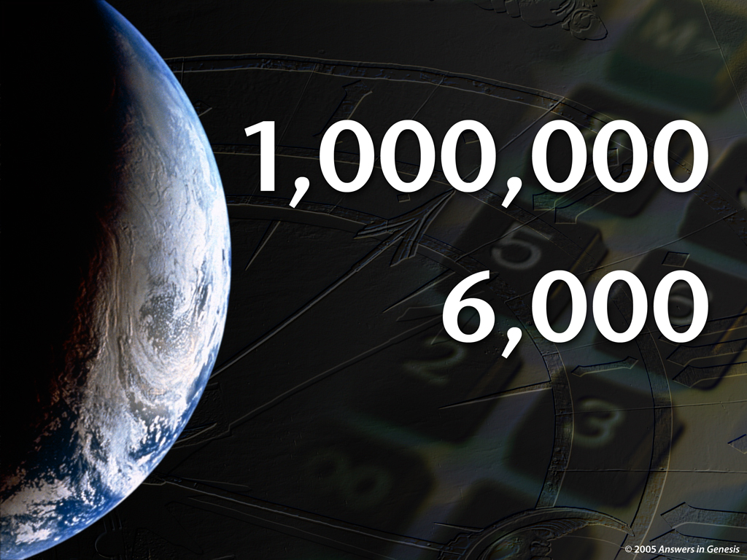
How Old is the Earth?

Slide 5
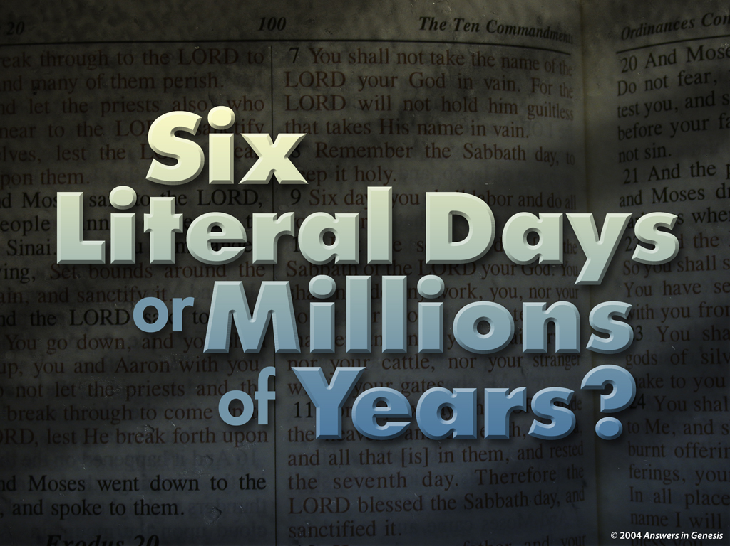
How Long was the Creation?

Slide 6

Creation Narative Genesis 1 (1) In the beginning God created the heavens and the earth. …(4) … God separated the light from the darkness. (5) God called the light day, and the darkness He called night. And there was evening and there was morning, one day.

Slide 7

Genesis 1 (6) … an expanse in the midst of the waters, … (8) … God called the expanse heaven. And there was evening and there was morning, a second day. …

Slide 8

Genesis 1 (10) … dry land earth, … seas; … (11) … vegetation … (13) There was evening and there was morning, a third day.

Slide 9

Genesis 1
(14) … lights in the expanse of the heavens to separate the day from the night, …(16) … the greater light to govern the day, and the lesser light to govern the night; He made the stars also. … (19) There was evening and there was morning, a fourth day.

Slide 10

Genesis 1
(20) … waters teem with swarms of living creatures, and let birds fly above the earth … (23) There was evening and there was morning, a fifth day.

Slide 11

Genesis 1
(24) … the earth bring forth
living creatures after their
kind: … (27) God created
man in His own image, in
the image of God He
created him; male and
female He created them. …
(31) God saw all that He had
made, and behold, it was
very good. And there was
evening and there was
morning, the sixth day.

Slide 12

The Word “Day” (Hebrew = yom)
How can you have a “Day” on day 1 before the sun was created on day 4?
A “Day” is defined as a single rotation of the earth on its axis. Also, God created “Light” on day 1.
Besides all of this, when God had Moses write the book of Genesis, a “Day” was well defined as what we call a “solar day”, a single rotation of the earth on its axis (today ~24 hours).

Slide 13
The Word “Day”
Can Mean Many Different Things, If It Is Divorced From Its Context.
It can mean a solar day, one rotation of the earth, ~24 hours long.
It can mean an age or long period of time. Like “during our father’s day”.
It can mean the daylight portion of the day.

Slide 14
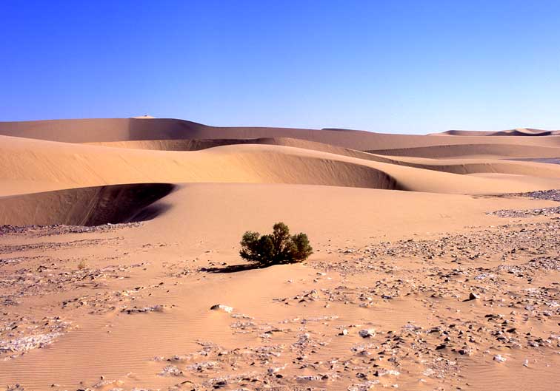

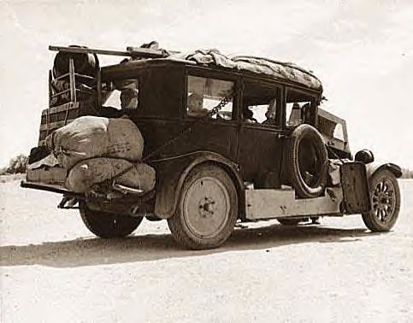
The Word “Day”
Can Mean Many Different Things
“Back in my father’s day,
it took three days
to cross the desert
during the day.”

Slide 15
The Word “Day” Within Its Context,
It Has One Specific Meaning
“Back in my father’s day
(age or long period of time),
it took three days
(solar day, rotation of the earth, ~24 hours)
to cross the desert during the day
(daylight portion of the day).”

Slide 16
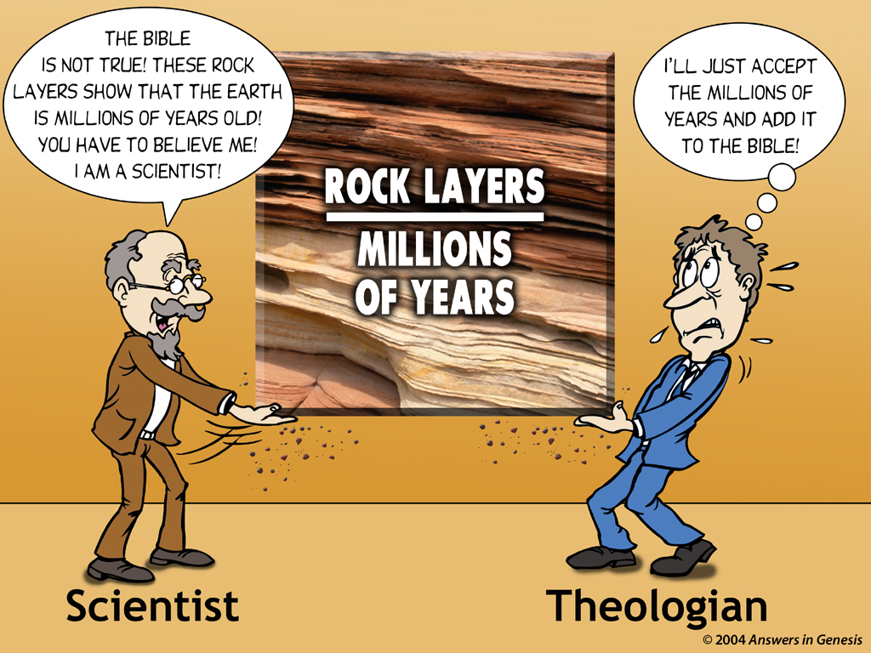
Mil of yrs-Scientist & Theologian 00843
(Evolutionary Geologist)

Slide 17
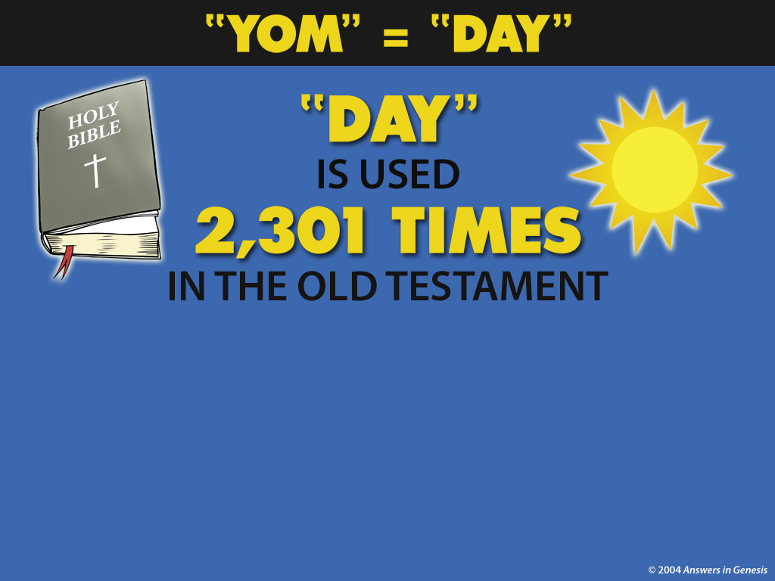


Day Used 2301x 00824
Strongs 3117

Slide 18
Old Earthers Don’t Question the Meaning of “Day” Outside of Genesis
They Don’t Question the Meaning of “Day” in Exodus
When Moses was on the Mountain getting the 10 Commandments
for 40 Days
(40 thousand years?)

Slide 19
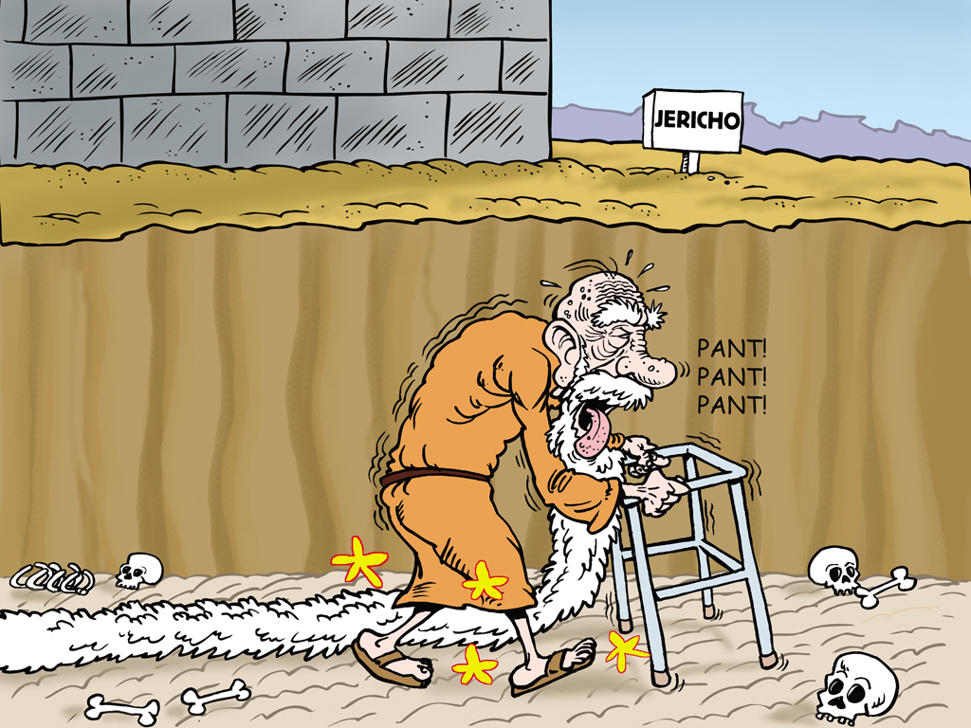
Joshua + Jericho March 00297
Old Earthers Don’t Question the Meaning of Day” in Joshua
Joshua marching around Jericho
7 days (7 thousand years?)

Slide 20
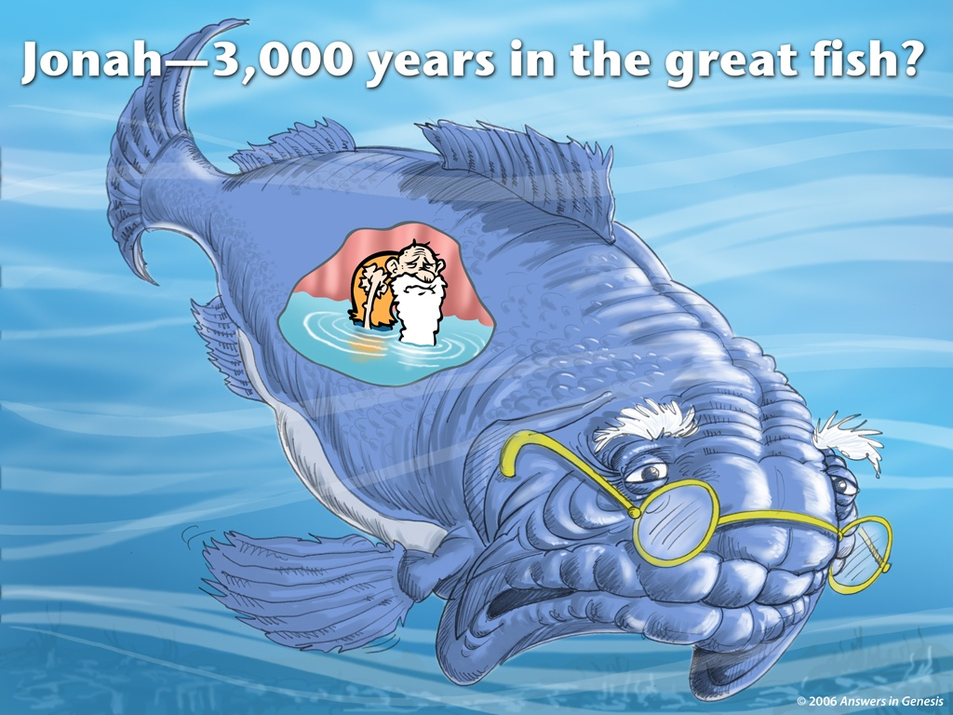
Jonah 3 days in the belly of the fish
Old Earthers Don’t Question
the Meaning of “Day” in Jonah

Slide 21
Genealogies Forbid Old Earthers from Inserting Millions of Years after Adam
Genealogies :
    Genesis 5 Genesis 11
    1 Chronicles 1 Luke 3
    Jude 14
Do not allow millions of years after Adam.
That is why they can only attack Genesis 1.

Slide 22
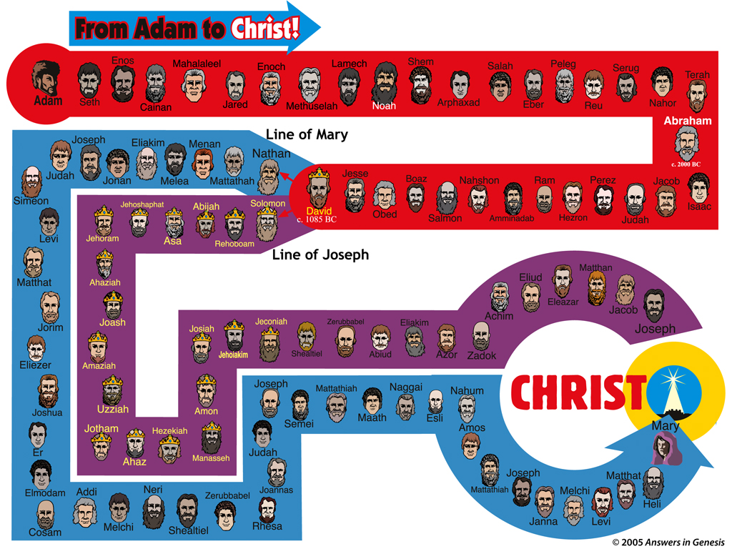

Slide 23
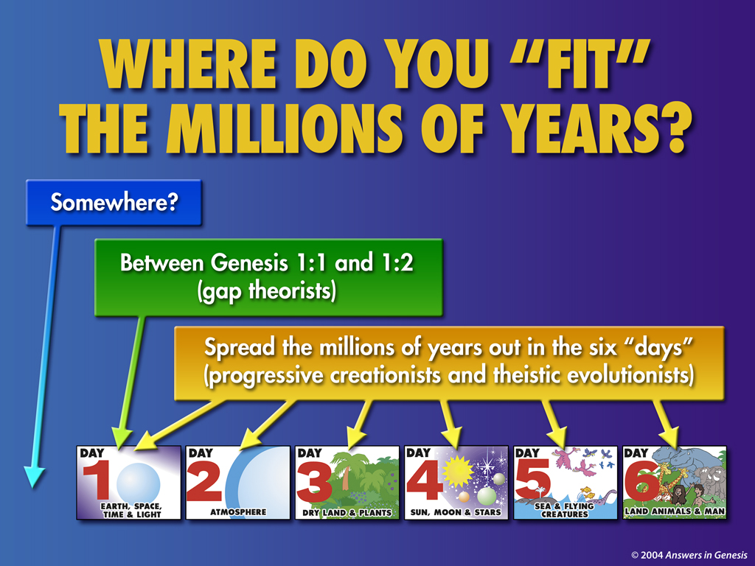

Slide 24
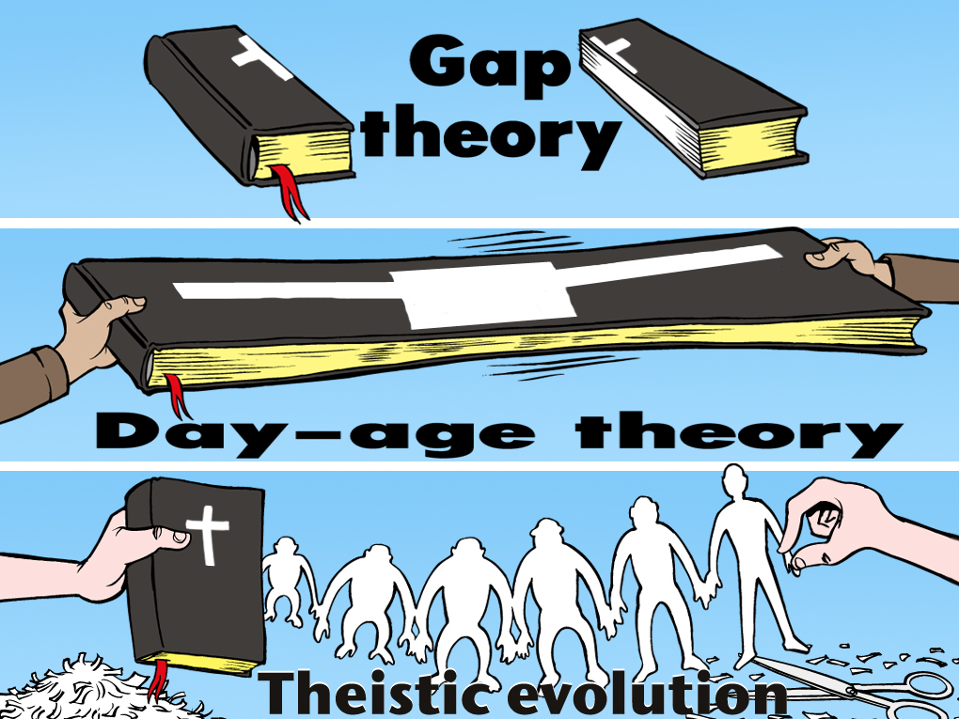
Gap -3 long ages

Slide 25
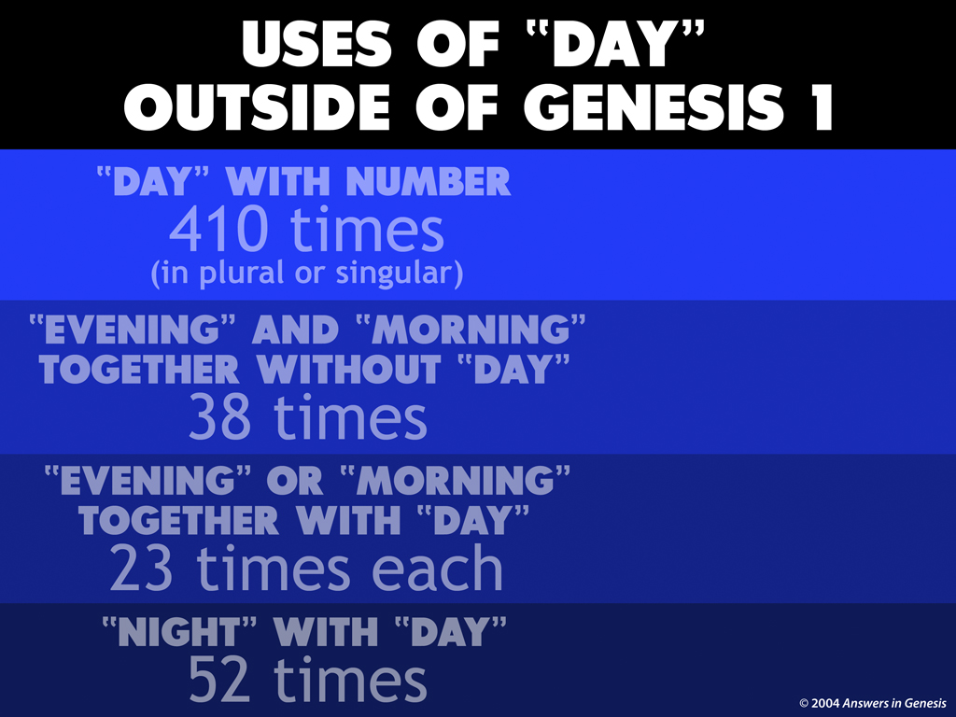

Slide 26
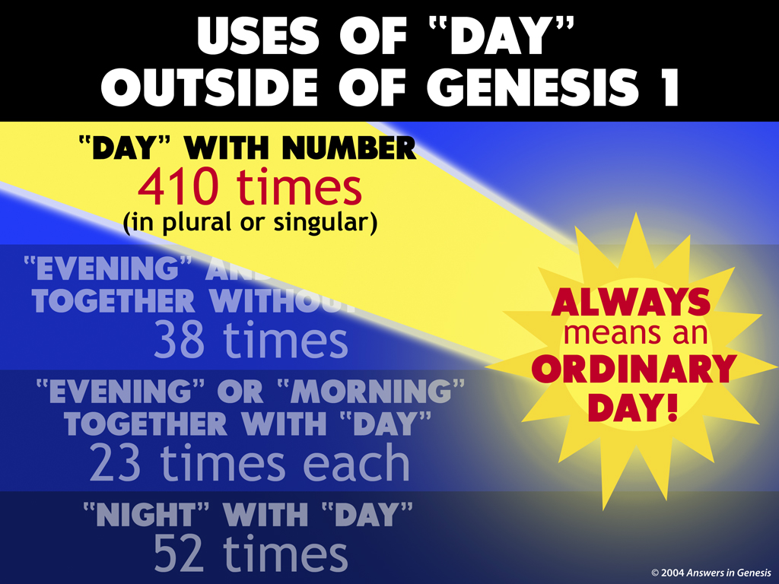
A Solar Day, ~24 Hours

Slide 27
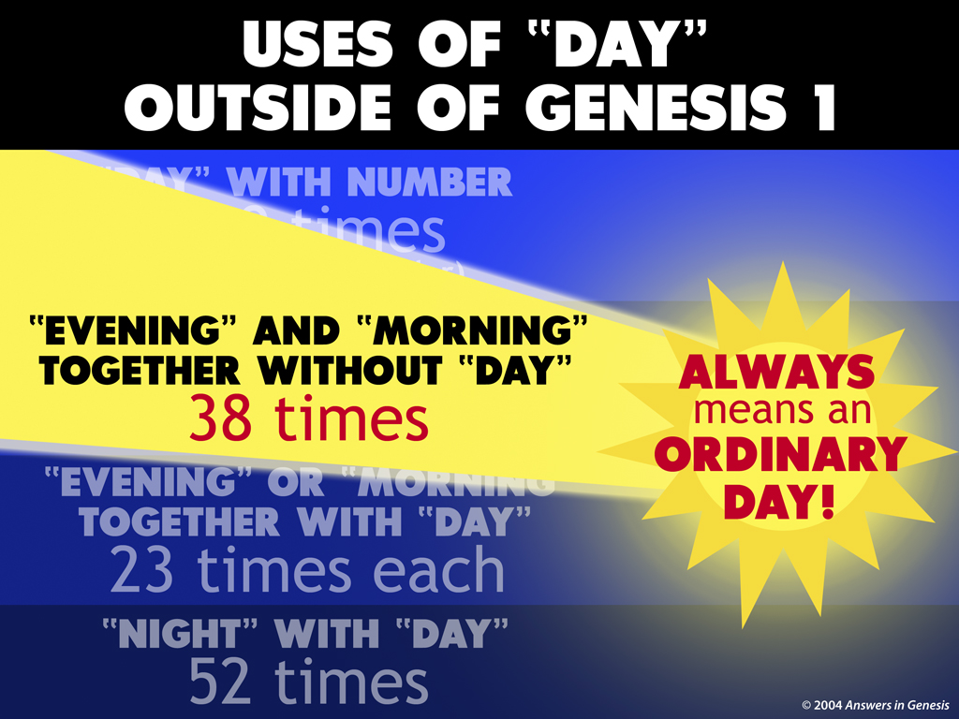
A Solar Day, ~24 Hours

Slide 28
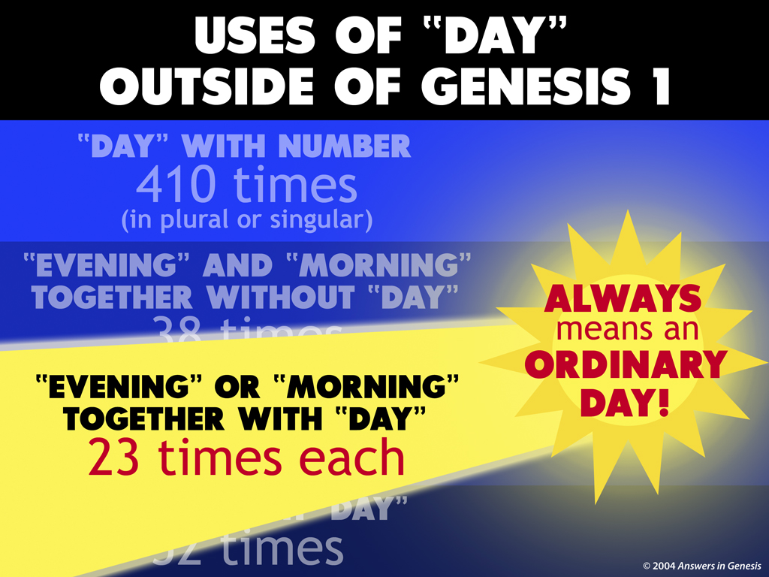
A Solar Day, ~24 Hours

Slide 29
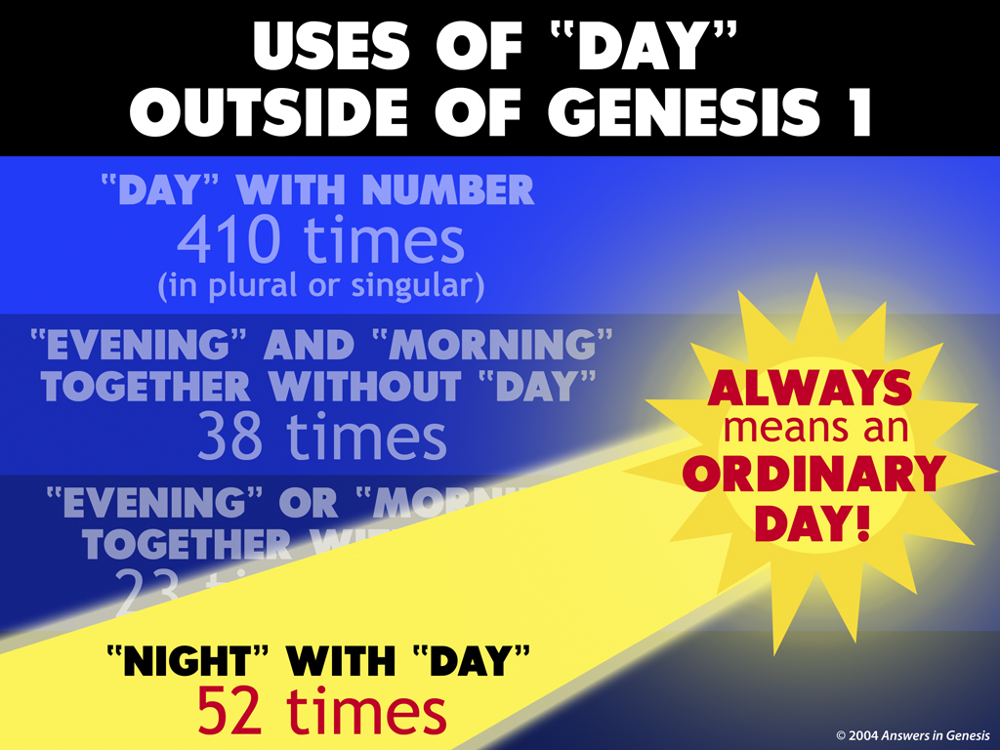
A Solar Day, ~24 Hours

Slide 30
The Word “Day” (Hebrew = yom)
Therefore, when Day (yom) is used in the context with “evening” and “morning”, it always means a solar day, one rotation of the earth, ~24 hours long.
When Day (yom) is used in the context with a number, it always means a solar day, one rotation of the earth, ~24 hours long.
When Day (yom) is used in the context with “night”, it always means a solar day, one rotation of the earth, ~24 hours long.

Slide 31
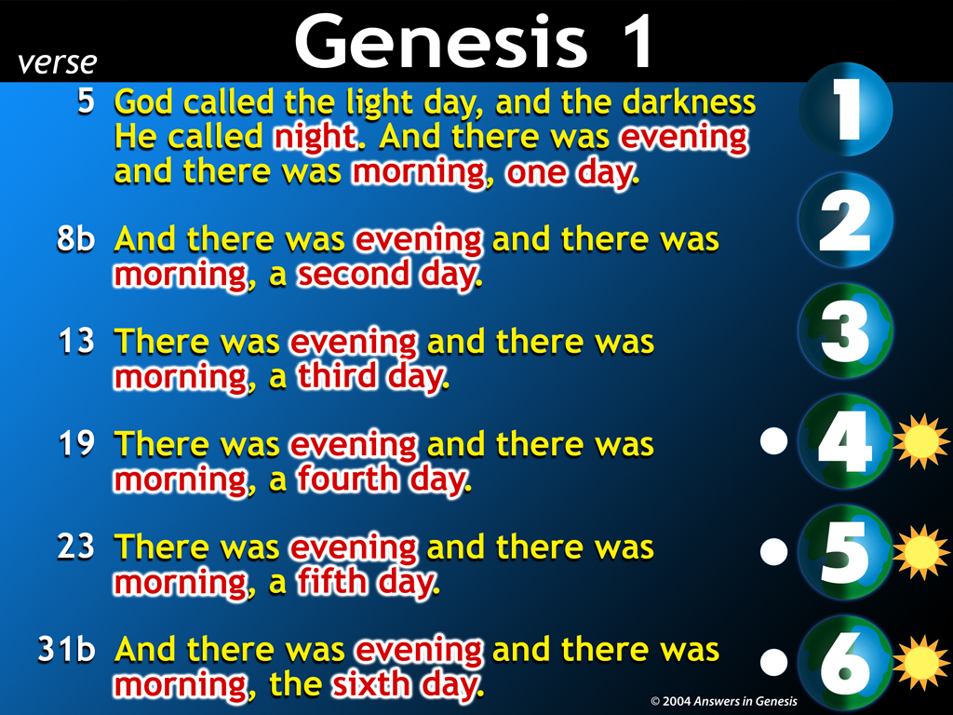
Parallels Numbers 7
Dedication of the Temple

Slide 32
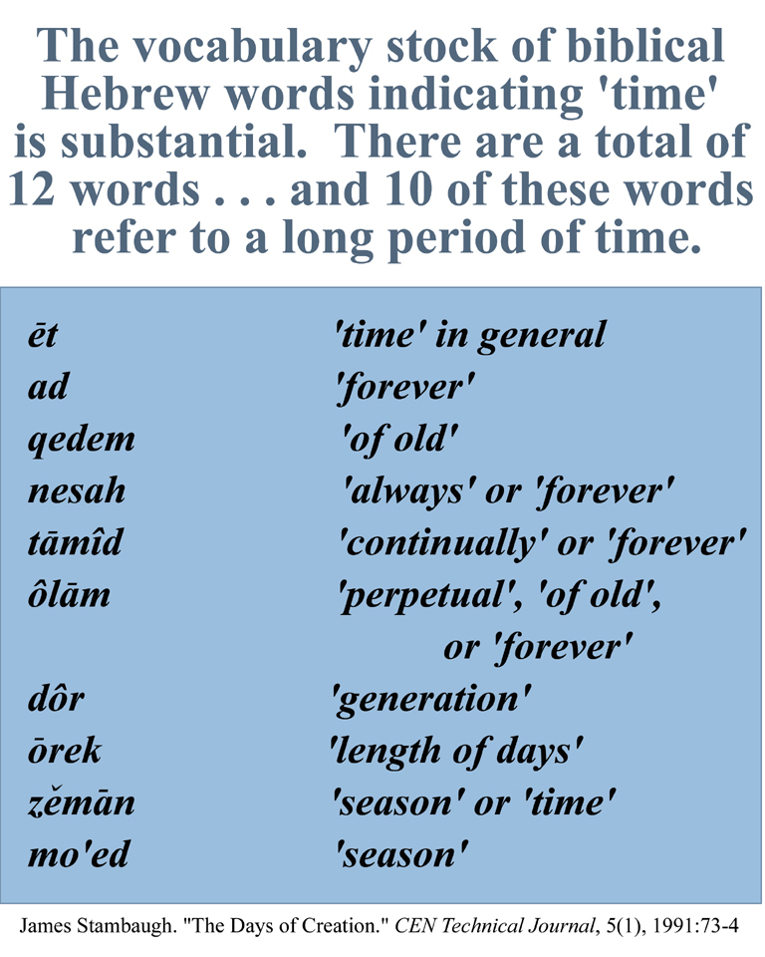
Long Period of Time Words-Stambaugh

Slide 33

Old Earthers Twist the Clear Meaning of the Biblical Text (and admit it)
“… Christians are often inclined to take the young-earth position simply because it appears to be the plainest reading of the Bible”
Don Stoner, A New Look at an Old Earth, Pg.32-33, 37.

Slide 34

Old Earthers Twist the Clear Meaning of the Biblical Text (and admit it)
“It is apparent that the most straight forward understanding of the Genesis record, without regard to all of the hermeneutical considerations suggested by science, is that God created heaven and earth in six solar days, that man was created in the sixth day, that death and chaos entered the world after the Fall of Adam and Eve, that all of the fossils were the result of the catastrophic universal deluge which spared only Noah’s family and the animals with them.”
Pattle P.T. Pun (Wheaton College), “A Theology of Progressive Creationism”, Perspectives on Science and the Christian Faith, Vol. 38, No.1, March 1987.

Slide 35

Old Earthers Twist the Clear Meaning of the Biblical Text (and admit it)
“From a superficial reading of Genesis 1, the impression would seem to be that the entire creative process took place in six twenty-four-hour days. If this was the true intent of the Hebrew author … this seems to run counter to modern scientific research, which indicates that the planet Earth was created several billion years ago …”
Gleason L. Archer, A Survey of the Old Testament Introduction, Pgs. 196-197.

Slide 36
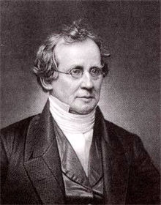
Old Earthers Twist the Clear Meaning of the Biblical Text (and admit it)
“It is of course admitted that, taking this account by itself, it would be most natural to understand the word [day] in its ordinary sense; but if that sense brings the Mosaic account into conflict with facts, and another sense avoids such conflict, then it is obligatory on us to adopt the other.
Charles Hodge (Princeton University), Systematic Theology, Pg. 571.

Slide 37

Old Earthers Twist the Clear Meaning of the Biblical Text (and admit it)
“… We have to admit here that the exegetical basis of the creationists is strong … in spite of the careful biblical and scientific research that has accumulated in support of the creationists’ view, there are problems that make the theory wrong to most (including many evangelical) scientists … Data from various
disciplines point to a very old earth and an even older universe …”
Dr. James Boice, Pastor (speaker on The Biblical Study Hour), Genesis, An Expositional Commentary, Vol.1, Pgs. 57-62.

Slide 38
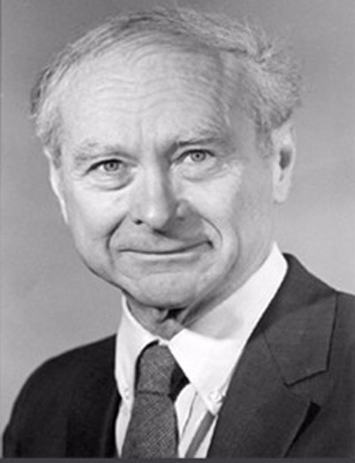
Old Earthers Twist the Clear Meaning of the Biblical Text (and admit it)
“In this article I have advocated an interpretation of biblical cosmogony according to which Scripture is open to the current scientific view of a very old universe, and in that respect, does not discountenance the theory of the evolutionary origin of man.”
Meredith Kline (Framework Hypothesis), “Space and Time in the Genesis Cosmogony”, Perspectives on Science and the Christian Faith, 48:2-15, 1996.

Slide 39

Old Earthers Twist the Clear Meaning of the Biblical Text (and admit it)
“Yes, the young earth creationists have the strongest exegetical case …
Well, science teaches an old earth, so we have to go along with it.”,
William Dembski
(Intelligent Design Movement).

Slide 40


Slide 41
Old Earthers Twist the Clear Meaning of the Biblical Text Because of a Higher Authority
According to Old Earthers, Evolutionist religious interpretations of some scientific data takes precedence over the clear meaning of the Biblical text. Therefore, they are saying , you don’t have to take God’s word as written and you can interpret it based on external interpretations.
Thus, the interpretetions of the Evolutionist Scientists have thus become ‘gods’ to these Old Earthers. The Evolutionist Scientists’ words have more authority to them than the Word of God itself.
(Ex. 20:3 No other gods)

Slide 42

Gen. 3:1 “Indeed, Has God Said …”

Slide 43
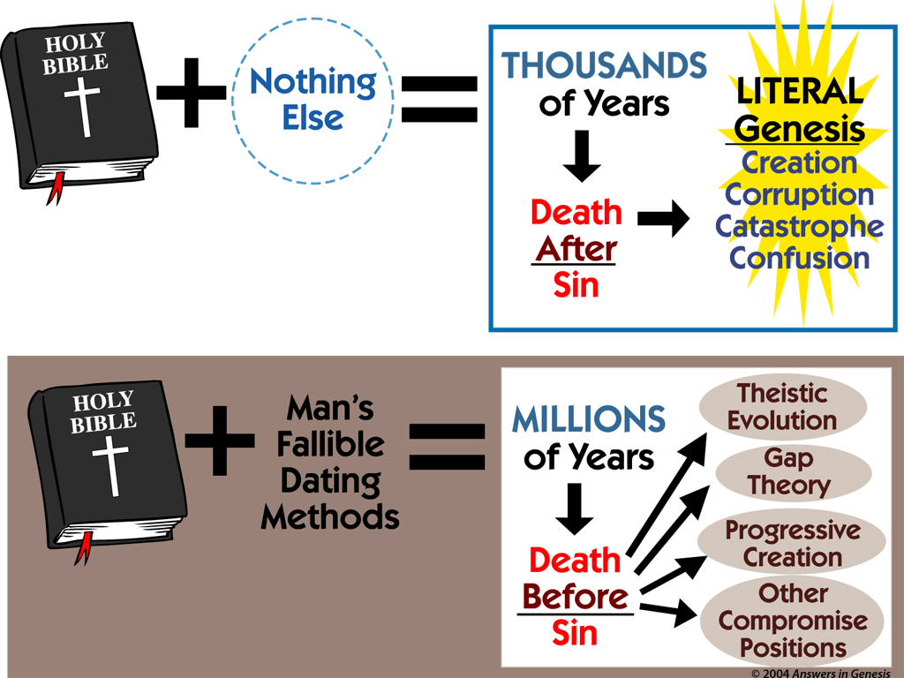

Slide 44
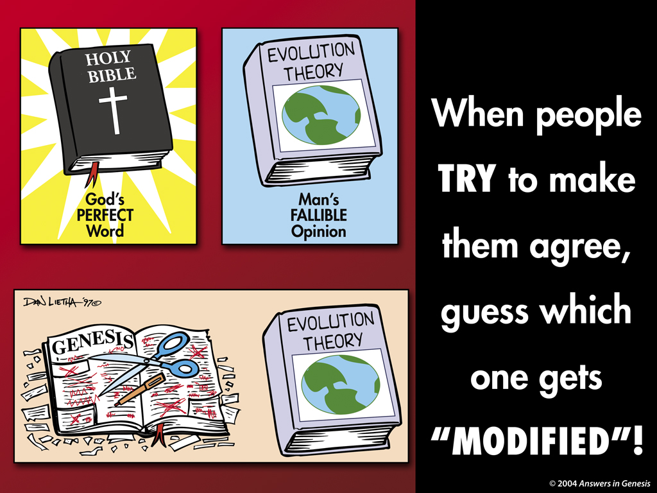

Slide 45
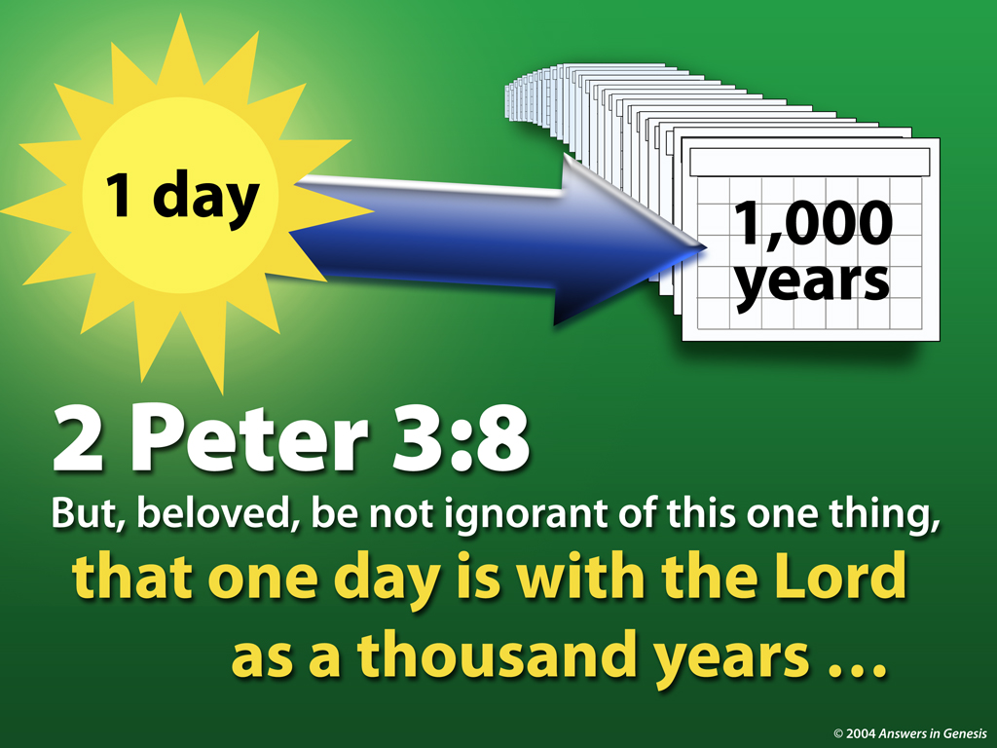
1 Day = 1000 Years ?

Slide 46
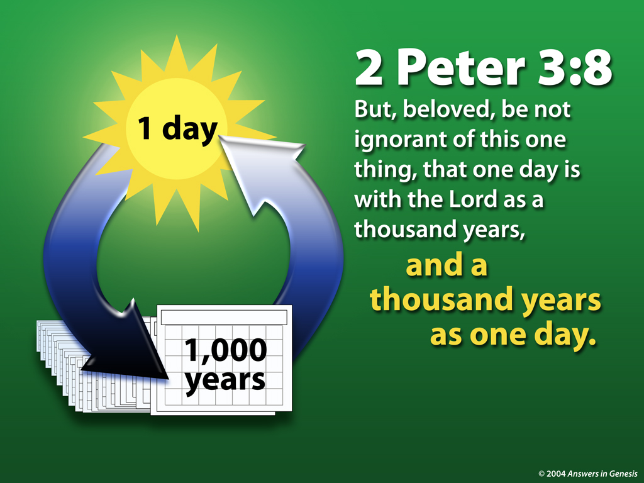
1 Day = 1000 Years - No!

Slide 47
1 Day = 1000 Years - No!
They are trying to take a New Testament phrase to try to interpret Old Testament Grammar.
The Old Earthers typically only quote the first half of this verse and not the second half of the verse which contradicts their application.
They also ignore the context of the verse that talks about the patience of God not being correlated to time as we know it. The context is not defining a day.

Slide 48
1 Day = 1000 Years - No!
Why don’t they quote (out of context also) Psalm 90:4 where it says that a thousand years are as a watch in the night (3 hours) to support their view?
Psalm 90:4
For a thousand years in Your sight Are like yesterday when it passes by, Or as a watch in the night.

Slide 49
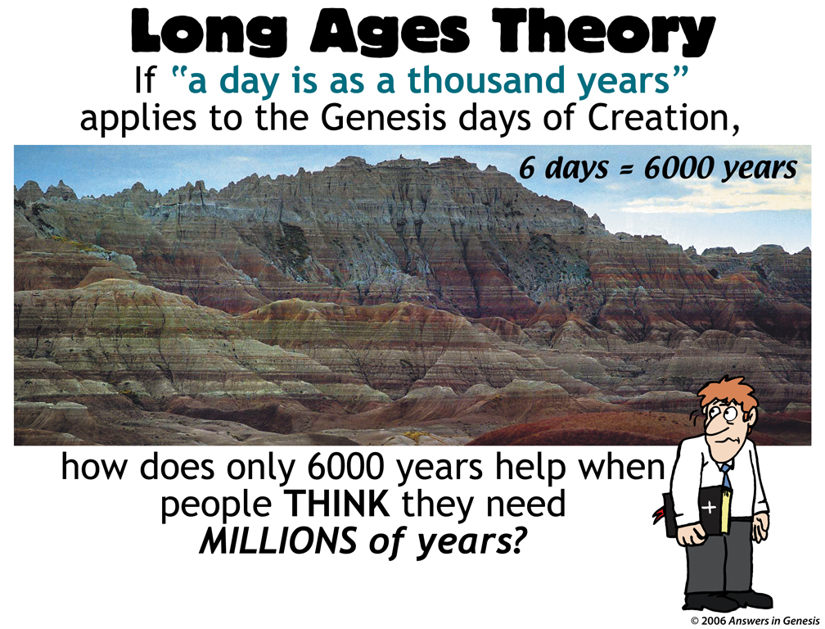

Slide 50
The Gap Theory
Formless and Void
Some Old Earthers will try to put in a gap between Gen.1 verse 1 and verse 2 to add years to the age of the earth.
They try to say that Lucifer fell during this time and there was a Lucifer’s destruction (or Lucifer’s Flood) that destroyed the world.
The rest of the Genesis 1 story is a recreation of the earth.
This has many problems that will be addressed in more detail later.

Slide 51


Gap-Gen1.1 + Gen1.2 00828
Genesis 1:1–2
In the beginning God created the heavens and the earth.
Genesis 1:1
In the beginning God created the heavens and the earth.
Genesis 1:2
The earth was formless and void, and darkness was over the surface of the deep, and the Spirit of God was moving over the surface of the waters.

Slide 52
The Gap Theory
Replenish the Earth, Gen 1:28
King James Version (KJV) Gen 1:28 “… God said unto them, Be fruitful, and multiply, and replenish the earth …”
The Old English word “replenish” does not mean “to refill”, but “to fill completely”. The meaning of the word has changed over time.
The Hebrew word “mala” is accurately translated in modern English in the New American Standard Bible (NASB) as “fill”.

Slide 53
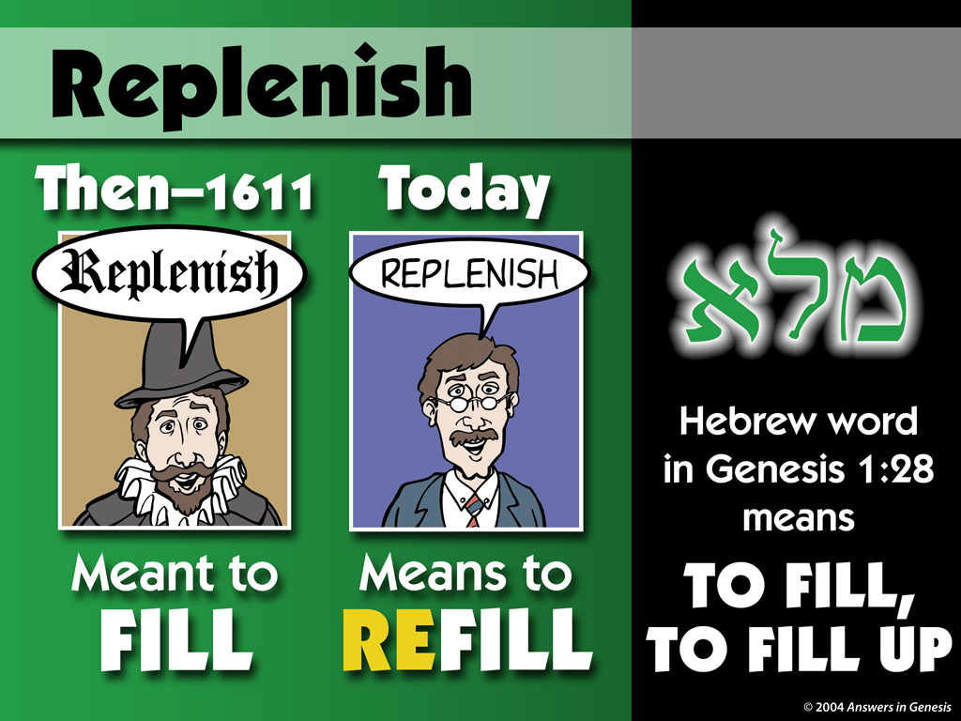
Replenish 00842

Slide 54
The Gap Theory
Formless and Void
Gen 1:2 vs. Jeremiah 4:23
They will also claim that the phrase in Gen 1:2 “formless and void” {Hebrew tohu (Strongs 8414) wa bohu (Strongs 922)} means that it was destroyed in the gap.
They will quote Jeremiah 4:23 saying that “formless and void” (tohu wa bohu) means that it was destroyed.

Slide 55
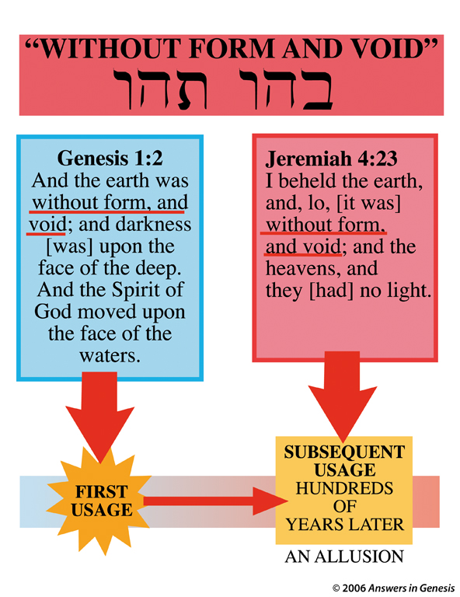

Slide 56
The Gap Theory
Formless and Void, Gen 1:2 vs. Jeremiah 4:23
Context of Jeremiah 4 - Jeremiah picturing God’s coming judgement as a cosmic catastrophe – an undoing of the Creation.
Imagery from Gen. 1 creation account, indicated that no aspect of life would remain untouched. God would make Judah “formless and void”, a phrase that describes the emptiness of the earth before God’s work in creation.
Grammatically, the start of Gen.1:2 that says “and the Earth was …” is a waw disjunctive. A waw disjunctive is an explanation or description of the previous verse, it does not follow in time. Thus verse 2 is a description of the earth when it was first created. The Hebrew grammar does not allow for any gap there between Gen. 1:1 and 1:2.
Dr. Jonathan Sarfari

Slide 57
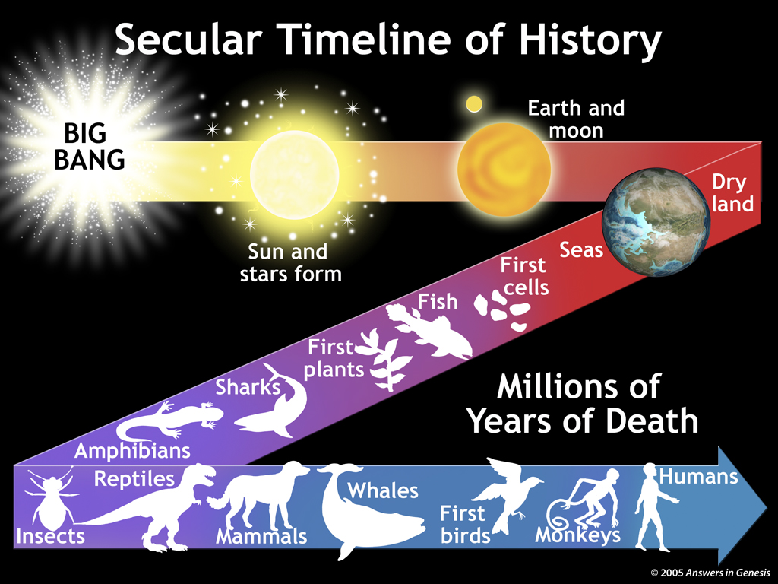

Slide 58
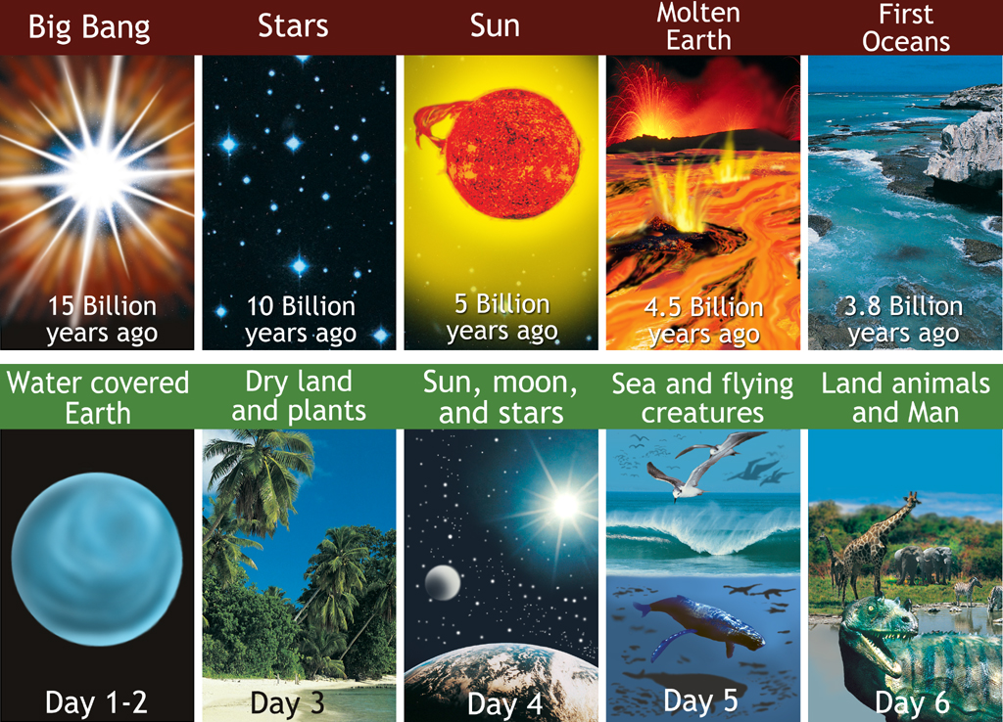
Day-Big bang and Biblical day

Slide 59

Diff – Evolution & Creation 1
Differences Between Evolution and Biblical Creation
Evolution/Long Ages
Biblical Creation
1. Sun before Earth
1. Earth before Sun
2. Dry land before sea
2. Sea before dry land
3. Atmosphere before sea
3. Sea before atmosphere
4. Sun before light on Earth
4. Light on Earth before Sun
5. Stars before Earth
5. Earth before stars
6. Earth at same time as planets
6. Earth before planets
7. Marine creatures before land plants
7. Land plants before marine creatures
8. Earthworms before starfish
8. Starfish before earthworms
9. Land animals before trees
9. Trees before land animals

Slide 60
Diff – Evolution & Creation 2
Differences Between Evolution and Biblical Creation
Evolution/Long Ages
Biblical Creation
10. Death before man
10. Death after man
11. TB pathogens before man (dinos had TB)
11. TB pathogens after man
12. Reptiles before birds
12. Birds before reptiles
13. Land mammals before whales
13. Whales before land mammals
14. Simple plants before fruit trees
14. Fruit trees before other plants
15. Insects before mammals
15. Mammals (cattle) before ‘creeping things’
16. Land mammals before bats
16. Bats before land mammals
17. Dinosaurs before birds
17. Birds before dinosaurs

Slide 61
Diff – Evolution & Creation 3
Differences Between Evolution and Biblical Creation
Evolution/Long Ages
Biblical Creation
18. Insects before flowering plants
18. Flowering plants before insects
19. Sun before plants
19. Plants before Sun
20. Dinosaurs before dugongs
20. Dugongs before dinosaurs
21. Land reptiles before marine reptiles
21. Marine reptiles before land reptiles
22. Land reptiles before pterosaurs
22. Pterosaurs before land reptiles
23. Land insects before flying insects
23. Flying insects before land insects

Slide 62
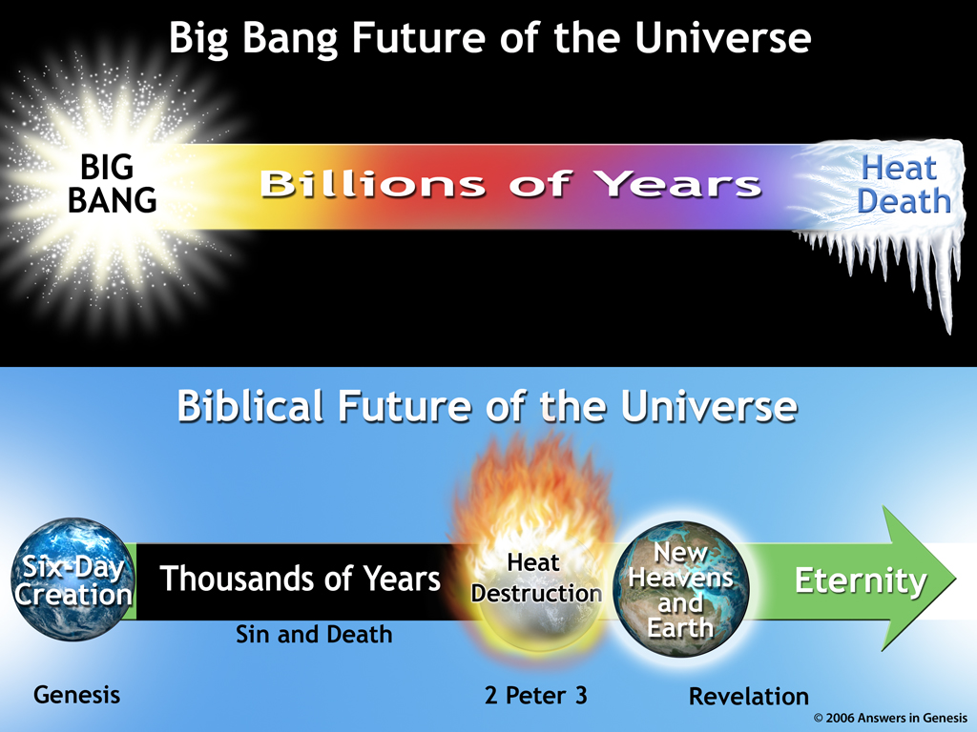
2 Futures of the Universe 02291

Slide 63
Grammatical Analysis
Hebrew Poetry
Synonymous Parallelism – saying the same thing.
Psalm 19:1-2 (1) The heavens are telling of the glory of God;
And their expanse is declaring the work of His hands.
(2) Day to day pours forth speech,
And night to night reveals knowledge.
Antithetical Parallelism – saying the opposite thing (contrast).
Proverbs 28:1 The wicked flee when no one is pursuing,
But the righteous are bold as a lion.
Proverbs 28:4 Those who forsake the law praise the wicked,
But those who keep the law strive with them.

Slide 64
Grammatical Analysis
Historical / Structured Narative
Hebrew Narratives - begins with a verb, a “Qatal” (Qal Historical Perfect). Then continues with a Wayyiqtol (Waw Consecutive) that indicate a sequence of events in past tense material. Can then be followed by multiple Wayyiqtol (Waw Consecutive).
  bara (“created”) - historical perfect
  wayyomer (“and … said”) - waw consecutive
  wayhi (“and there was”) - waw consecutive
  wayyore (“and … saw”) - waw consecutive
Structured Narrative
  1. God’s Command – “Let there be …”, a Jussive Verb (command or request).
  2. Rapid Fufillment – “and it was so”.
  3. Assessment – “God saw it was good”.
  Closure of the day – “there was evening and there was morning, day #”.
  Dr. Spiros Zohiates – The Complete Word Study Old Testament

Slide 65
Grammatical Analysis
Genesis 1
Hebrew Scholar, Stephen Boyd, PhD. – The Masters College.
Analysis - studying and cataloging 522 Hebrew Poetry and Narrative texts.
Hebrew Poetry commonly utilizes a high frequency of Imperfect and Perfect Verbs.
Hebrew Narrative commonly utilizes a high frequency of Waw-Consecutive Prefect Verbs.
Based on the analysis, Genesis 1 has a probability of 99.9972604% that it is a Historical Narrative and not Poetry.

Slide 66
Adam’s Sin Cause Death on the Earth
Genesis 3:3 but from the fruit of the tree which is in the middle of the garden, God has said, ‘You shall not eat from it or touch it, or you will die.’ ” (physical and spiritual death)
1 Corinthians 15:21-22 (21) For since by a man came death, by a man also came the resurrection of the dead. (22) For as in Adam all die, so also in Christ all will be made alive. (resurrection - physical and spiritual)
Romans 5:12 Therefore, just as through one man, sin entered into the world, and death through sin, and so death spread to all men, because all sinned.
Therefore, there could not have been any death (man or animals) until after Adam sinned.

Slide 67
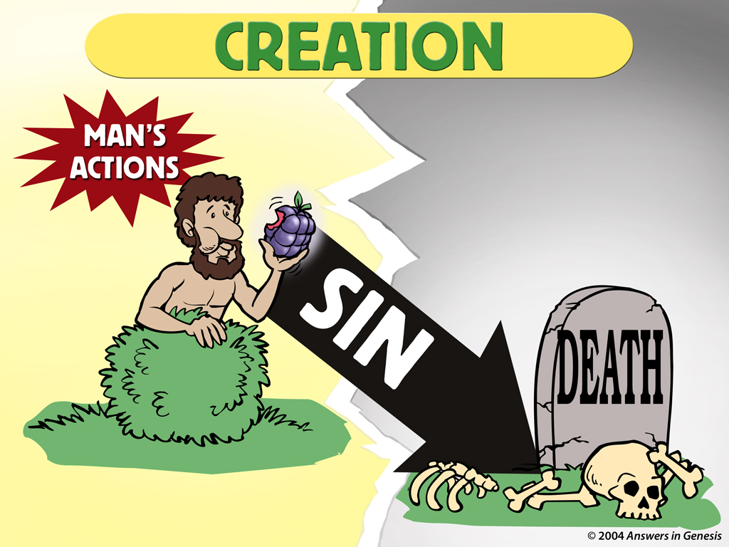
Crea Actions-Death 01131

Slide 68
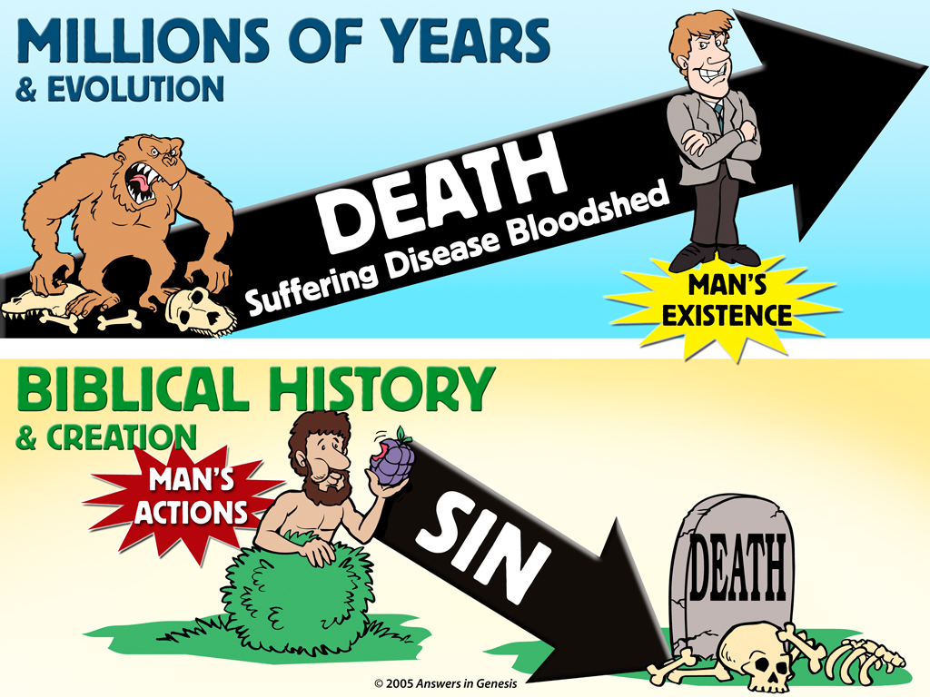

Slide 69
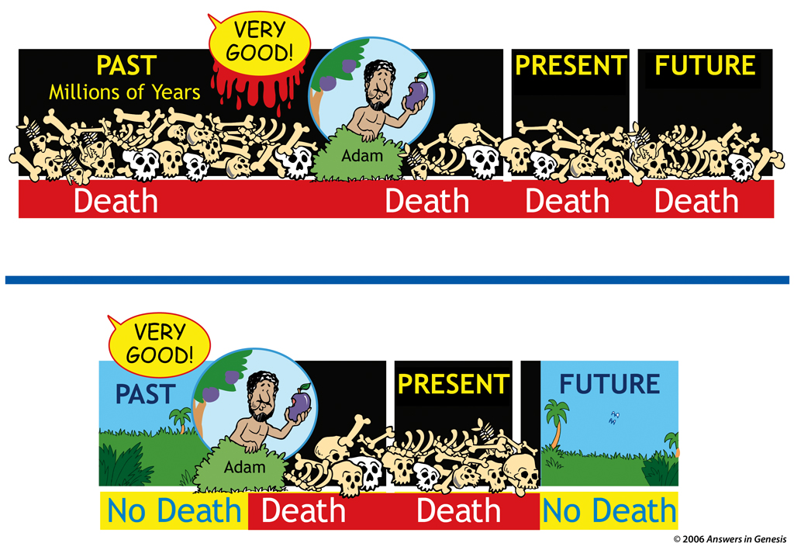
History of Death on the Earth

Slide 70

Nephesh-Man + Animals 00864
Do Plants Die?
Breath of Life
No Breath of Life
Plants wither, not die

Slide 71
The Creation was “Very Good”
Believers in the Old Earth Evolution Models or modified Evolution Models believe that there was death and destruction before Adam was created.
Genesis 1:31 God saw ALL that He had made, and behold, it was very good. …
According to God’s Word, No Death, No Destruction, No Disease, No Thorns, etc. at the end of the 6th day of creation.

Slide 72
The Creation was “Very Good”
Animals Killing and Eating Other Animals?
Genesis 1:29-30 (29) Then God said, “Behold, I have given you every plant yielding seed that is on the surface of all the earth, and every tree which has fruit yielding seed; it shall be food for you; (30) and to every beast of the earth and to every bird of the sky and to every thing that moves on the earth which has life, I have given every green plant for food”; and it was so.
Thus, no animals killing other animals to eat them for food (as we see in the fossil record). Every person and animal was a vegetarian until after the fall. Man was allowed to eat animals only after the world wide flood.

Slide 73

Notes:
Created: September 2005.

Slide 74
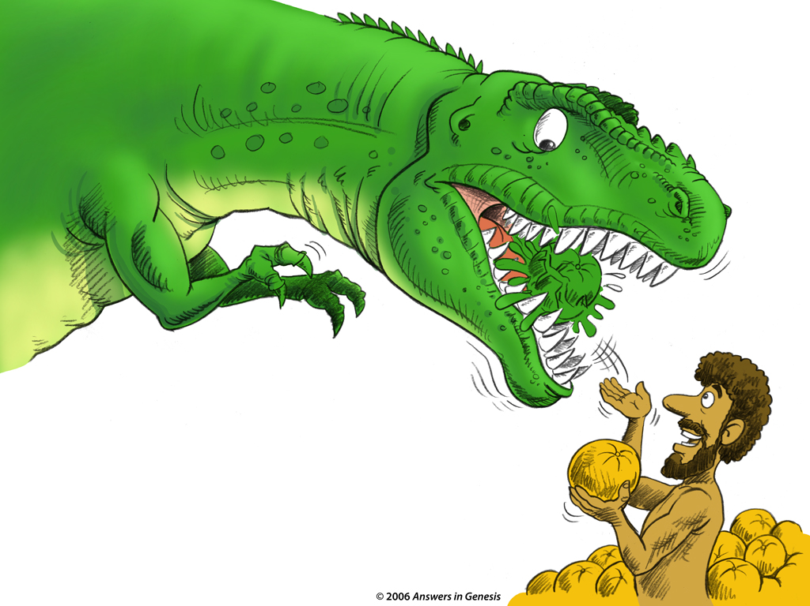
D H-Adam Feeding Dino 01754
Dinosaurs and other animals ate plants.

Slide 75


Slide 76


Slide 77


Slide 78

T rex Fossil Disease 01665

Slide 79
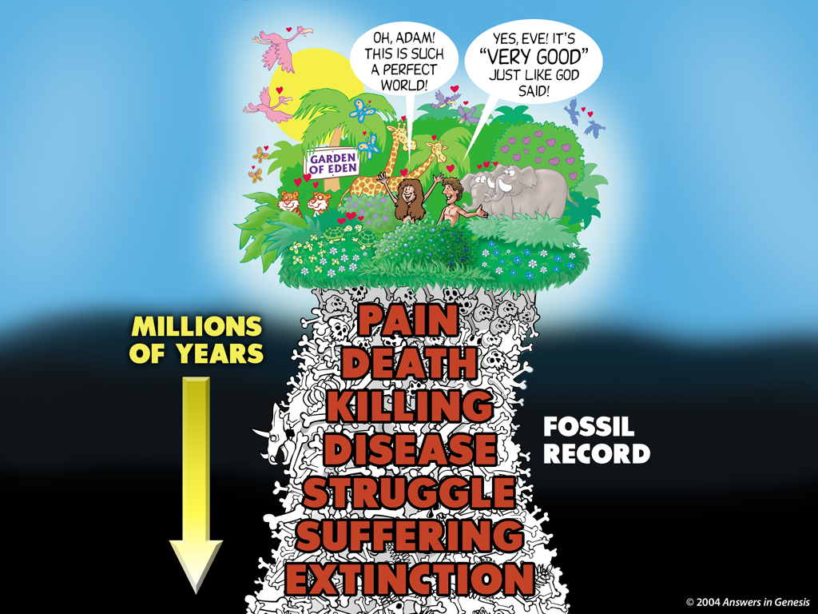

Slide 80
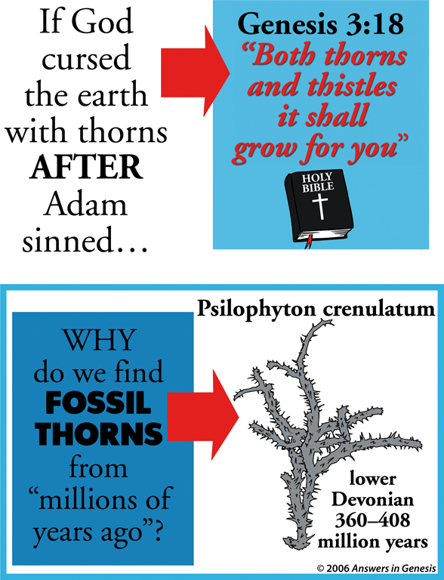

Slide 81
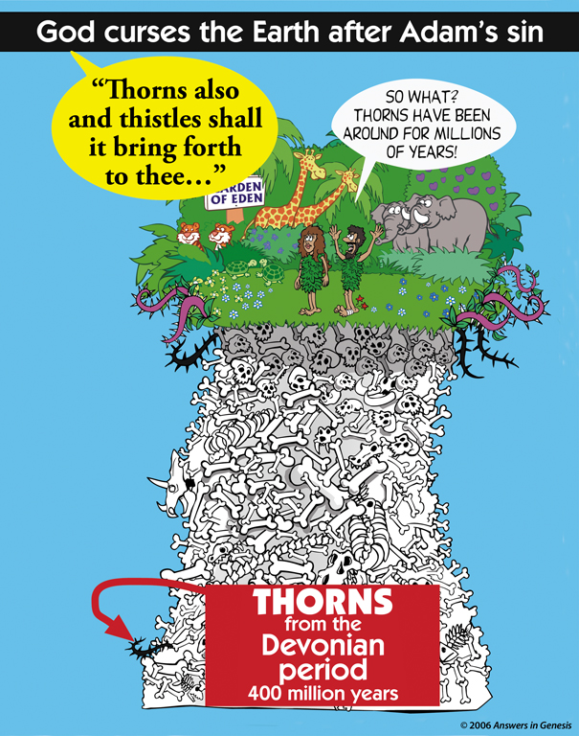

Slide 82


Slide 83
The Creation was Cursed After the Fall
Romans 8:19-22
(19) For the anxious longing of the creation waits eagerly for the revealing of the sons of God. (20) For the creation was subjected to futility, not willingly, but because of Him who subjected it, in hope (21) that the creation itself also will be set free from its slavery to corruption into the freedom of the glory of the children of God. (22) For we know that the whole creation groans and suffers the pains of childbirth together until now.

Slide 84
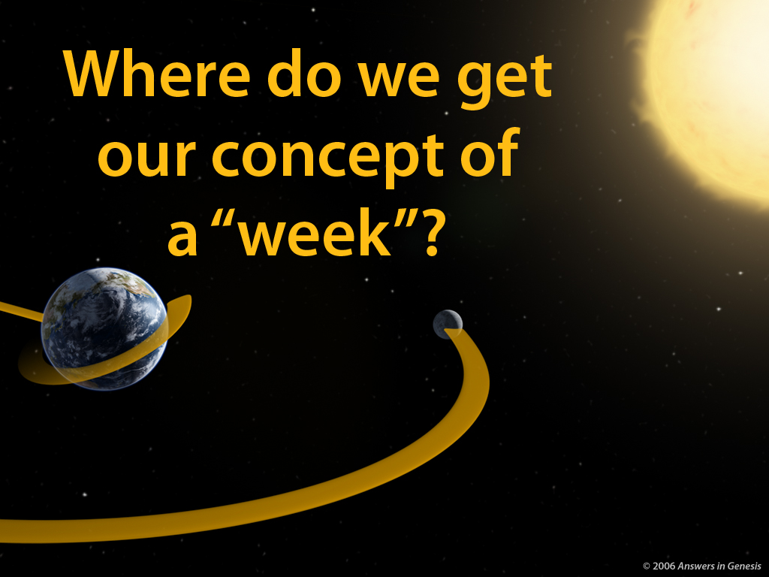

Slide 85
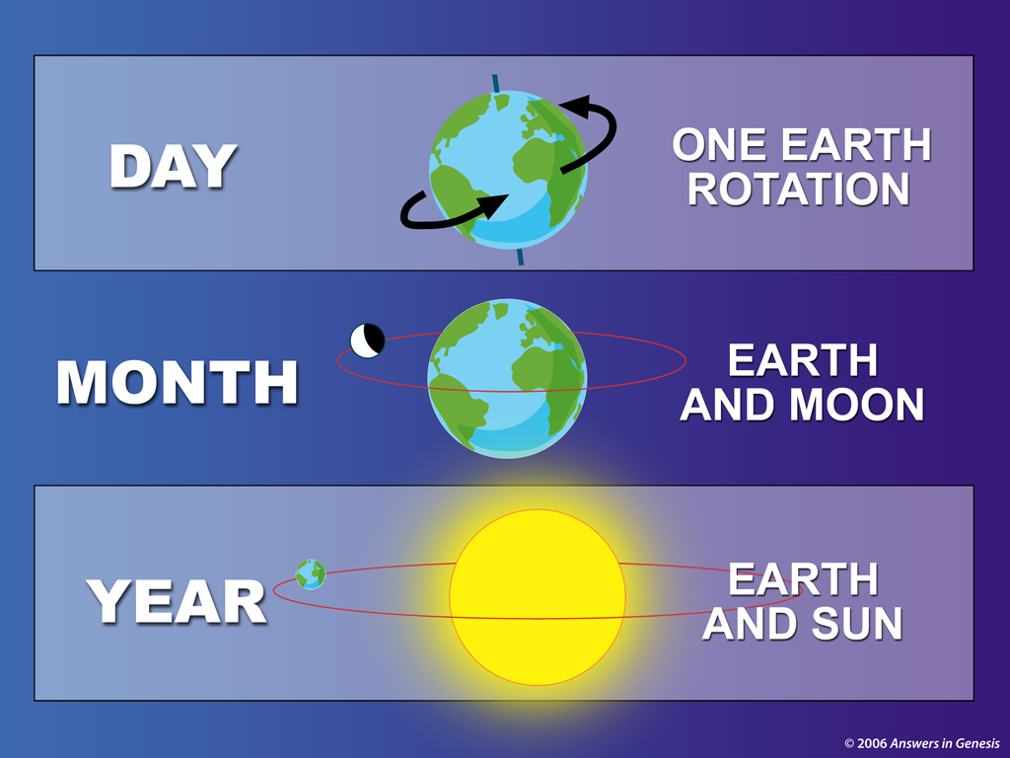

Slide 86
God Created Everything in 6 Days
The Week is based on
the Creation Week (6 Days + 1 Day of Rest = 7 Days).
Exodus 20:11 For in six days the Lord made the heavens and the earth, the sea and all that is in them, and rested on the seventh day; therefore the Lord blessed the sabbath day and made it holy. (context = the 10 Commandments of God given to Moses)
Exodus 31:17 for in six days the Lord made heaven and earth, but on the seventh day He ceased from labor, and was refreshed.
This is the testimony of God the Father on the Creation.

Slide 87

Bible-Inspired and Inscribed 00479
Exodus 31:18 … two tablets of the testimony, tablets of stone, written by the finger of God.

Slide 88
Merism in the Bible
The term “Heaven and Earth” is a form of “Merism” (a Figure of Speech) to mean everything in the creation.
Modern Day Merism –
  Open Day and Night. → 24 Hours.
  We looked High and Low. → Everywhere.
  We looked Left and Right. → Everywhere.

Slide 89
God Made Man and Woman at the Beginning of the Creation (as a whole)
This is the testimony of Jesus Christ on the Creation.
Mark 10:6 … from the beginning of creation, God made them male and female.
Matthew 19:4 …He (God) who created them from the beginning made them male and female,
Jesus’ comments about Adam and Eve, Cain and Able, Noah and the Flood, Sodom and Gomorrah, etc., clearly show that He took the events recorded in Genesis as Literal History, Just as did all the New Testament writers.
Did God the Father and God the Son (Jesus) lie to us if there are millions or billions of years?

Slide 90
The Creation was Completed in the Creation Week
Genesis 2:1-3 (1) Thus the heavens and the earth were completed, and all their hosts. (2) By the seventh day God completed His work which He had done, and He rested on the seventh day from all His work which He had done. (3) Then God blessed the seventh day and sanctified it, because in it He rested from all His work which God had created and made.
Hebrews 4:3-4 (3) … His works were finished from the foundation of the world. (4) … concerning the seventh day: “And God rested on the seventh day from all His works”;

Slide 91
Bi-pedal Primates or a Race of Men Without Souls ?
Believers in the Old Earth modified Evolution Models believe that there were bi-pedal primates or a race of men without souls before Adam was created. They believe that fossils like Homo-Sapiens (Modern Man with human culture) were men without souls.
Other Old Earthers believe that Adam was figurative and never really existed.

Slide 92

Grandmother?
EVE

Slide 93

Adam

Slide 95
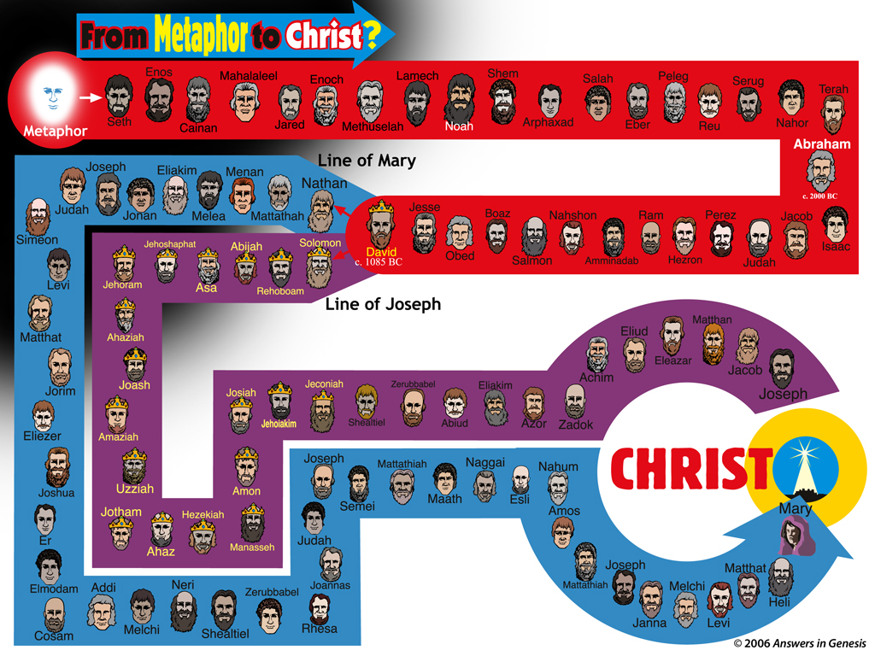

Slide 96


Slide 97


Slide 98
The Bible - Adam the First Man
Genealogies tie Jesus to Adam, thus Adam was a real person.
Luke 3:23-38 Jesus was a direct descendent of Adam.
Jude 14-15 … Enoch, in the seventh generation from Adam
Genesis 3:20 Now the man called his wife’s name Eve, because she was the mother of all the living (humans).
1 Timothy 2:13 For it was Adam who was first created, and then Eve.
1 Corinthians 15:45 … “The first man, Adam, became a living soul.” The last Adam became a life-giving spirit.
If Jesus is to be our Kinsman-Redeemer (Lev. 25) to save us, he must be related to us by blood (through Adam, the father of all men). Otherwise, the idea attacks the salvation story of our Kinsman-Redeemer saving us.

Slide 99
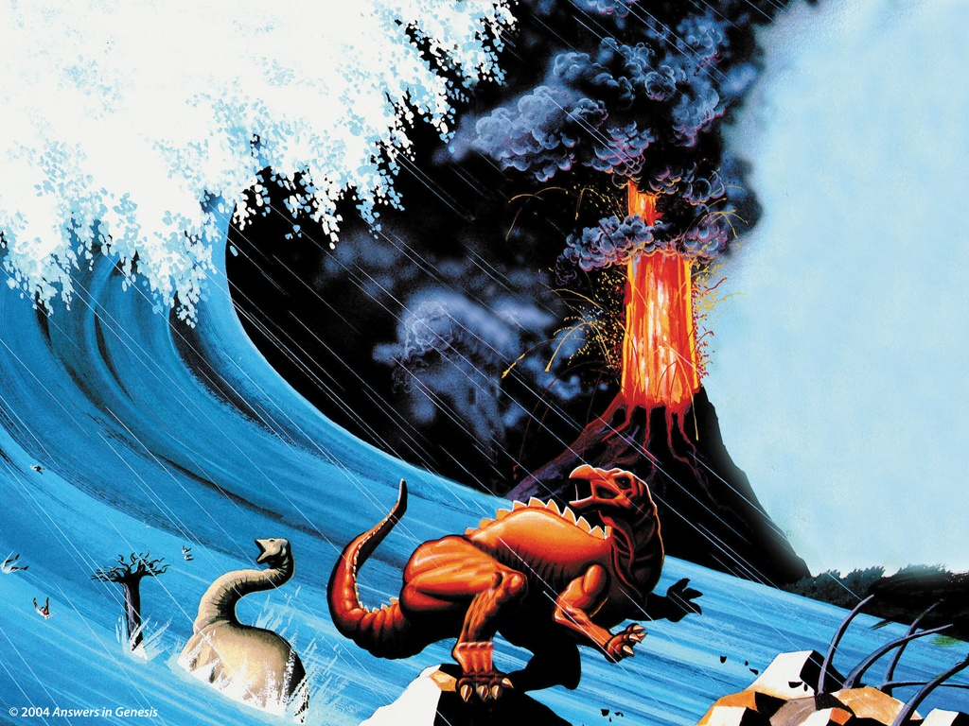
Was there a Worldwide Flood or just a Local Flood?

Slide 100

Was Noah’s Ark Really Needed?

Slide 101
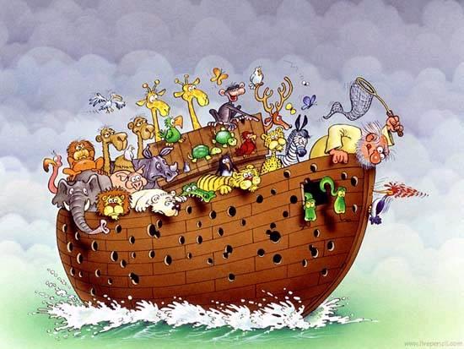
Noah’s Ark ?

Slide 102
Worldwide Flood? What does the Bible say?
Genesis 6-8
6:17 “Behold, I, even I am bringing the flood of water upon the earth, to destroy all flesh in which is the breath of life, from under heaven; everything that is on the earth shall perish.
6:20 … two of every kind will come to you to keep them alive.
7:3 … by sevens, male and female, to keep offspring alive on the face of all the earth.
7:4 … I will send rain on the earth forty days and forty nights; and I will blot out from the face of the land every living thing that I have made.”
7:11 … on the same day all the fountains of the great deep burst open, and the floodgates of the sky were opened.
7:12 The rain fell upon the earth for forty days and forty nights.

Slide 103
Worldwide Flood? What does the Bible say? [Continued]
Genesis 6-8
7:19 The water prevailed more and more upon the earth, so that all the high mountains everywhere under the heavens were covered.
7:20 The water prevailed fifteen cubits higher, and the mountains were covered.
7:21 All flesh that moved on the earth perished, birds and cattle and beasts and every swarming thing that swarms upon the earth, and all mankind;
7:22 of all that was on the dry land, all in whose nostrils was the breath of the spirit of life, died.
7:23 … He blotted out every living thing that was upon the face of the land, from man to animals to creeping things and to birds of the sky, and they were blotted out from the earth; and only Noah was left, together with those that were with him in the ark.

Slide 104
Worldwide Flood? What does the Bible say? [Continued]
Genesis 6-8
7:24 The water prevailed upon the earth one hundred and fifty days.
8:4 … the ark rested upon the mountains of Ararat.
8:5 The water decreased steadily until the tenth month; in the tenth month, on the first day of the month, the tops of the mountains became visible. (~2.5 months after ark rested on the mountain)
8:13 Now it came about in the six hundred and first year, in the first month, on the first of the month, the water was dried up from the earth. … the surface of the ground was dried up
(~10.5 months later. The flood started on the 600th year, the 2nd month, and the 17th day, Gen 7:11)
8:14 In the second month, on the twenty-seventh day of the month, the earth was dry. (~12 months)

Slide 105
Worldwide Flood? What does the Bible say? [Continued]
Matthew 24:37-39 Jesus said : (37) “For the coming of the Son of Man will be just like the days of Noah. … (39) and they did not understand until the flood came and took them all away; so will the coming of the Son of Man be.
Luke 17:26-27 Jesus said : (26) And just as it happened in the days of Noah, so it will be also in the days of the Son of Man: (27) … until the day that Noah entered the ark, and the flood came and destroyed them all.
2 Peter 2:5 and (God) did not spare the ancient world, but preserved Noah, a preacher of righteousness, with seven others, when He brought a flood upon the world of the ungodly;

Slide 106
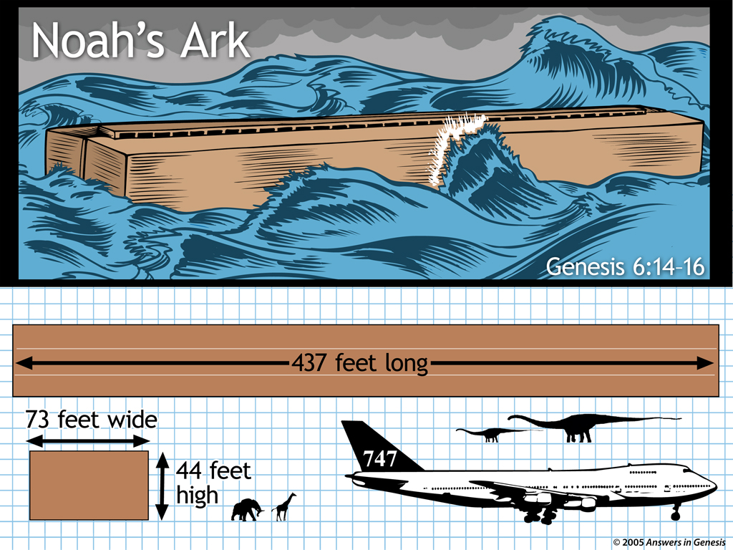
If 1 Cubit = 17.5 inches
1 Cubit = 16 to 24 inches

Slide 107

Old Earthers Claim it was just a Local Flood

Slide 108
Mockers of the Worldwide Flood
2 Peter 3:3-6 (3) … in the last days mockers will come with their mocking, following after their own lusts, (4) and saying, “Where is the promise of His coming? For ever since the fathers fell asleep, all continues just as it was from the beginning of creation.” (5) For when they maintain this, it escapes their notice that by the word of God the heavens existed long ago and the earth was formed out of water and by water, (6) through which the world at that time was destroyed, being flooded with water.
The Mockers deny that there was a World Wide Flood that destroyed the world and they believe in Gradualism (everything continues as it was from the beginning). If the World Wide Flood caused the Geologic layers, then the earth cannot be old.

Slide 109
God’s Statement about the Worldwide Flood
Genesis 8:21 … the Lord said … I will never again destroy every living thing, as I have done.
9:11 … all flesh shall never again be cut off by the water of the flood, neither shall there again be a flood to destroy the earth.”
9:15 … I will remember My covenant, which is between Me and you and every living creature of all flesh; and never again shall the water become a flood to destroy all flesh.
Isaiah 54: 9 … I swore that the waters of Noah Would not flood the earth again; …
Did God the Father lie to us about a world wide flood, if it was actually a local flood and local floods still occur today?

Slide 110
God Does Not Lie
Numbers 23:19 God is not a man, that He should lie, Nor a son of man, that He should repent;…
Titus 1:2 … God, who cannot lie, promised long ages ago
Hebrews 6:18 … it is impossible for God to lie, …

Slide 111
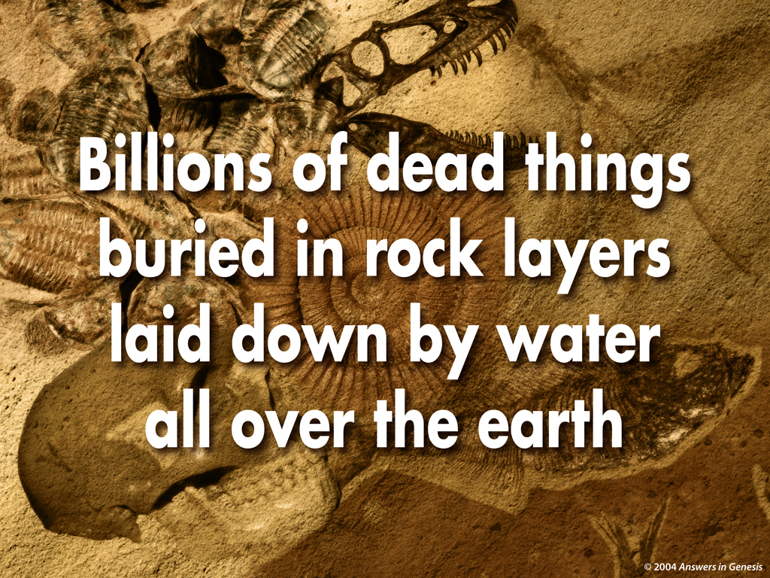
Evidence of a Worldwide Flood?
rapidly

Slide 112
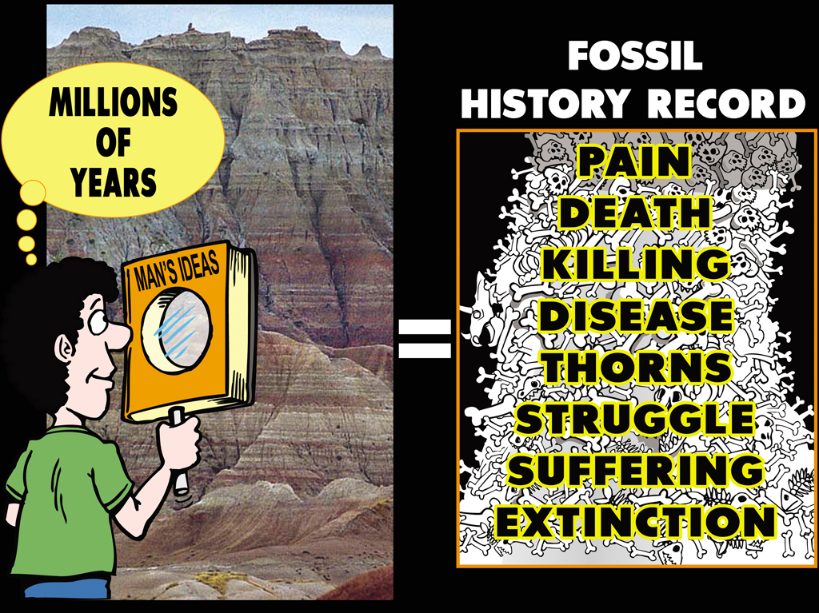

Slide 113
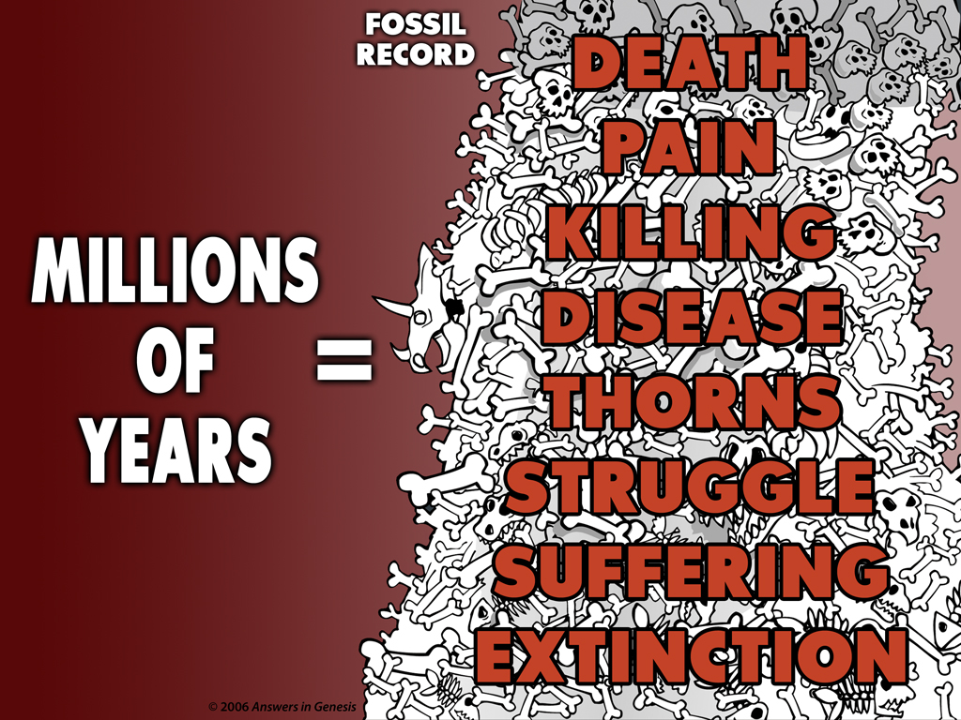

Slide 114
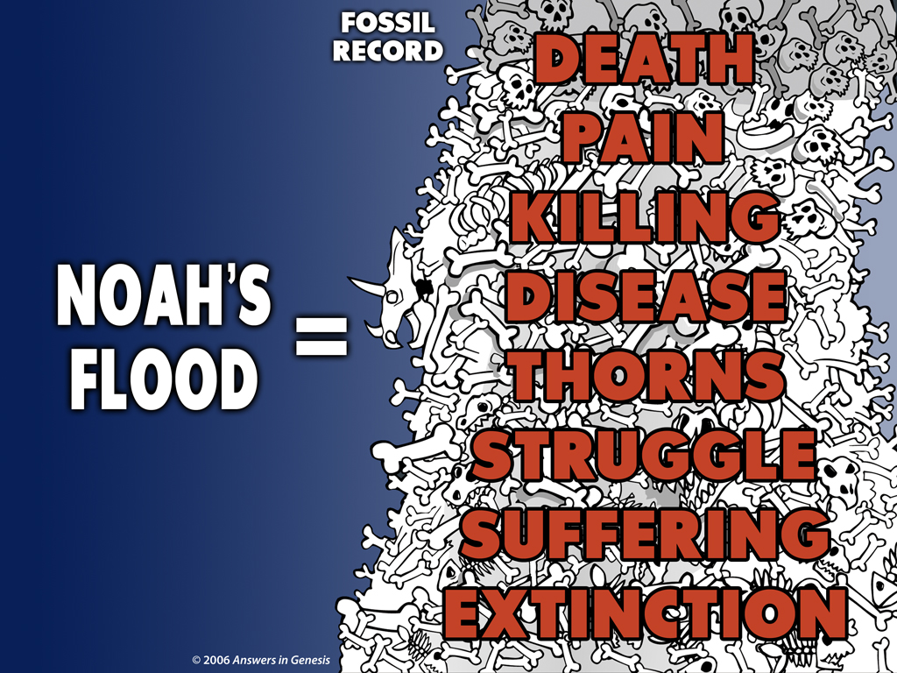

Slide 115


Slide 116
Does it Really Matter
if the Earth is Old or Young?
Old Earthers are using Outside Influences to Reinterpret the clear passages of the Bible.
Twisting the Perfect Inerrant Word of God to fit it into Man’s Sinful, Fallible, and Unprovable Assumptions about the past.
In doing so, they are actually calling God the Father and Jesus liars.
In doing so, they are Undermining the Authority of Scripture (The Word of God).
This leads to Theistic Liberalism that reinterprets actual historical events in the Bible as only having figurative meaning and eventually lead to a Denial of the Fundamentals of Christianity.

Slide 117
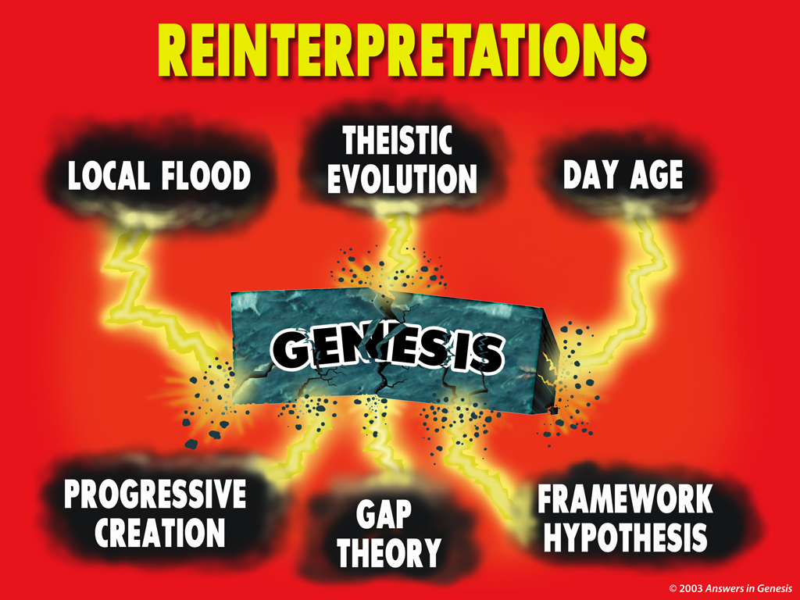
Reinterpretations 00363

Slide 118
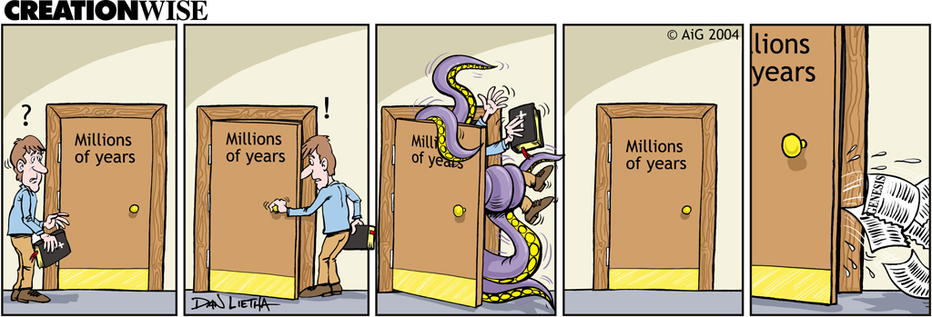
Opening the Door to Millions of Years

Slide 119

Example:
Flat Earth?
Isa 40:22 He who sits above the circle (sphere) of the earth, …
Job 26:7 He stretches out the north …hangs the earth on nothing.

Slide 120
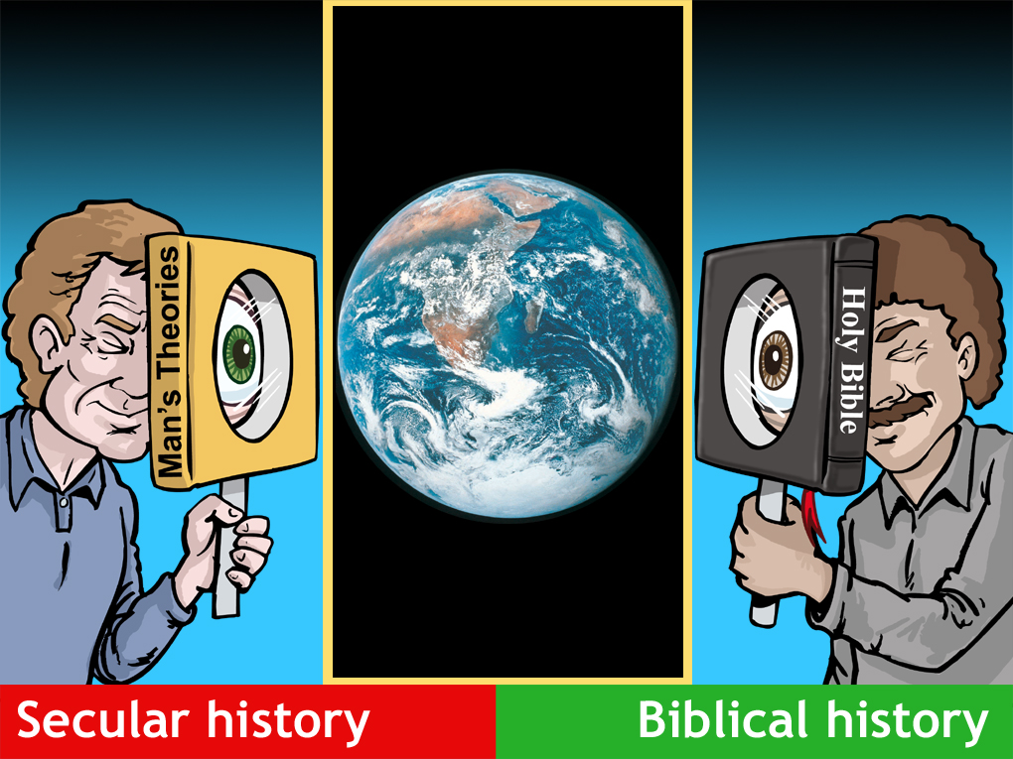
Mag men w/earth

Slide 121


Slide 122


Slide 123


Slide 124


Slide 125
Religion of Evolutionary Science
Earth is Billions of Years Old, Not Created in 6-Days by God.
Miracles are Impossible and thus never happened.
Jesus did not really change water to wine, nor calm a storm.
Jesus did not really walk on water.
Jesus did not really raise people from the dead.
The Virgin Birth is Impossible and thus never happened.
The Resurrection of Jesus from the Dead is Impossible and thus never happened.
We can Reinterpret Anything in the Bible to how we feel it should be viewed today.
Jesus is not the Only Way to God the Father.
There is not such thing as Sin? No such thing as Hell?
Thus The Bible Really Does Not Mean Anything at all and is of No Value to us today.

Slide 126


Slide 127


Slide 128



Slide 129


Slide 130
Any Evidences for a Young Earth?
Biological Evidences :
1. DNA in Supposed “Ancient” Fossils.
2. Lazarus Bacteria from Salt Inclusions.
3. Decay in the Human Genome.
4. “Mitochondrial” Eve.
5. Human Y-Chronosome Variations Limited Worldwide.
6. Many Fossil Bones Hardly Fossilized.
7. Dinosaur Blood Cells, Blood Vessels, and Proteins Not Fossilized.
8. Lack of 50:50 Racemization (mixture of dextrorotatory and levorotatory) of Amino Acids in Fossils.
9. Existence of Living Fossils.
10. Discontinuous Fossil Sequences.
11. Age of World’s Oldest Living Organisims (Trees).

Slide 131
Any Evidences for a Young Earth?
Geological Evidences :
12. Scarcity of Plant Fossils in many Formations Containing Abundant Animal / Herbivore Fossils.
13. Thick, Tightly Bent / Folded Strata without signs of Melting of Fracturing.
14. Polystrate Fossils (Trees through many levels of Strata).
15. Rapid Coal Formation Under Natural Conditions vs. Wood Premineralizaton.
16. Rapid Formation of Oil Under Natural Conditions.
17. Rapid Formation of Opals Under Natural Conditions.
18. Rapid, Catastrophic formation of Coal Beds.
19. Rapid Petrifaction of Wood.
20. Classic Dykes and Pipes (intrusion of sediment through overlaying sedimentary rock).

Slide 132
Any Evidences for a Young Earth?
Geological Evidences :
21. Para (Psudo) Conformities (millions of years of geology missing without erosion).
22. Ephemeral Markings (raindrop marks, ripple marks, animal tracks) at boundaries of Para (Psudo) Conformities shows Rapid Deposition of the Upper Strata.
23. Inter-Tonguing of Adjacent Strata, supposedly millions of years apart.
24. Lack of Bioturbation (worm holes, root growth) at Paraconformities.
25. Almost a Complete Lack of Clearly Recognizable Soil Layers Anywhere in the Geologid Column.
26. Limited Extent of Unconformities (surface erosion).
27. Salt Concentration in World’s Oldest Lake.

Slide 133
Any Evidences for a Young Earth?
Geological Evidences :
28. Turbidity Currents (underwater landslides) Create Huge Areas of Sediment in Hours.
29. Flume Tank Research shows Rapid Laminar Sedimentation.
30. Observed Rapid Hydraulic Canyon Formation (Providence Canyon, Burlingame Canyon, Lower Loowit Canyon).
31. Observed Rapid Island Formation and Maturation (Surtsey Island, Tuluman Island).
32. Rapid Rate of Coastline Errosion.
33. Vertical Errosion Rate of the Continents.
34. Existence of Flat Plateaux supposedly millions of years old (Kangaroo Island, Australia).
35. Recent and Almost Simultaneous Origin of All the Mountain Ranges Around the World.

Slide 134
Any Evidences for a Young Earth?
Geological Evidences :
36. Discordant Drainage Systems (Water Gaps) in Mountain Ranges.
37. Erosion Rates of Niagara Falls, NY.
38. River Delta Growth Rates.
39. Underfit Streams (continent-wide distribution of river valleys too large for the contained streams).
40. Amount of Salt in the Oceans.
41. Amount of Sediment on the Sea Floors.
42. Iron-Manganese Nodules (IMN) Growth Rates on Sea Floors.
43. Age of Placer Deposits (concentrations of heavy metals such as tin).
44. High Pressure in Oil / Gas Wells (permeability vs. time).

Slide 135
Any Evidences for a Young Earth?
Geological Evidences :
45. Direct Evidence of Oil Formation Today (Guaymas Basin, Bass Straight).
46. Rapid Reversals in Paleomagnetism.
47. Pattern of Magnetization in the Magnetic Stripes where Magma is welling up at the Mid-Ocean Trenches.
48. Measured Rates of Stalactite and Stalagmite Growth.
49. Decay of Earth’s Magnetic Field.
50. Excess Heat Flow from the Earth.

Slide 136
Any Evidences for a Young Earth?
Radiometric Dating and the Age of the Earth :
51. Carbon-14 in Coal.
52. Carbon-14 in Oil.
53. Carbon-14 in Fossil Wood.
54. Carbon-14 in Diamonds.
55. Incongruent Radioisotope Dates using the Same Isotope Decays.
56. Incongruent Radioisotope Dates using Different Isotope Decays.
57. Demonstrably Non-Radiogenic “Isochrons” of Radioactive and Non-Radioactive Elements.
58. Different Faces of Same Zircon Crystal giving Different Ages.
59. Indications of Rapid Radioactive Decay in the recent past.
60. Helium from Alpha-Decay retained in Zircons.

Slide 137
Any Evidences for a Young Earth?
Radiometric Dating and the Age of the Earth :
61. Lead in Zircons from Deep Drill Cores vs. Shallow ones.
62. Pleochroic Halos in Granite by Concentrated Specks of Short Half-Life Elements (Polonium).
63. Squashed Pleochroic Halos (Radiohalos) from Polonium Decay.
64. Australia’s “Burning Mountain” (radiometric dating of lava intrusion that started coal burning).

Slide 138
Any Evidences for a Young Earth?
Astronomical Evidence for a Younger Earth and Universe :
65. Evidence for Recent Volcanic Activities on Earth’s Moon.
66. Recession of the Moon from the Earth (4cm/yr., roche Limit).
67. Slowing of Earth’s Rotation Speed (reduction in angular momentum).
68. Ghost Craters on Moon’s Maria (dark “seas” formed from massive lava flows).
69. Presence of Significant Magnetic Field around Mercury.
70. The Outer Planets Uranus and Neptune have Magnetic Fields.
71. Jupiter’s Larger Moons (Ganyemde, Lo, & Europa) have Magnetic Fields.
72. Volcanically Active Moons of Jupiter (Lo).
73. Few Crater Impact on Jupiter’s Moon Europa.

Slide 139
Any Evidences for a Young Earth?
Astronomical Evidence for a Younger Earth and Universe :
74. Methane on Titan (Saturn’s largest Moon).
75. Rate of Change / Disappearance of Saturn’s Rings.
76. Encelandus (a Moon of Saturn) Massive Jets of Water Vapor.
77. Miranda (a small Moon of Uranus) Extreme Surface Features.
78. Neptune Strong Wind Velocity.
79. Neptune’s Rings Thin and Thick Regions.
80. Triton (Neptune’s Moon) Minimal Impacts.
81. Uranus & Neptune Magnetic Fields are Significantly Off-Axis.
82. Orbit of Pluto is Chaotic.
83. Existence of Short-Period Comets.

Slide 140
Any Evidences for a Young Earth?
Astronomical Evidence for a Younger Earth and Universe :
84. Near-Infrared Spectra of Kuipler Belt Object, Quaoar & Charon, indicate Crystalling Water Ice and Ammonia Hydroxide.
85. Life of Long-Period Comets that are Sun-Grazing (Hyakutake or Hale-Bopp).
86. Life of Near-Earth Asteroids.
87. Life of Binary Asteroids.
88. Rapid Rate of Changes in Stars.
89. Faint Young Sun Paradox (compression of sun’s core, brighten from a start of -2C to +15C today).
90. Cometesimals (Small Comet Remnants add 100 million Tonnes of Water to the Earth Every Year).
91. Giant Gas Planets, Jupiter & Saturn, Radiate More Energy than they Receive from the Sun.

Slide 141
Any Evidences for a Young Earth?
Astronomical Evidence for a Younger Earth and Universe :
92. Speedy Stars Moving Away from Each Other in Dwarf Galaxies.
93. Aging of Spiral Galaxies.
94. Number of Type I Supernova Remnants (SNRs) too small.
95. Rate of Expansion and Size of Supernovas.

Slide 142
Any Evidences for a Young Earth?
Human History :
96. Human Population Growth Rate.
97. Lack of “Stone Age” Human Skeletons and Artifacts.
98. Length of Recorded History, ~ thousands of years old.
99. Language Differences (languages in Australia vs. South-Eastern India and Sri Lanka.
100. Common Cultural Stories & “Myths”, for example an earth destroying flood.
101. Origin of Agriculture.

Slide 143






Slide 144
Causing Division in the Church?
John 14:6 Jesus *said to him, “I am the way, and The Truth, and The Life; no one comes to the Father but through Me. (Jesus was very narrow minded and caused division between truth and error!)
Matthew 10:34-36 (34) “Do not think that I came to bring peace on the earth; I did not come to bring peace, but a sword. (35) “For I came to set a man against his father, and a daughter against her mother, and a daughter-in-law against her mother-in-law; (36) and a man’s enemies will be the members of his household. (Truth divides!)
Romans 16:17 Now I urge you, brethren, keep your eye on those who cause dissensions and hindrances contrary to the teaching which you learned, and turn away from them.

Slide 145
Causing Division in the Church?
Jude 17-19 (17) But you, beloved, ought to remember the words that were spoken beforehand by the apostles of our Lord Jesus Christ, (18) that they were saying to you, “In the last time there will be mockers, following after their own ungodly lusts.” (19) These are the ones who cause divisions, worldly-minded, devoid of the Spirit.
2 Peter 3:3-6 (3) … in the last days mockers will come with their mocking, following after their own lusts, (4) and saying, …, all continues just as it was from the beginning of creation.” …(6) For when they maintain this, it escapes their notice … (6) … the world at that time was destroyed, being flooded with water. (Uniformitarianism and Gradualism, the underlying foundation of the Religion of Evolutionism)

Slide 146
Standing On the Word of God
2 Corinthians 10:5 We are destroying speculations and every lofty thing raised up against the knowledge of God, and we are taking every thought captive to the obedience of Christ,
1 Peter 3:15 always being ready to make a defense to everyone who asks you to give an account for the hope that is in you, yet with gentleness and reverence
John 3:12 (Jesus said) If I told you earthly things and you do not believe, how will you believe if I tell you heavenly things?
…………………………………………………………………………
Matt. 16:18 … upon this rock (Peter’s Testimony about Christ) I will build My church; and the gates of Hades will not overpower it.

Slide 147

Will You Believe and Trust God’s Word?

Slide 148


Refuting Compromise 00914a

Slide 149

Unformed and Unfilled 01016

Slide 150
THE END
Answers In Genesis www.AnswersInGenesis.org
Creation Ministries International Creation.com
Institute for Creation Research www.icr.org

