Slide 1

Jim Hovis, Creation Science Fellowship of New Mexico, 2002;
updated January 2012
Reliability Engineering and the
Second Law of Thermodynamics;
Compared to Scripture (Genesis).

Slide 2

What are the observable systems?
Evolution- based on belief in past processes or faith. No one was there to observe. No hard evidences. A continuation. (actually not observable)
Creation- based on belief in past event or faith. We have a record of one who was there. A one-time event. (actually not observable)
Reliability*- based on observable events. Everybody today can see the process. A continual process.
Which ones are Theories and which are Laws?
*For detailed paper, see www.creationsciencenm.org and do a search for “reliability”

Slide 3

Second Law of Thermodynamics Definition per
Physicist Lord Kelvin (& Clausius):
“There is no natural process the only result of which is
to cool a heat reservoir and do external work.”
There are actually two parts to the Second Law: Thermo (energy) and Statistical Dynamics (Boltzmann: decay of complexity)
Interpreted as:
Usable energy in the universe is becoming less and less
All natural systems degenerate when left to themselves
Everything disintegrates over time
Everything ages and wears out
The effects of the Law is everywhere (Universal)
K
B
Is it a Law of Decay (less complexity with time), or
a Law of less work done by using the heat of a system and
its final temperature is less than before for each cycle?
Where is time in the equation (passage of the same, that is)?
(See last 2 slides)

Slide 4

What are the tenets of Reliability?
All things will fail, given enough time.
The distribution of failures for a population is exponential.
The distribution of failures in a system is usually exponential.
All things have a probability of failure from the start.
It is a Law of Decay and a breakdown of complexity (organization)
It is universal (here and in the whole Universe).
Was this true in the “Beginning” No!
Was this true in the “Garden of Eden”? No!
Was this true after the Garden of Eden? Yes!
Note: Normal wear and tear is not part of
the Second Law, neither is friction (that is a force)

Slide 5
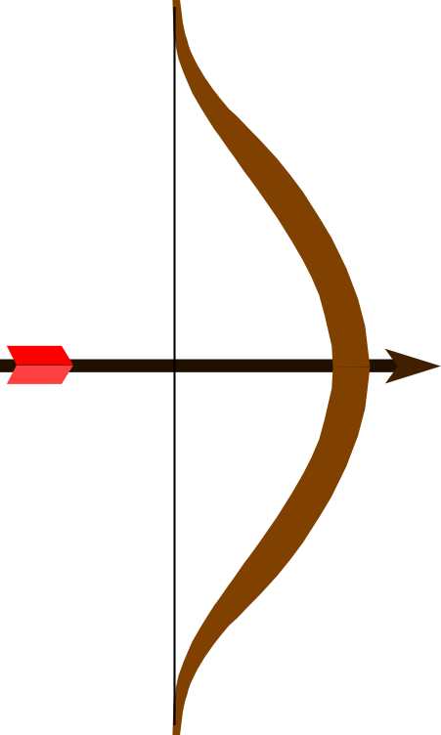
Reliability Engineering and the Bible
The Science and Discipline of Failure Management and Prevention
Includes Failure Analysis, Design and Testing
Analysis includes Predictions and Risk Assessments
Includes effects of Entropy & Second Law
The Genesis Fall of man
Thermodynamics
Statistical Mechanics
Entropy
Failures
Useful Life
Useful life is the time from initial production (new) to
the time when the system has critical loss of function (worn out or “death”)

Slide 6

What was life like before the Fall?
The amount of work (energy→ ΔQ(heat) = ΔW(work) = Δ(Pressure * Volume)) expended to a system would be available to extract back out. All systems would have 100% efficiency (or nearly so)
ΔS (entropy) could still be negative or positive value due to disorder and lower energy states, but also could be zero change in many processes.
A manufacturer could design, build and sell appliances to everybody and then they would either go out of business or design something else. Spare parts suppliers would have essentially no market. This is because there would be no failures of products due to the Second Law. Deliberate damage may occur. Or failures due to poor designs could still happen.
Transistors and microchips would never wear out. (Organized structure of the atoms; The n-p-n (or p-n-p) junctions would never dissipate over time as they do now. Electronic equipment would only have quality control type failures.)
Clothing and shoes stores and manufacturers would run out of customers to sell to, except for new designs and styles.

Slide 7
Before the Fall? Continued…….
Buy a new car and you wouldn’t need a warranty and it will last your lifetime.
Plant a garden and the yield of produce will be more than 100%, assuming you don’t feed the bugs and such. Weeds will have to grow with their own water and food.
Perpetual motion machines would be possible, until you try to extract work from it, then it would eventually use up the energy content. (Superconductors are sort of there already, if the temperature is kept cold enough.)
Fractals might no longer be possible. (Assuming the chaos theory is correct! Which it probably isn’t)
A Steam locomotive train may have near 100% efficiency instead of the barely 10-15%.
An electrical transformer (converts voltage to higher or lower values) is nearly 100% efficiency now, but then most systems will be also at this level.
My computer will most likely never fail. Microsoft will probably go out of business once everyone has the latest greatest designs of hardware and software.
Not much will be wasted. Everything can be used over and over, unless we destroy it somehow.
Some previously irreversible processes could now be reversible.

Slide 8

Why did God subject the Universe to bondage just because Adam and Eve disobeyed the commandment?
failure
failure
failure
failure
Perhaps it was so that we could experience in our physical experience the rebellion that God felt?

Slide 9

What happened in the World since the Fall?
We can deduce (from Genesis 3 and Romans 8) that the effects of the curse are as follows:
Things will wear out with time (through usage)
Things will decay (molecular structures will eventually fall apart)
Nothing will be 100% efficient
Available Energy to do work will continually decrease, when the system is the whole Universe
Failures of all things will occur given enough time. (Loss of function)
Death for all living systems is an end result of the Law of Decay (or catastrophic failure)
Were the effects of the Second Law ever suspended in past history?
Yes, in Deuteronomy 29:5 when we are told that the Israelites, while they were wandering in the Wilderness for 40 years, did not have their clothes wear-out nor their feet get sore and swell.
And in Revelation 9:6, when men will seek death, but cannot achieve it.

Slide 10

Now, Can we use the Second Law of Thermodynamics to refute the concept of the Theory of Evolution?
Answer:
It depends……
Warning: This is even controversial among Creation Scientists
Do we understand the two parts of the derivative of Entropy?
Is Thermodynamic Entropy violated by Evolution Processes? YES!
Is Statistical Mechanics Entropy violated as well? YES!
Does Reliability refute the concept of Evolution Process? YES!
When we discuss Evolution and the Second Law, are we on the same footing and understanding of Entropy and the effect of the Law of Corruption (Decay) with time?
Keep in mind that just because Evolutionists don’t like,
or don’t accept the premise of our argument,
doesn’t mean that we can’t use it!

Slide 11
Three formulations of the Second Law of Thermodynamics
In an isolated system, the direction of spontaneous change is always toward greater entropy. ΔG = - TΔS (less energy available to do work)
There is a pervasive trend in “nature” towards disorder and decay (less complexity). ΔS = -ln(W)
Natural processes go in the direction of increasing the total entropy of the Universe. The “Heat Death”.
Scientific observation: Ordered complexity is always evidence of intelligent design somewhere, somehow!
That includes information that is found in DNA.
“Heat Death” means the Universe ends up motionless, cold, and dead.)

Slide 12
The Evolutionist’s View of Entropy*
Evolution is a proven, documented fact
Creation and Scripture are false; Creation Science is pseudo-science (or just religion)
Entropy is valid only for closed systems
Evolution is an open system supplied by energy from the Sun
Complexity arises from random changes (or beneficial mutations)
Intelligent input is not required for Evolution
Application of external energy to an open system of organized complexity still results in increased entropy if that’s all there is. The Evolutionist ignores intelligent input. (Big difference between dead wood heating up and living trees that can use the energy to build.)
*(Per Ernst Mayr protégé of deceased Asimov, Sagan, Gould)

Slide 13
Definitions of Thermodynamics: God’s Laws as applied to systems
ΔS is a made up quantity to determine the spontaneity of a reaction or change of state.
[Statistical Mechanics Model]
(implies that systems will move toward the lowest energy state spontaneously)
ΔS = -ln(Ψ)
[Thermodynamics Model]
(Always a positive number if the system is allowed to run by itself- i.e. no outside energy input, or intelligence)
ΔS = (ΔE + work)/T
Many Scientists try to equate the two parts of Entropy, but they really should be added. (Hovis Theory)
ΔS = (ΔE + work)/T + (k_{r} /T)[∫dΨ/Ψ]
But, we need to account for the following:
(1 - e^{-λt}) is the Reliability (Hazard) Function; λ is the rate of failure (failures per hour), t is time (hours).

Slide 14

If there are 2 aspects of the nature of Entropy, what should the calculation be?
They should be added together (in my humble opinion)
ΔS = Thermodynamic definition + Disorder Definition
ΔS = (ΔE + work)/T + (-log(Ψ)/T)(Failure function)
Failure Function = (1 – Reliability) = 1 – e ^{- λ t}
Now, we have the element of TIME (t) in the Entropy Equation!
Is it right? Who knows!
Is Evolution now OK? Still NO!

