Slide 1
Big Bad Theology and Science Debates
Unconscious Worldview Assumptions as Spiritual & Scientific Land Mines
K.G. Powderly Jr.

Slide 2
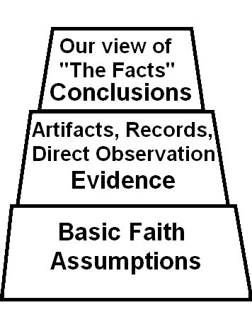
What is a worldview?
A grid of faith-assumptions through which we see the world
A personal or cultural concept of truth and reality
A bias that guides how morality, theology, philosophy, the sciences, politics, law, the arts, history, and economics are understood
WARNING: Not all biases are equal—some are more honest and educated than others
This pyramid maps any worldview

Slide 3
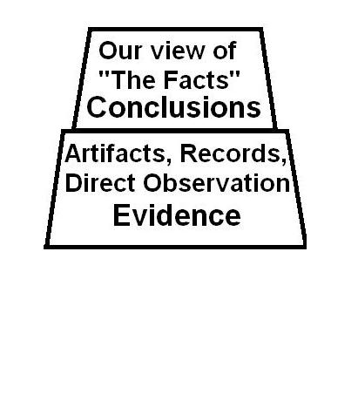
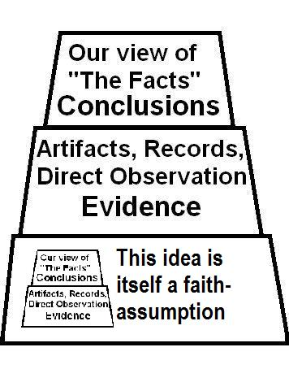
Today academics tell us we can simply dispense with the bottom layer
But their model self-destructs because…
…that masquerades as objectivity

Slide 4
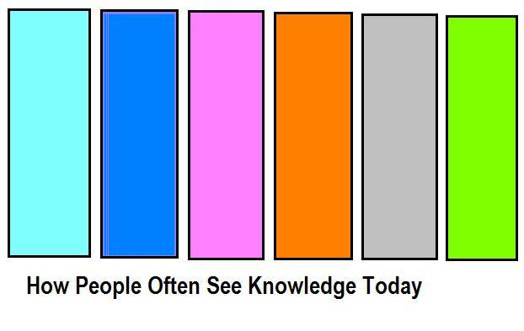
People often confuse reality with the ways we categorize our knowledge about reality
POLITICS
THEOLOGY
SCIENCE
PHILOSOPHY
THE ARTS
HISTORY
We expect reality to neatly conform to our rigidly non-overlapping categories & even childishly demand it do so

Slide 5
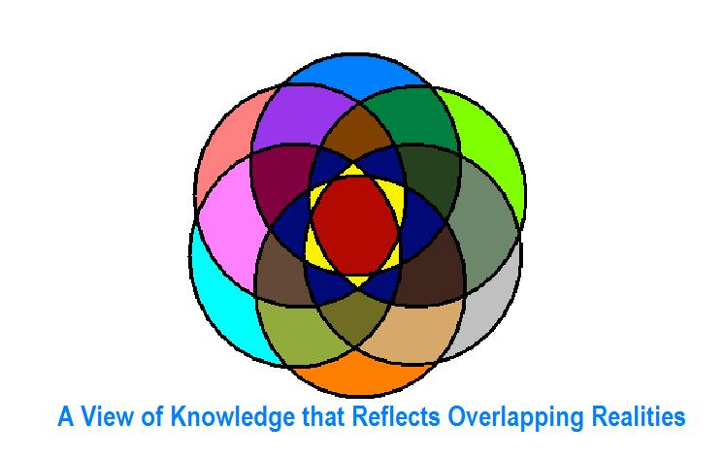
Fortunately, neither reality nor the God who created it will give in to such demands
PHILOSOPHY
THEOLOGY
POLITICS
HISTORY
SCIENCE
THE ARTS
Instead, it is we who must conform or follow the dodo…

Slide 6
To some degree, all our forms of knowledge must overlap because…
It is self-evident that everything in reality is interrelated—that causes in one category often lead to effects in others; sometimes unpredictably

Slide 7
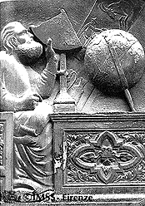
We must keep this firmly in mind if we hope to…
understand the science & theology conflicts of the past & the current challenges to a Bible-based Creationist worldview

Slide 8
Closer examination reveals that such debates are not usually between “science” & “theology” at all…
Rather, they reflect a clash between the theology of one worldview with that of another
Or a clash of both the theology & science arising from one worldview’s faith-assumptions with those of another worldview
Or an irresolvable conflict between the morality and truth-claims of two mutually exclusive worldview systems
Either way…

Slide 9
Every moral system demands its own cosmology
That means the idea of “science” can easily be reduced to a flashy prop in the hands of clever illusionists—unless the moral system in question accepts the idea of objective truth as reality

Slide 10
Side-bar: What is objective truth?
The classical concept of truth—as opposed to that which is false
A truth that is open to examination by others—that is in some sense verifiable
In ethical reasoning, it is that truth which best fits the human condition as it is observed
Put simply, objective truth is a truth that remains true even if nobody in the world really wants it to be
It’s both comforting and frightening that way

Slide 11
On to our main topic…
What are the roots of today’s perceived science vs. religion conflicts?
More importantly, how did their worldview arise out of their moral faith-assumptions about truth?
How did the classical ancient world of Greece & Rome see the cosmos?

Slide 12
The Greek worldview assumed...
Material reality was evil simply because it was material and not spiritual
The original divine “demiurge” (or Prime Mover) was too pure to create a material reality
The original “demiurge” involuntarily radiated copies of itself that then shot-out further copies growing more corrupt as they went, until one sunk close to some pre-existing matter and made a material world
The “pull of the material” was the source of evil
The “gold in Havilah” (Gen. 2) was the source of greed
A materially-caused evil corrupted the spirits of both gods and men

Slide 13
The Greek word pneuma, from which we get pneumatic or air-driven…
Means air, breath, wind, and spirit—all of which were more-or-less the same thing to the Greek worldview

Slide 14
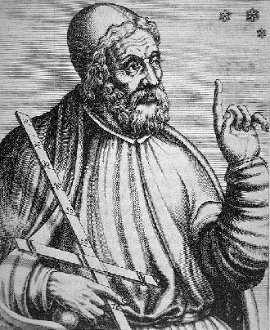
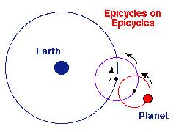
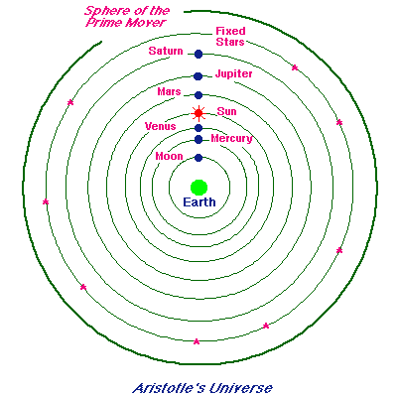
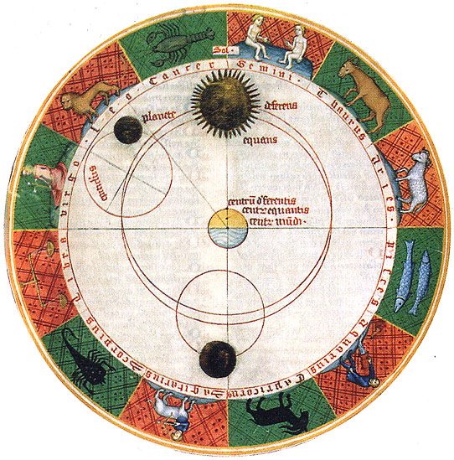
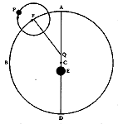
Aristotle’s Cosmology, as developed by Ptolemy, dominated the Greco-Roman worldview
Ptolemy’s more sophisticated “Epicycle Theory”
Claudius Ptolemy
Aristotle’s simplistic Geocentrism

Slide 15
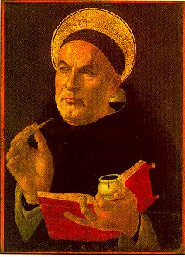
Scholasticism reawakened Christian academics in the late Middle Ages, but sometimes produced extremes...
Tomas Aquinas 1225-1274
Revived Aristotle & Ptolemy's geocentric worldview on the cosmos in Catholic Europe
Did away with the pagan Greek reason for earth’s centrality based on material corruption
Substituted a Christian reason for earth’s centrality—God had placed Man in a special place
Set the mold for higher education in late Middle Ages

Slide 16
Tomas Aquinas 1225-1274
Associated sin with poor moral and philosophic reasoning skills
Said man’s reasoning could be unaffected by the Genesis Curse, provided the man reasoned in a way consistent with created reality (For example, a non-Christian can still be a great doctor or scholar)

Slide 17
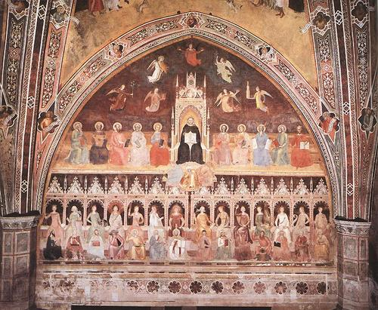
Idea Mechanics Principle # 1: Law of Unintended Consequences...
Notice in Da Firenze’s painting, Triumph of St. Tomas and Allegory of the Sciences, that Plato, Euclid, and Aristotle are set on the same level with St. Augustine on the lower tier
Aristotle became “unofficial prophet” on the subject of the natural world in Medieval church due to the “authority-based” academic model

Slide 18
Law of Unintended Consequences...
Aristotle’s worldview with Earth at the center of universe skewed Scripture interpretation for Catholics and early Protestant reformers
A distortion of Aquinas’ point about the Curse eventually gave rise to the wacky idea that “sin could be educated out of people”
An incomplete view of the Genesis Curse resulted: man’s reasoning abilities were increasingly seen as unaffected by sin

Slide 19
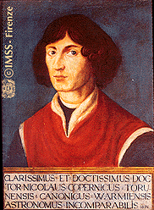
But not everyone thought Aristotle was such hot stuff…
Enter Nicolaus Copernicus 1473-1543
Preferred Pythagoras & Plato to Aristotle, and assumed a sun-centered or heliocentric universe
Did this at a time when Aristotle’s geocentric (Earth-centered) view dominated Medieval worldview faith-assumptions about reality
Was a physician, lawyer & church administrator—a Christian
Argued from philosophy, not experimental observation

Slide 20
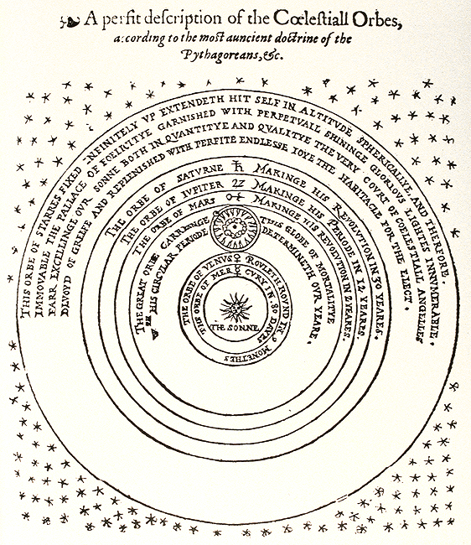
The Pythagoreans calculated that a sun-centered universe was geometrically more elegant in explaining planetary motions but could not prove it by direct observation

Slide 21
Christianized Neo-Platonism is easily detectable in Copernicus’ writings:
He quoted pagan Neo-Platonist literature, which praised the sun as “the Visible God,” though he brought a Christian perspective by clarifying that the sun only symbolized divinity (“God is light and in Him is no darkness at all” 1 John 1:5)
Copernicus metaphorically described the sun (in terms of its created purpose) as, “the Lamp, the Mind, the Ruler of the Universe [who] sits upon a royal throne ruling his children the planets which circle around him” –Nancy Pearcey, Saving Leonardo, Pg.188 ©2010 B&H
Philosophy & spirituality drove the rise of the sun-centered solar system theory long before empirical evidence existed to support the idea—it’s what made Copernicus want to ask the questions in the first place

Slide 22

Experimental proof for a sun-centered solar system had to wait another century for...
Galileo 1564-1642, who...
Invented a better telescope
Supported Copernicus’ view with observed evidence from his telescope & from mathematics
Tended to be arrogant, which made him enemies in both church and science leadership circles (which was usually the same circle in those days)

Slide 23
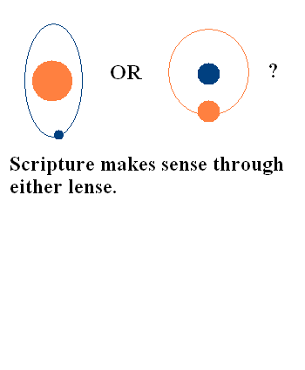
To Medieval Christian intellectuals educated under Aquinas’ revival of Aristotle…
The Earth-centered universe view seemed like a more natural and literal fit with Scripture
The Sun-centered view seemed foreign to a natural reading of the Bible
Actually, Scripture does not directly teach about planetary orbits, it just describes historic events the way people saw them

Slide 24
Today’s skeptics try to compare the Creation-Evolution Debate with the
Galileo Controversy
But that’s an “apples & oranges” comparison
In the Galileo Controversy the Church ignored the context & genre (type of literature) of the Scriptures in question (like Joshua’s long day)
Today’s Creationism arises from the context & genre of Genesis 1-11 (History)
Today’s Creationists are generally honest about their faith-assumptions
Advocates of Molecule-to-Man Evolution generally are not, or are not aware that they make them

Slide 25
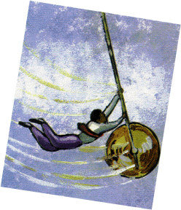
Worldview paradigm shifts often swing as on a pendulum between extremes
Medieval “absolute Aristotle” – an honestly mistaken way to support “absolute moral truth”
Postmodern “absolute Copernicus” – an equally erroneous support for “absolute moral relativism” –an oxymoron
A full swing between extremes can take centuries

Slide 26
Both extremes attempt to find in Nature an apologetic for their moral systems…
Medieval Absolute Aristotle
Postmodern absolute Copernicus
Sought in Nature a sign to confirm an absolute Divine moral order (assumed they grasped Nature’s teleology or purpose more than they did)
Didn’t know how big God (and God’s cosmos) really was
Feared that if the cosmological order didn’t match the social one that somehow Christian society would unravel
Seeks a random cosmos to confirm that humanity is in no special place, having no real meaning or purpose (assumes cosmic evolution)
Doesn’t know how big God (and the God’s cosmos) really is
Really, really, hysterically fears that if evidence of design is taken seriously that pluralistic secular society will collapse

Slide 27
But hasn’t science proven that Earth is, as Stephen Hawking once said,
“…a medium sized planet going around a medium sized star on the outer edge of a fairly average galaxy, which is itself simply one of a local group of galaxies”?
…that we are indeed randomly placed at no special location in the universe?

Slide 28
Perhaps we should look at a little more of Hawking’s statement…
“However we are not able to make cosmological models without some admixture of ideology. In the earliest cosmologies, man placed himself in a commanding position at the centre of the universe. Since the time of Copernicus we have been steadily demoted to a medium sized planet going around a medium sized star on the outer edge of a fairly average galaxy, which is itself simply one of a local group of galaxies. Indeed we are now so democratic that we would not claim our position in space is distinguished in any way.” The Large Scale Structure of Space-Time, p. 134 (with George Ellis)

Slide 29

An ideology works structurally in the idea realm just like a religious dogma
Ideology Assumptions
Religious Dogma

Slide 30
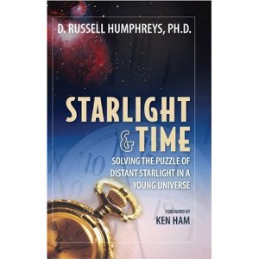
Dr. Russ Humphreys showed that the Copernican Principle as an absolute…
Is not based on scientifically observed data at the galactic cluster scale
Is not necessary at that scale to explain what is observed (MW background radiation, red-shifted light of distant objects, etc.)
Is an arbitrary assumption imposed by an ideology that dislikes the only alternative…

Slide 31
Dr. Humphreys did this by…
Exposing the underlying assumptions of the Big Bang Cosmology—assumptions even most non-cosmologist scientists are not aware of
Mainly the assumption that “the universe has no center and no outer edge”
And the assumption that “space has a more-or-less equal distribution of matter floating in it when viewed at the galactic cluster-sized scale”
Humphreys asked, “why assume these things when no observations support them?”

Slide 32
Because if the universe has a center and an outer boundary…
Our galaxy would have to be somewhere near the center of the universe because, on a galactic cluster scale, we see an equal distribution of distant objects on all sides
If our galaxy is near the universe’s center it is the final “smoking gun” in a long line of “smoking guns” that we were placed here by design, because the odds of it happening randomly would be astronomically absurd
What are some of the other “smoking guns”?

Slide 33
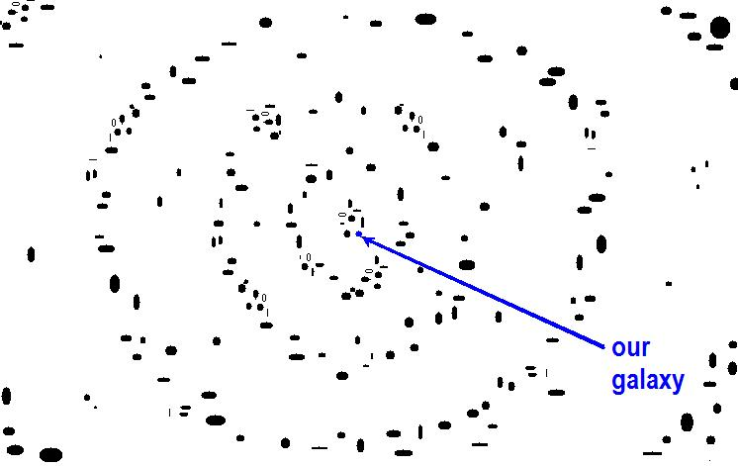
Recent data increasingly suggests both Aristotle & Copernicus were right—just not absolutely so
Beginning with astronomer William Tift in 1976, the filtering out of planetary, solar system, and galactic motions showed that the red shifts of distant galactic objects are at quantized distances—incremental rather than gradual
This suggests that at the macro level Copernicanism is wrong—there is a universal center

Slide 34
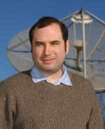
Guillermo Gonzalez and The Privileged Planet addresses other “smoking guns”
Sun orbits galaxy between star-clouded spiral arms, making inter-galactic space visible to great distances
Earth at exactly right range from sun; not too hot or cold
23 degree axial tilt for seasons
Large moon for tides, and same visual “size” as sun—the odds against this alone happening by chance are way past astronomical

Slide 35
So, since both worldviews have their own bias, the question isn’t really about religion vs. science then, is it?
It’s about truth, and how badly does a civilization really want to walk off a cliff like Wile E. Coyote—only in the real world?

Slide 36
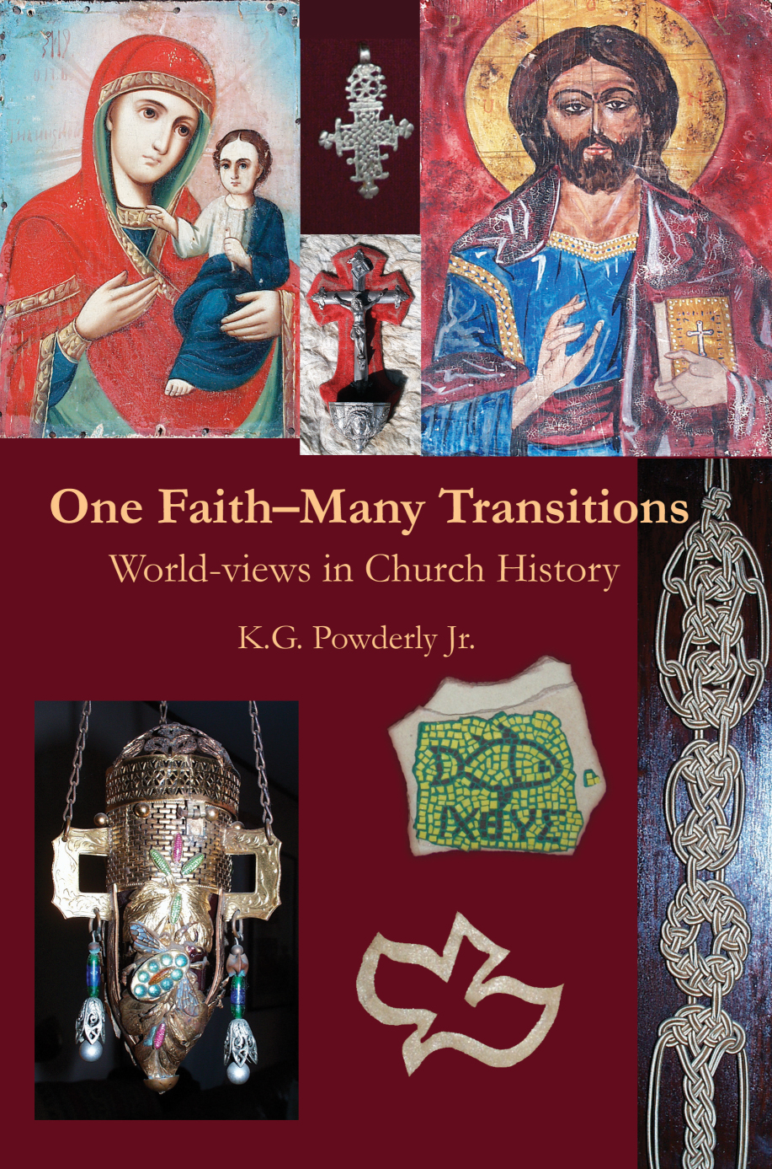
Notes:
For a good overview on the major flow of Church History that emphasized how worldviews affected our developing beliefs and doctrines...

Slide 37
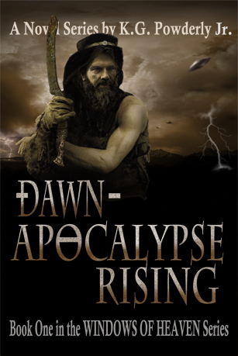


The Windows of Heaven novels

Slide 38

The Windows of Heaven novels

