Slide 1
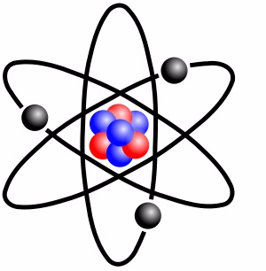

Science killed the Religion of darwinism

Slide 2
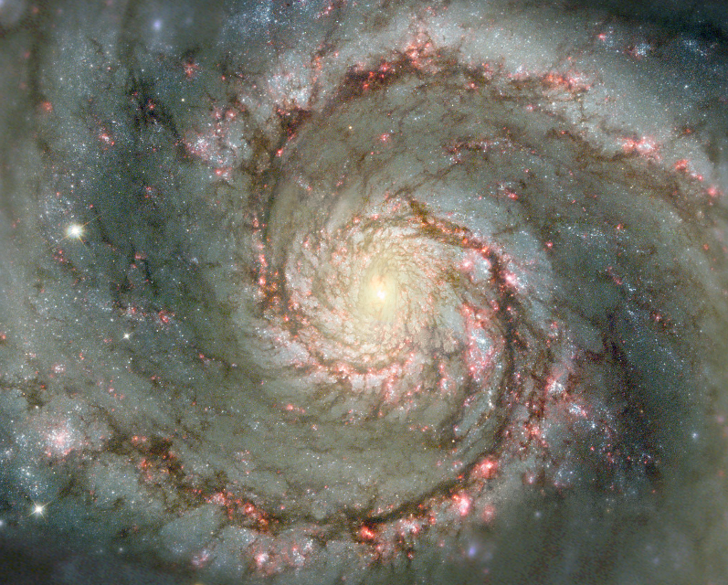
Evidences For Atheists
That Show The Existence of God
2011/02/14
Isn’t the Belief in God just a Religious Faith?

Slide 3
WHY SHOULD CHRISTIANS CARE?
God Commands it :
  1 Peter 3:15 … always being ready to make a defense to everyone who asks you to give an account for the hope that is in you, yet with gentleness and reverence
  Jude 3 … contend earnestly for the faith which was once for all handed down to the saints.
  2 Cor.10:5 We are destroying speculations and every lofty thing raised up against the knowledge of God, and we are taking every thought captive to the obedience of Christ
God Loves the People of the World :
  John 3:16 For God so loved the world, that He gave His only begotten Son, that whoever believes in Him shall not perish, but have eternal life.
Separation from God because of our sin is a reality :
  2 Cor.10:5 If your right eye makes you stumble, tear it out and throw it from you; for it is better for you to lose one of the parts of your body, than for your whole body to be thrown into hell. (New American Standard Bible)

Slide 4
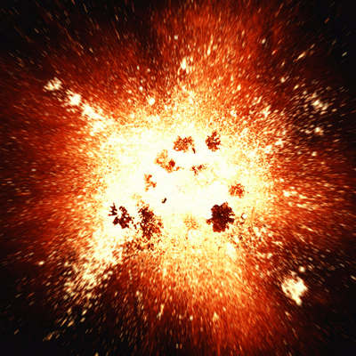
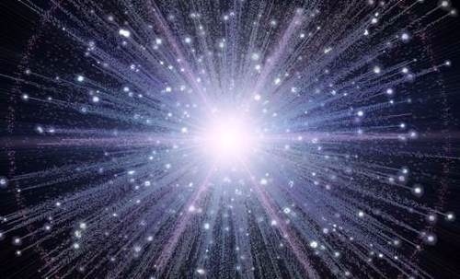
Theories of the cosmos
Cosmology – From Greek - Cosmos (World/Universe) & Logos (Word/Study of) = Study of the Structure of the Universe.
Cosmogony – Study of the History of the Universe.
Theories :
Steady State Universe
Expanding Universe
Modified Steady State Universe
Oscillating Universe
Inflationary Universe
Quantum Universe
String Theory
Multiple Universes

Slide 5
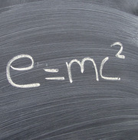
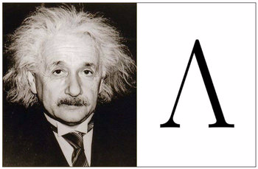
Steady State Universe
Eternally Existing, thus no beginning and no creation.
Popular with Evolutionists and Atheists because it did not need a creator (God), which supported their Materialistic World View.
Einstein had to add a cosmological constant “fudge factor” to his General Theory of Relativity to make it fit the Steady State Universe Model. Later he wrote that adding this cosmological constant “fudge factor” had been “the biggest blunder of my life.”
The Steady State Universe Model was popular with Albert Einstein until …
Cosmological Constant (Lambda)

Slide 6
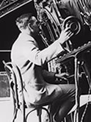
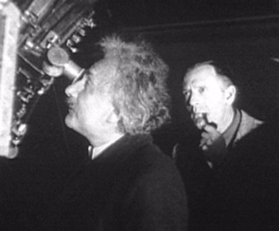
Red Shift of Light from Distant GAlaxies
1927 Edwin Hubble - Palomar Observatory at Mt. Wilson, 200” Dome Telescope - Hubble Deep Field Observations – Established Red Shift of Light from distant galaxies.
The greater the distance, the greater the red shift.
Hubble interpreted this red shift as a Doppler Effect caused by the galaxies moving away from the earth. {a religious assumption}
Galaxies moving away from us in all directions implied the universe had a beginning. If it had a beginning, then it had a transcendent cause.
This red shift is actually due to the stretching of space, which stretches out the light waves.
Einstein, confronted with the evidence, realized that the red shift implied a beginning of the universe and thus the existence of God, the creator.

Slide 7
Stretching of Space
What did God reveal to us?
Job 26:7 He stretches out the north …hangs the earth on nothing.
Isa 40:22 He who sits above the circle of the earth, … Who stretches out the heavens like a curtain.
Isa 42:5 … Who created the heavens and stretched them out …
Isa 44:24 … Stretching out the heavens by Myself …
Isa 45:12 … I stretched out the heavens with My hands …
Isa 48:13 … My right hand spread out the heavens …
Isa 51:13 … the Lord your Maker, Who stretched out the heavens …
2 Sam.22.10; Ps.18:9, 104:2, 144:5; Job 9:8, 26:7; Jer.10:12, 51:15
Col. 1:16-17 … by Him (Jesus) all things were created, both in the heavens and on earth, visible and invisible, … - all things have been created through Him and for Him. … in Him all things hold together.

Slide 8
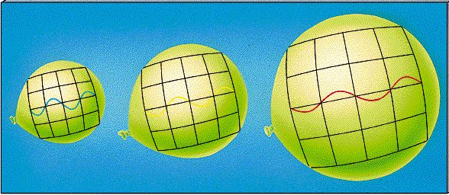
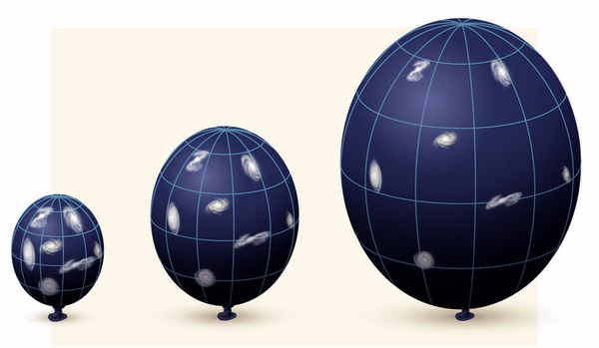
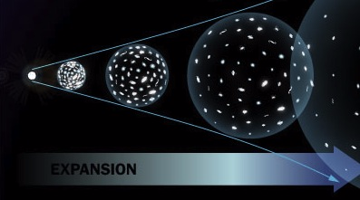
SINGULARITY POINT in the BEGINNING
The Beginning of :
  Space
  Time
  Matter
  Energy
Singularity Point – The Laws of Physics no longer hold.

Slide 9
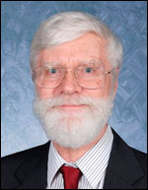
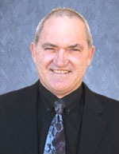
CREATION MODELS
Black Hole Cosmology – The Big Bang Theory.
Expansion of space and matter at the same time.
Cosmological Principle –
Homogeneous Universe, No unique location.
White Hole Cosmology (Humphreys & Hartnett)
Space expands first, then matter expands later.
Einstein’s Theory of Relativity – Time Dilation (Velocity, Acceleration, and Gravity).
Evidences :
Quantized Red Shift of Galaxy Light (Spheres of Galaxies around the Earth).
Rotational Axis of the Cosmic Microwave Background Radiation (CMBR).
Quasars bridged to Galaxies with large offset red shifts (NGC 4319).
Horizon Problem - smoothness of the Cosmic Microwave Background Radiation (COBE satellite).
Galaxies clumped into clusters and long strands of galaxies (not homogeneous).
Flatness problem (mass density smoothness).
Dark Matter and Dark Energy problem.

Slide 10
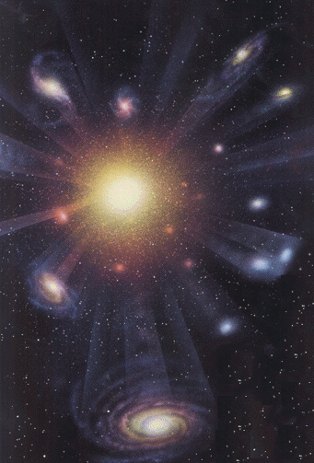
BEGINNING OF THE UNIVERSE
THE SINGULARITY POINT
Nothing (No Time, No Space, No Matter, No Energy, No Laws of Physics)
Everything (Time, Space, Matter, Energy, Laws of Physics, Etc.)

Slide 11
COSMOLOGICAL ARGUMENT
-
8
?
Kalam (Time) Argument - Al-Ghazali (1058-1111) Muslim philosopher. It is impossible to have an infinite regress of events in time and still arrive at today.
Thomist Cosmological Argument - Thomas Aquinas (1225-1274) Christian. Existence of a First / Uncaused Cause, because no infinite regress of causes could get it started.
Leibniz Cosmological Argument - G.W.F.Leibniz (1646-1716) German mathematician and philosopher. Why is there something rather than nothing. Why does anything at all exist. Therefore, there must be a reason or rational explanation for the existence of one state of affairs rather than another.

Slide 12
COSMOLOGICAL ARGUMENT
(CAUSE and EFFECT)
Law of Causality (Cause and Effect) – For an event (or effect) to occur, it has to have a cause. Nothing happens (or changes) without a cause.
The “Beginning / Creation of the Cosmos” was an event (or effect) that occurred.
Therefore it had to have a cause that began or created it.
That cause had to be distinct from what it caused / created since what the caused creation did not exist before.
Therefore The Creator (The First Cause, The Uncaused Cause, or God) exists and is outside of time, space, matter, and energy.

Slide 13
TRANSCENDENT CAUSE
The Universe is an Effect Which Demands
a Very – Very Great Cause.
The First Cause must be :
Independent of its Effect (Transcendent ).
Infinitely Powerful (Omnipotent / Transcending Energy).
Eternal (Transcending Time).
Spiritual (Transcending Matter, Space, and Energy).
All-Knowing (Omniscient).
Have Personhood (Decision to Create the Universe).

Slide 14
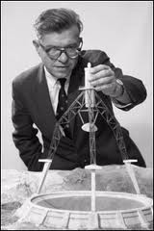
Modified Steady State universe
Sir Arthur Eddington - “Philosophically, the notion of a beginning of the present order of Nature is repugnant to me.”
Modified Steady State Universe – An Expanding Universe with continuous addition of new matter (New Galaxies). {violates conservation of matter/energy}
Question: Where did the new matter and energy come from and what caused it? Unknown.
Presupposition or World View (Religious Belief)
Atheism / Materialism assumes there is nothing outside the material world. Thus no possibility of a creator or a God.
Sir Arthur Eddington - “Religion first became possible for a reasonable man of science in the year 1927”

Slide 15

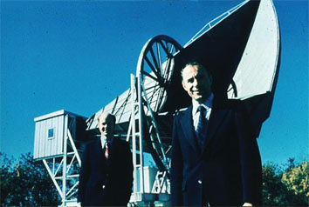
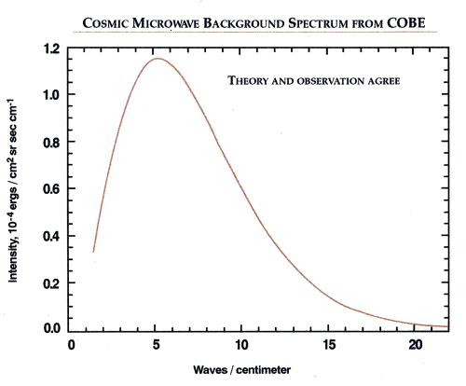
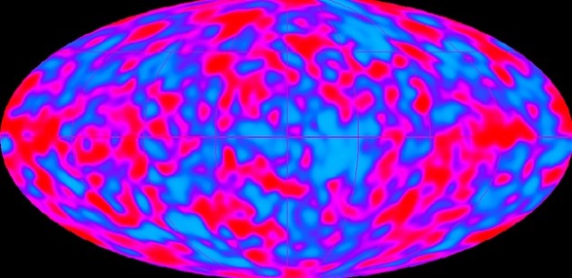
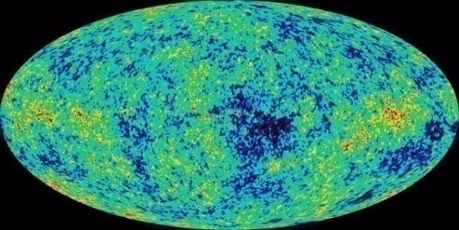
Cosmic Microwave
Background RADIATION
In 1948 George Gamow predicted the existence of a Hot Gas Microwave Background due to un-ionized atoms left over from the Big Bang’s initial conditions.
In 1964 Arno Penzias and Robert Wilson discovered that Cosmic Microwave Background Radiation of ~ 3°K (2.73°K) in all directions.
Sir Arthur Eddington abandoned his Modified Steady State Universe Model.
COBE(1990): ± 200 µ°K » very very smooth

Slide 16
TELEOLOGICAL ARGUMENT
(PURPOSE)
  (from Greek teleos meaning 'end' or 'purpose')
Nature exhibits complexity, order, adaptation, purpose and/or beauty.
The exhibited features cannot be explained by random or accidental processes, but only as a product of mind.
Therefore, there exists a mind that has produced or is producing nature.
A mind that produces nature is a definition of "God."
Therefore, God exists.

Slide 17
TELEOLOGICAL ARGUMENT
(DESIGN)
  Other forms of the argument assert that a certain category of complexity necessitates a Designer, for example :
All things that are designed were preconceived, intended, purposed, or contrived.
Preconception, intention, purpose, and contrivance necessitate an intellect, mind, or will.
All things that are irreducibly complex display intention and preconception. They can not occur by random chance.
The universe contains non-man made things that are irreducibly complex.
Those things display intention and preconception.
Those things necessitate an intellect, mind or will (» a Designer).
Irreducible Complexity (a variant of the watchmaker analogy) and Specified Complexity (closely resembling a fine-tuning argument)

Slide 18
ANTHROPIC ARGUMENT
Anthropic = Relating to Human Beings.
There exists an apparent delicate balance of conditions necessary for human life to exist.
The vast, perhaps infinite, range of possible conditions in which life could not exist is compared to the speculated improbability of achieving conditions in which life does exist, and then interpreted as indicating a Fine-Tuned Universe Specifically Designed so human life is possible.
Therefore, a Designer (or God) exists.

Slide 19
FINE-TUNING OF THE UNIVERSE
D - Dimensions (3 Spatial plus Time) – G.J. Withrow argued intelligent life not possible except in a universe with 3 basic dimensions. In 3-D, mathematical physics possesses many unique properties which are necessary prerequisites for the existence of rational information-processing observers .
α_{S} - Strong Nuclear Force (Nucleus Coupling Constant) -
Increase 1% » alter nuclear resonance levels » almost all carbon burned into oxygen.
Increase 2% » preclude formation of protons out of quarks » preventing the existence of atoms.
Decrease 5% » unbind deuteron » essential to stellar nueocynthesis » a universe of only hydrogen.
Estimated 0.8< a_{S}<1.2 current value or no elements of atomic weight greater than 4 (He, H, Li, & Be) formed.

Slide 20
FINE-TUNING OF THE UNIVERSE
α_{W} – Weak Nuclear Force (Neutron Coupling Constant) –
Appreciable increase » Big Bang’s burning proceed past helium to iron » fusion-powered stars impossible.
Appreciable weaker » a universe of only helium.
Appreciable increase » Big Bang’s burning proceed past helium
α_{G} – Gravational Force –
A little increase » all stars are red dwarfs, too cold for life.
A little decrease » all stars are blue giants, burn too briefly for life to exist.
Change of one part in 10⁴⁰ » disaster for stars like the sun (Davies).

Slide 21
FINE-TUNING OF THE UNIVERSE
α – the Fine Structure Constant or Electromagnetic Interaction –
m_{n}/m_{p} ratio – neutron to proton mass ratio – If m_{n} not > m_{p} by a little more than m_{e}, then atoms would collapse.
μ = m_{p}/m_{e} ratio – proton to electron mass ratio –
Ω = W_{o}/H_{o} ratio – W_{o} related to the Density of the Universe, H_{o} related to the Speed of Expansion of the Universe –
Change of one part in 10¹² » “The Flatness Problem”, re-collapse or no galaxies. At the Plank time, 10⁻⁴³ seconds after the Big Bang, density of the universe within one part in 10⁶⁰ of critical density (Hawking) .

Slide 22
FINE-TUNING OF THE UNIVERSE
Homogeneity Problem – Initial inhomogeneity ratio.
Ratio > 10⁻² then non-uniformities condense into black holes.
Ratio < 10⁻⁵ then inhomogeneities insufficient to condense into galaxies. » incredibly fine tuned.
Isotropic Problem (Very Smooth Cosmic Microwave Background Radiation) – One part in 10¹⁰⁽¹²³⁾ (Penrose).
The standard model of particle physics has about 26 freely adjustable parameters.

Slide 23
FINE-TUNING OF THE UNIVERSE
Quantum Physics – Pauli Exclusion Principle » quantized atomic electron orbital states / shells » chemistry » stability of matter » size of atomic and molecular structures.
Orbital Distance of the Earth to the Sun –
Too close » burn up. Too far » freeze.
Spectral Temperature vs. Molecular Binding Energy – living organisims sterilization or destruction vs. too small photochemical reactions.
Atmospheric Composition – Constrained by planetary mass. But planetary mass inevitable consequence of electromagnetic and gravitational interactions.
Solar System, Earth, Biology, etc., etc., etc., …

Slide 24

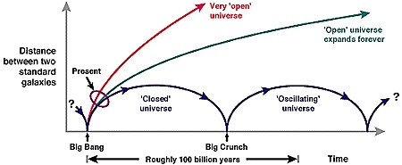
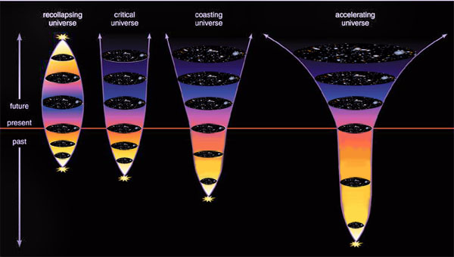
Oscillating universe
Expand → Collapse → Expand → Collapse → … Ω = gravitational potential / kinetic energy ≈ 1 (but < 1).
Problems:
  Not enough mass / matter to collapse the universe. Ω too small.
  Expansion of the universe is accelerating.
  No know mechanism to cause a bounce.
  No scientific test - metaphysics.

Slide 25
Scientific method vs. Metaphysics
Scientific Method – Systematic pursuit of knowledge involving the recognition and formulation of a problem, the collection of data through observation and experiment, and the formulation and testing of hypotheses. (Webster’ Dictionary)
    Testable.
    Repeatable.
Metaphysics – (Greek Meta = “akin to”) - A division of philosophy that is concerned with the fundamental nature of reality and being. (Webster’s Dictionary)

Slide 26
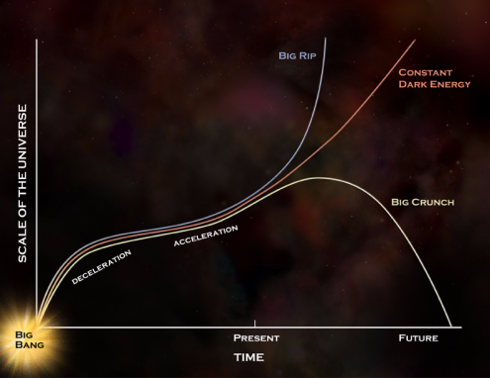
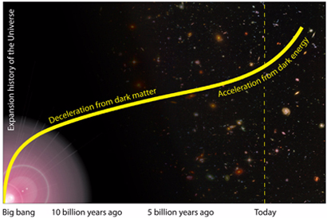
Inflationary universe
Flatness Problem (Ω ≈ 1) or no universe.
Horizon Problem (CMBR same temp 2.73°K in all directions » thermal equalization)
Inflationary Universe (Alan Guth) – Δ Rate of Expansion - deceleration then acceleration.
  Drives Ω close to 1.
  Caused by inflaton (energy field) or “symmetry breaking” (Δ unified forces at beginning of the Bib Bang).
  Highly speculative (metaphysics, not science). Require fine tuning10¹⁰⁰.
  Dark Matter – no local evidence in earth’s solar system or in the milky way galaxy, Earth unique?).
  Dark energy (no evidence).
  Mass/Energy - 4% visible, 23% dark matter, 73% dark energy.

Slide 27
Inflationary universe
(Continued)
Stephen Hawking recently declared both the so-called “old inflationary model” and the “new inflationary model”
to be “now dead as a scientific theory”
– though he still holds out hope for Linde’s more recent “chaotic inflationary model.

Slide 28
quantum universe and
String Theory
Quantum Universe (Edward Tryon) – similar to particle quantum theory. Heisenberg Uncertainty Principle.
  Highly speculative, no observational evidence or tests (meta-physics, not science).
Alien Design (Panspermia – started by aliens)
    Highly speculative, no observational evidence or tests (meta-physics, not science). Change in location.
String Theory – 10 dimensions (9 spatial dimensions + time), all matter consists of very small entities that behave like tiny vibrating strings. Six dimensions rolled up.
  Highly speculative, no observational evidence or tests (meta-physics, not science).

Slide 29
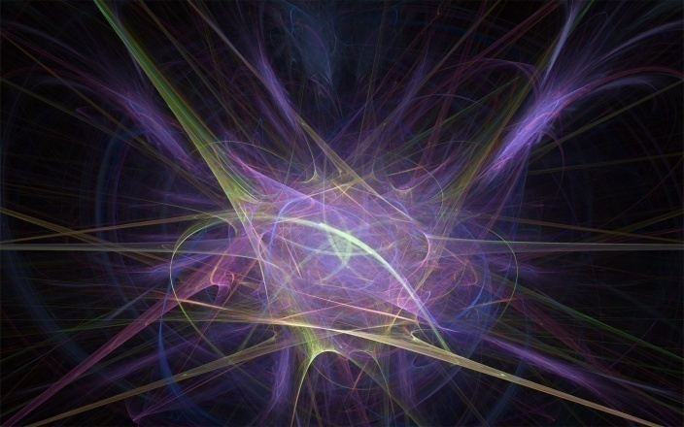
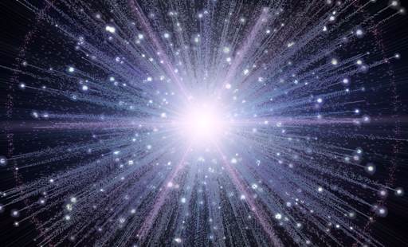
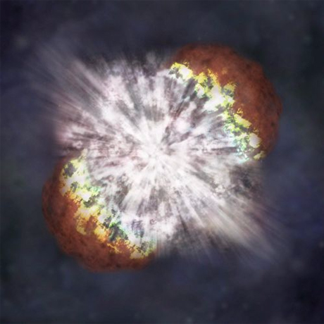
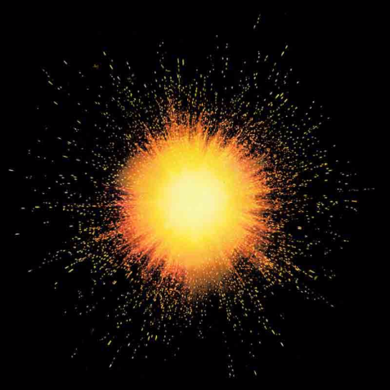
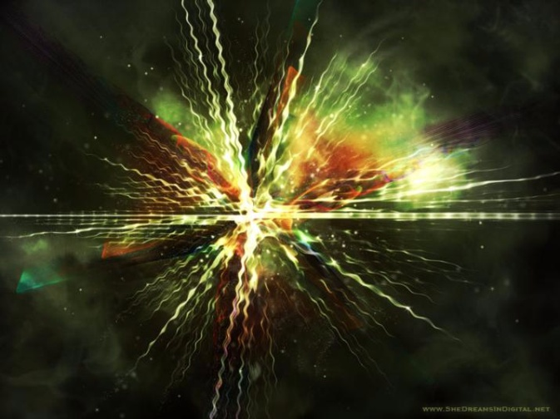
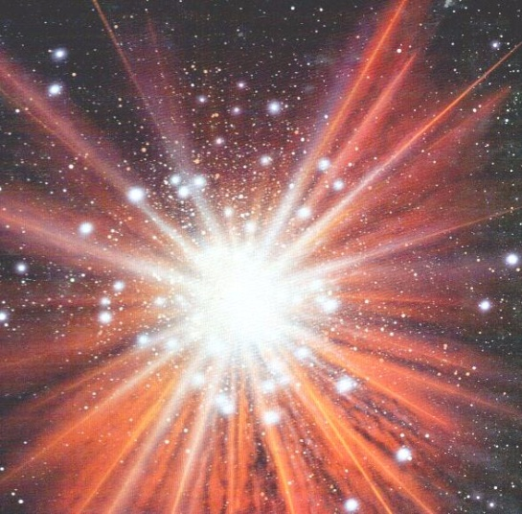
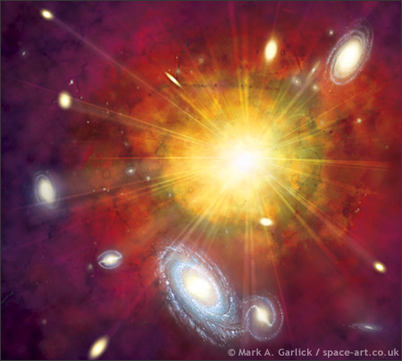
Multiple universes
Random Infinite Number of Universes Generated.
We ended up on the lucky one.
Universe Generator?
  Highly speculative, no observational evidence or tests (meta-physics, not science).
Occam’s Razor.

Slide 30
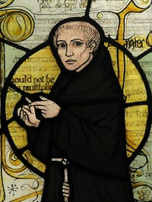
OCCAM’S RAZOR
(or Ockham’s Razor)
William of Ockham – 14th century logician, theologian, and Franciscan friar.
Latin – lex parsimoniae = Law of parsimony, law of economy, or law of succinctness.
“entities must not be multiplied beyond necessity”
“plurality should not be posited without necessity”
A principle which generally recommends selecting the competing hypothesis that makes the fewest new assumptions, when the hypotheses are equal in other respects.

Slide 31
ONTOLOGICAL ARGUMENT
(BEING)
Greek "ontology" – relating to the concept of being. His being by nature includes the concept of necessary existence.
A being greater than which cannot be conceived.
Anselm of Canterbury (1033-1109)
God is something of which nothing greater can be thought.
God may exist in the understanding.
To exist in reality and in the understanding is greater than to exist in the understanding alone.
Therefore, God exists in reality.

Slide 32
ARGUMENT FROM DEGREE
There must exist a being which possesses all properties to the maximum possible degree.
Robert J. Schihl :
Objects have properties to greater or lesser extents.
If an object has a property to a lesser extent, then there exists some other object that has the property to the maximum possible degree.
So there is an entity that has all properties to the maximum possible degree (definition of God).
Hence God exists.

Slide 33
ARGUMENT Of NON-PHYSICAL QUANTITIES OBSERVED
Morality (Argument from Morality) – Moral norms exist and have authority beyond the socially mediated standards. Universal Moral Law Giver.
Beauty (Argument from Beauty) – Exist in a way that transcends its material manifestations.
Love (Argument form Love) – Exist in a way that transcends its material manifestations.
Religious Experience (Argument form Religious Experience ) – Some religious experiences to point to and validate spiritual realities that exist in a way that transcends any material manifestations.

Slide 34
ARGUMENT FROM
A PROPER BASIS
Belief in God is "properly basic"; it is similar to statements like "I see a chair" or "I feel pain". Such beliefs are non-falsifiable and, thus, neither provable, nor disprovable; they concern perceptual beliefs or indisputable mental states.
Pius X condemning this view - oath against modernism : "I declare that by the natural light of reason, God can be certainly known and therefore his existence demonstrated through the things that are made, i.e., through the visible works of creation, as the cause is known through its effects.”
Rom.1:18-21 … men who suppress the truth in unrighteousness, because that which is known about God is evident within them; for God made it evident to them. For since the creation of the world His invisible attributes, His eternal power and divine nature, have been clearly seen, being understood through what has been made, so that they are without excuse. … they became futile in their speculations, and their foolish heart was darkened.

Slide 35
ARGUMENT FROM
PERSONAL EXPERIENCE
The Scottish School of Common Sense led by Thomas Reid - That God exists, is one of the chief metaphysical principles that we accept, not because they are evident in themselves or because they can be proved, but because common sense obliges us to accept them.

Slide 36
ARGUMENT FROM TESTIMONY
The testimony or experience of certain witnesses contain the propositions of a specific revealed religion.
Swinburne argues that it is a principle of rationality that one should accept testimony unless there are strong reasons for not doing so.
The witness argument gives credibility to personal witnesses, contemporary and throughout the ages. A variation of this is the Argument from Miracles which relies on testimony of supernatural events to establish the existence of God.
The Majority Argument argues that the theism of people throughout most of recorded history and in many different places provides prima facie demonstration of God's existence.

Slide 37
ARGUMENT FROM HISTORICAL EVENTS OR PERSONAGES
Hebraic history asserts God intervened in key specific moments in history (the Exodus, giving the Ten Commandments, etc.) witnessed by all the tribes of Israel.
The Resurrection of Jesus, observed by many witnesses, documented by religious and non-religious historians, and other writers of the time, support Jesus’ claim to be the “Son of God” and indicates, a fortiori, God's existence (Christological Argument).

Slide 38
ARGUMENT FROM FULFILLED BIBLE PROPHECY
Isaiah argues that only the God of the Bible can foretell specific future entities and events without fail!
    Isa 41:21-24 “Present your case,” the Lord says. … declare to us what is going to take place; … announce to us what is coming; Declare the things that are going to come afterward, That we may know that you are gods; …
    Isa 42:9 … Before they spring forth I proclaim them to you.”
    Isa 44:6-7 “Thus says the Lord, … ‘I am the first and I am the last, And there is no God besides Me. ‘Who is like Me? … let them declare to them the things that are coming And the events that are going to take place.
      Isa 48:3 “I declared the former things long ago … I acted, and they came to pass.
True Prophets of God are 100% accurate (Deut 18:20-22).

Slide 39
ARGUMENT FROM FULFILLED BIBLE PROPHECY (Cont.)
The Bible declares that “all scripture is inspired by God” (2 Tim.3:16) and He “does nothing without revealing his plan to his servants the prophets.” (Amos 3:7)
The prophecies of Daniel (chapters 2, 7, 8, 9, and 11) and Revelation tell a select history of the world and God’s plan for it from the 6th Century BC to the establishment of the “kingdom of God” after the end of the world.
If subsequent history fulfills every point of the prophecies up to the present then, as Isaiah states, "we may know that You are God," else not. "Have the prophecies been fulfilled?“, Yes!
~300 very specific Prophecies about Jesus.
  “Every Prophecy of the Bible” by Dr. John Walvoord (Dallas Theological Seminary)

Slide 40
ARGUMENT FROM MIRACLES
Since religion began, miracles, or the working of wonders, have been considered a sign of the existence of the divine.
Miracles may be seen to contravene all that we know about the laws governing the physical world (such as turning water into wine); or simply a highly unlikely happening which seems to be evidence of divine providence (such as a lottery win just as the house was about to be repossessed).

Slide 41
PASCAL’S WAGER
Pascal's Wager (or Pascal's Gambit) - suggestion posed by the French philosopher Blaise Pascal that even though the existence of God cannot be determined through reason, a person should "wager" as though God exists, because so living has everything to gain, and nothing to lose.
Naturalism (Atheism, Darwinism) > Futilism (serving no useful purpose) and Hedonism (pleasure or happiness is the sole or chief good in life).
Theism (Christianity) > Eternal Life beyond the material realm.

Slide 42
ARGUMENT FROM REASON
If according to Naturalism, all of our thoughts are the effect of a physical cause, then we have no reason for assuming that they are also the consequent of a reasonable foundation.
Knowledge, however, is apprehended by reasoning from foundation to consequent.
Therefore, if naturalism were true, there would be no way of knowing it – or anything else not the direct result of a physical cause – and we could not even suppose it, except by a fluke.

Slide 43
TRANSCENDENTAL ARGUMENT
(TAG - Transcendental Argument for God)
The Christian God is the precondition of all human knowledge and experience . Logic, Science, Ethics, and other things that we take seriously do not make sense in the absence of God.
Because the triune God of the Bible, being completely logical, uniform, and good, exhibits a character in the created order and the creatures themselves (especially in humans), human knowledge and experience are possible.
This reasoning implies that all other worldviews (such as atheism, Buddhism, and Islam), when followed to their logical conclusions, descend into absurdity, arbitrariness, or inconsistency.
Atheistic arguments (a random cause) must ultimately refute themselves if pressed with rigorous consistency.

Slide 44
Will these EVIDENCES turn someone to God?
No, it is a matter of the individual’s will. It is not just an issue of scientific facts and evidences.
Many individuals would rather ignore the evidence or accept totally irrational beliefs rather than surrender their lives to God.
The purpose of using the evidences is show them the irrationality of their foundational beliefs or World View. It is to show that they can not logically stand on their anti-God belief system. When they realize that they can not stand on their irrational belief system, then maybe they will be more open to accepting God.
The key to getting some to turn to God is PRAYER. God works on their heart to draw them to Himself.
  John 6:44 …No one can come to Me (Jesus) unless the Father (God) who sent Me draws him …

Slide 45
THE END
Yes! There are good scientific and logical reasons for believing in the existence of God.
Matt. 16:18 … upon this rock (Peter’s Testimony about Christ) I will build My church; and the gates of Hades will not overpower it.
References :
Reasonable Faith, William Lane Craig.
Show Me God, Fred Heeren.
Universe by Design, Danny Faulkner, Ph.D.
Dismantling the Big Bang, John Hartnett, Ph.D.
Starlight and Time, Russell Humphreys, Ph.D.
Every Prophecy of the Bible, Dr. John Walvoord.
The Privileged Planet, Guillermo Gonzalez and Jay Richards.
The Case for a Creator, Lee Strobel.
Rare Earth, Ward and Brownlee.

