Slide 1
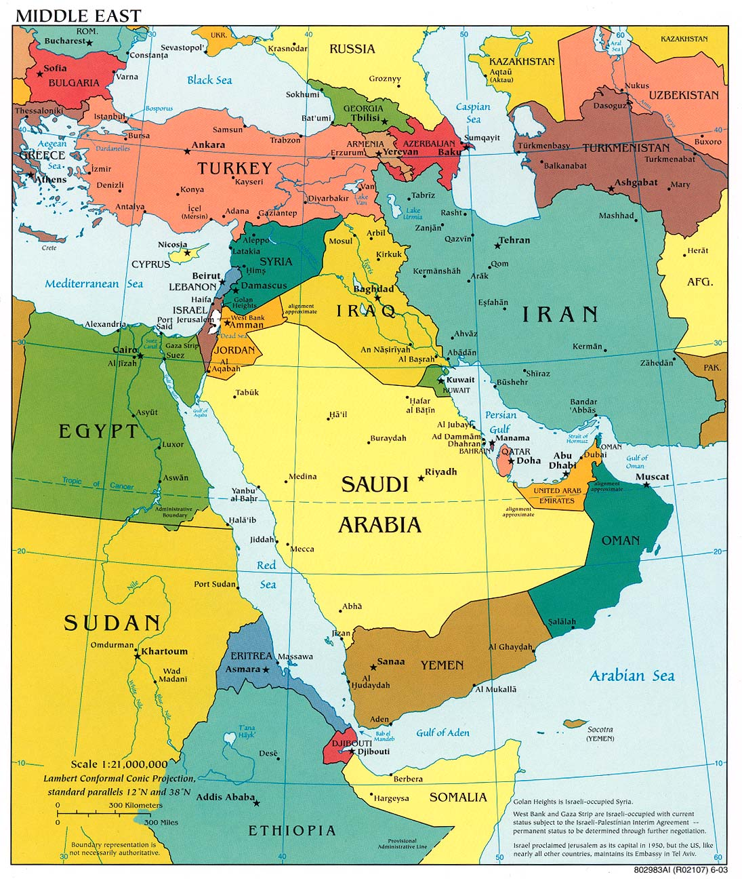
Ezekiel 38, 39 Russia/Iran Invasion to Israel
Plus: Ethiopia, Libya, eastern Germanic States, Eastern & Western Turkey

