Slide 1
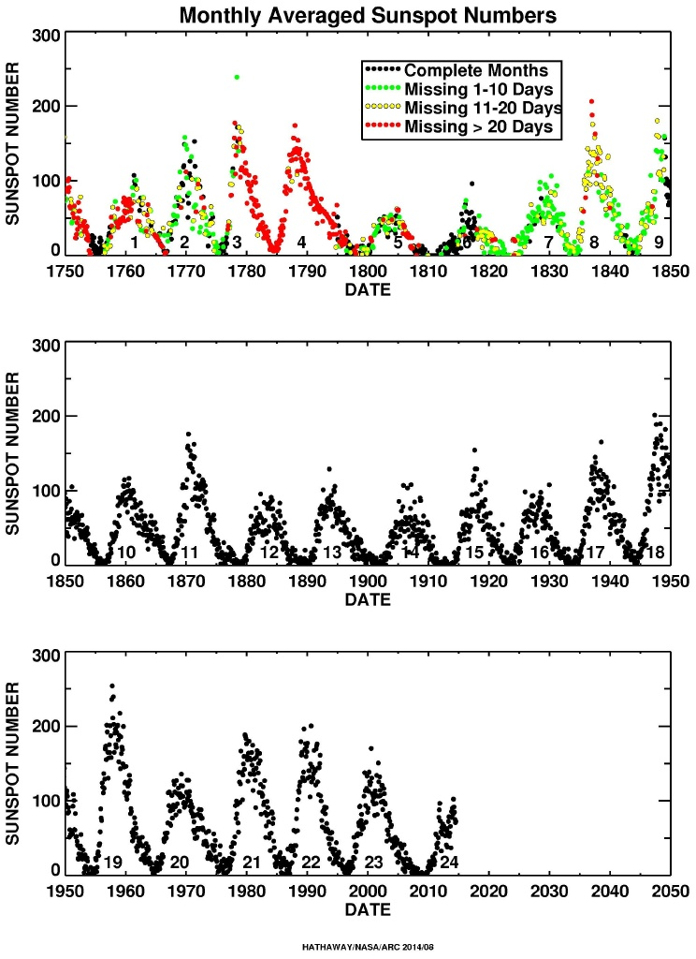

Slide 2
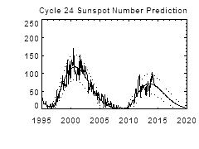

Slide 3
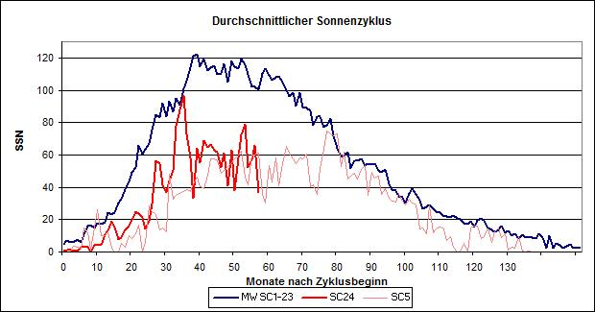
Since the end of the Dalton-Minimum 190 years ago, never has the sun been so inactive as during the past 7 years
The sun continues to remain in an unusually weak cycle 24.
The above graphic shows the mean value (blue), the current cycle (red), and the very similar sunspot cycle SC5 (light gray) which occurred during the Dalton Minimum of the early 19th century. Horizontal axis is the number of months after the start of cycle.
The long term cycles appear to be 11, 22, 80, 179, 200, and 400 years.
These are related to sunspot activity and magnetic cycles.
Obviously harmonic cycles are part of the 11 and 22 year maximums and minimums.
Data compiled from Internet
By Jim Hovis, August 13, 2014

Slide 4
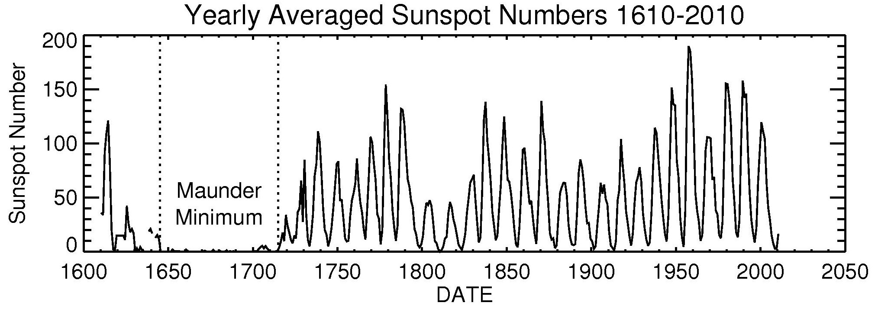

Slide 5
